Slide 1
Italy Renaissance and Baroque
History of Built of the Built Environment I

Slide 2
ITALY
EARLY RENAISSANCE: 1300-1500
HIGH RENAISSANCE: 1500-1520
LATE RENAISSANCE OR MANNERISM: 1520-1600
BAROQUE: 1600-1720

Slide 3
“WHAT IS GOING ON
IN THE WORLD”…..
AND LEADING UP TO THE RENAISSANCE?

Slide 4
BY THE 9TH CENTURY, VENICE EMERGED AS THE
CENTER OF TRADE IN THE WEST AS THE END POINT OF THE SILK ROUTES
VENICE BECAME A DOMINANT REGIONAL GOVERNMENT
AND WEALTHY
NAVAL & TRADING PORT

Slide 5
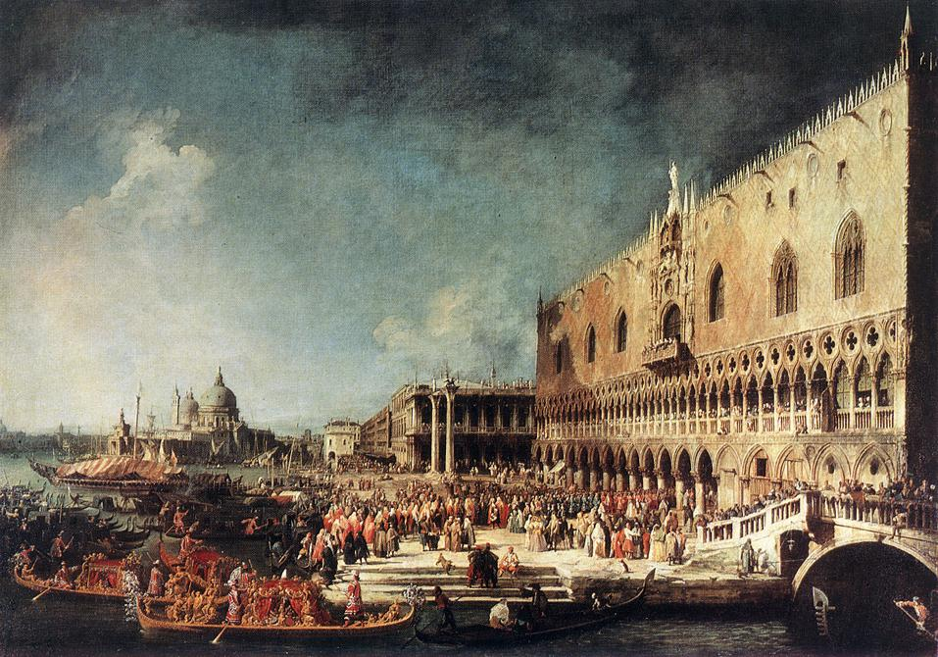
VENETIAN FESTIVAL AT THE DOGES PALACE

Slide 6
VENICE’S POWER AND ECONOMY DECLINED IN 1453 WITH THE FALL OF CONSTANTINOPLE AND THE DISCOVERY OF THE AMERICAS AND NEW TRADE ROUTES WEST

Slide 7
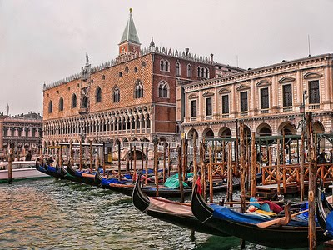

Slide 8
AS THE OTTOMAN TURKS TOOK OVER THE AREAS AROUND CONSTANTINOPE, GREEK SCHOLARS IMMIGRAED TO WESTERN EUROPE BRINGING MANUSCRIPTS WITH CLASSICAL KNOWLEDGE. CLASSICAL FORMS BEGAN TO BE IDEALIZED AND COPIED.

Slide 9
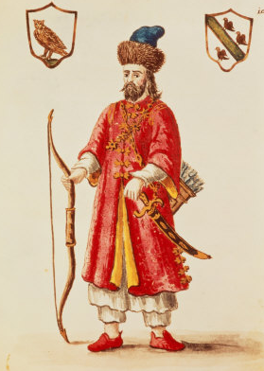
MARCO
POLO
1254-1324
A
PROMINENT VENETIAN WHO TRAVELED THE “SILK ROAD” TO CHINA

Slide 10
MARCO POLO RETURNS FROM 27 YEARS IN CHINA, AND WRITES HIS MEMOIRS IN 1299
“THE TRAVELS OF MARCO POLO”
1ST “ARMCHAIR” TRAVEL LOG ABOUT EXOTIC PLACES IN ASIA

Slide 11
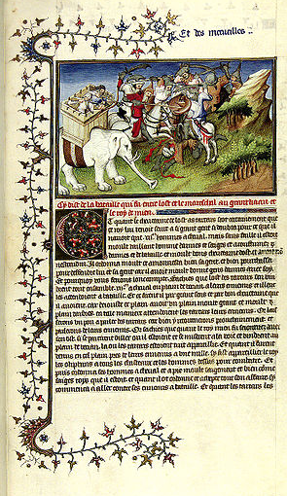
FROM A PAGE WRITTEN IN 1299,
THE
TRAVELS OF MARCO POLO

Slide 12
IN 1320, BUBONIC PLAGUE KILLS 30 MILLION IN EAST ASIA.
VIA SILK ROAD TRADE ROUTES FROM THE EAST,
“BLACK DEATH” ARRIVES IN EUROPE
IN 1346

Slide 13
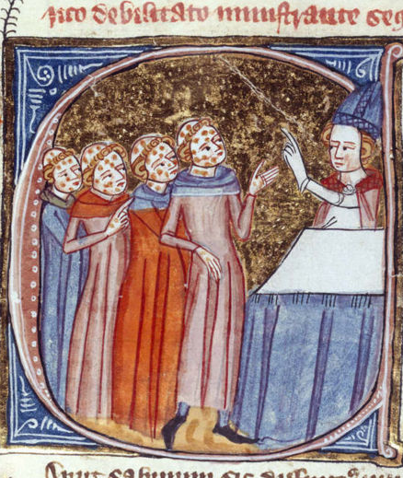
MONKS, DISFIGURED BY THE PLAGUE, BEING BLESSED BY A PRIEST. ENGLAND, 1360–75

Slide 14
FROM 1346 TO 1353,
“BLACK PLAGUE”
SWEEPS ACROSS EUROPE KILLING HALF THE POPULATION;
ESTIMATES FROM
75 TO 200 MILLION PEOPLE
A WORLDWIDE PANDEMIC

Slide 15
THE “FINANCIAL CRASH”
OF 1345 WAS PRECEDED BY ENGLAND’S KING EDWARD III DEFAULTING (PLAGUE)
ON HUGE LOANS FROM FLORENTINE BANKS.
FLORENTINE BANKS CLOSED &
WEALTHY FAMILY DYNASTIES WERE DESTROYED
& LEFT PENNILESS.

Slide 16
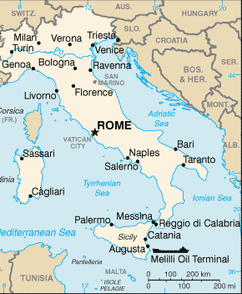
FLORENCE, ITALY:
THE “EPICENTER” OF THE RENAISSANCE

Slide 17
1400 FLORENCE, ITALY: CONSIDERED THE “EPICENTER” OF THE RENAISSANCE WITH THE “MEDICI” DYNASTY
AS THE CENTRAL FOCUS
15TH CENTURY:
CONSIDERED BEGINNING OF THE “MODERN WORLD”

Slide 18
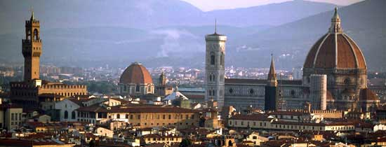
FLORENCE, ITALY:
THE “EPICENTER” OF THE RENAISSANCE

Slide 19
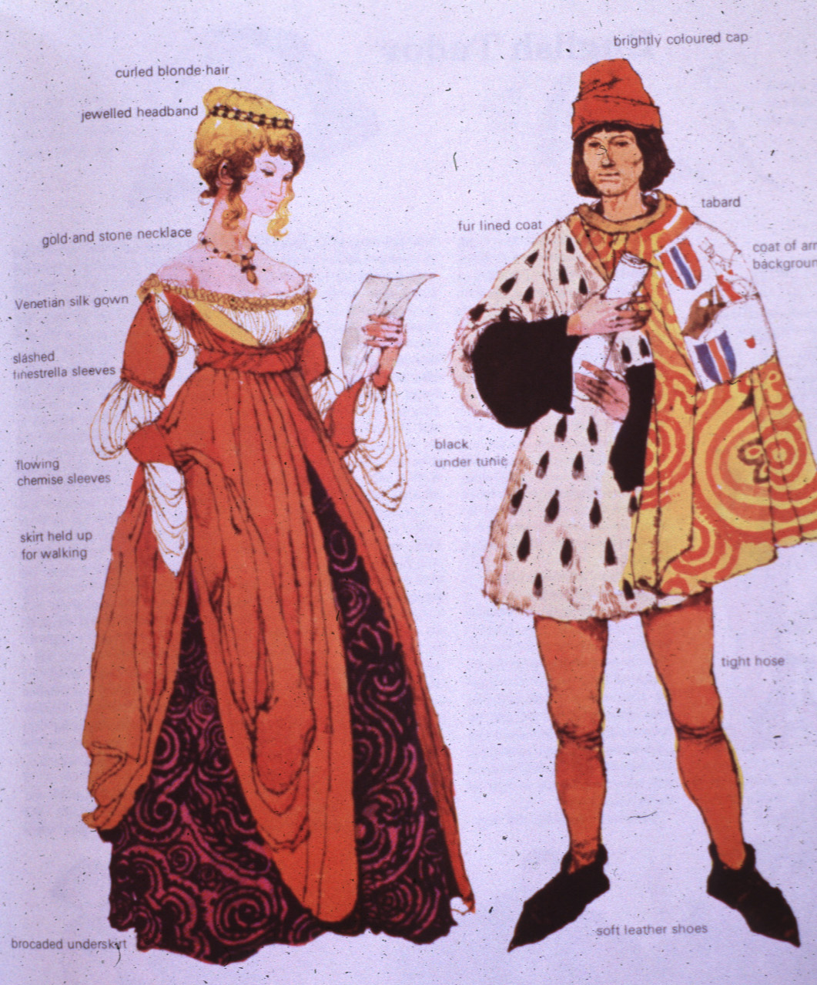
ITALIAN RENAISSANCE
CLOTHING

Slide 20
ANNENBERG
“ART OF THE WESTERN WORLD”
EARLY RENAISSANCE
1:00 TO 10:32 http://www.learner.org/resources/series1.html?pop=yes&pid=230

Slide 21
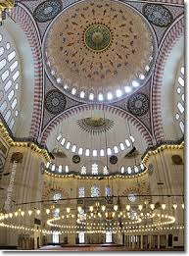
THE OTTOMAN EMPIRE WAS GOING THROUGH IT’S OWN “REBIRTH” AS A SUPER-POWER UNDER THE RULE OF SULEYMON THE MAGNIFICENT

Slide 22
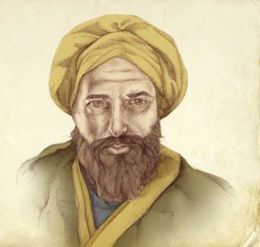
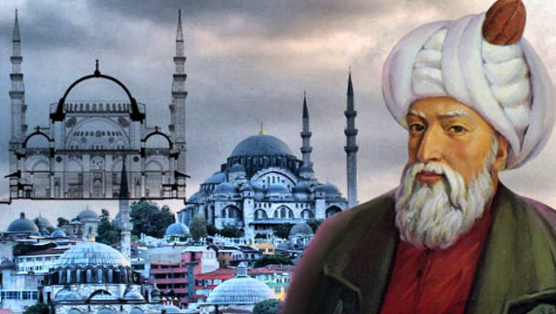
“RENAISSANCE PEOPLE” IN THE OTTOMAN EMPIRE INCLUDE
TAQI-AL-DIN 1526-1585
“GREATEST SCIENTIST OF HIS AGE”
AND MIMAR SINAN ARCHITECT FOR OVER 300 BUILDINGS IN OTTOMAN EMPIRE.

Slide 23
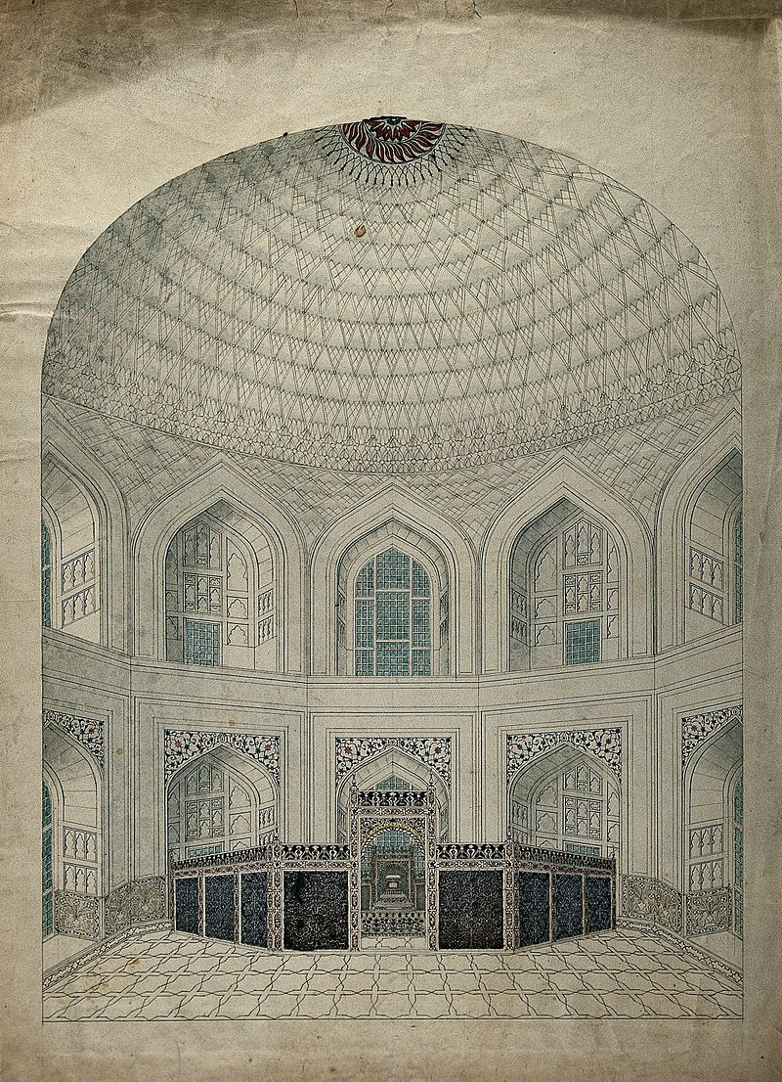
THE MUGHAL EMPIRE IN INDIA WAS ALSO GOING THROUGH A CULTURAL RENAISSANCE WITH PATRONAGE FROM MUGHAL LEADERS

Slide 24




RENAISSANCE
“REBIRTH”
RE-DISCOVERY OF CLASSICAL ANTIQUITY

Slide 25
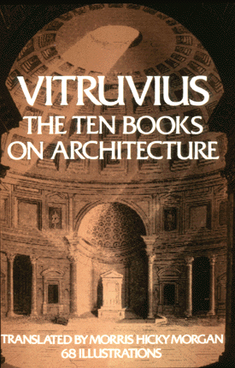
VITRUVIUS:
1ST CENTURY ARCHITECT,
TRANSLATED
&
RE-PUBLISHED
IN 1486

Slide 26
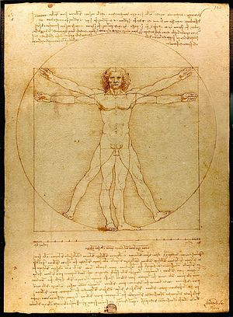
“VITRUVIAN MAN”
LEONARDO DA VINCI’S
1490 STUDY OF DIVINE PROPORTION IN THE HUMAN BODY FUSING SCIENCE AND ART INSPIRED BY VITRUVIUS’ WRITINGS.

Slide 27
RENAISSANCE “HUMANISM”
CELEBRATED THE JOY OF LIVING,
PLEASURES OF NATURE,
RECOGNIZED BEAUTY OF ART, ARCHITECTURE AND
INTERIOR DESIGN,
VALUED EDUCATIONS, LITERATURE, LITERACY, MUSIC AND CULTURE
UNIVERSITIES ESTABLISHED
RESPECTFUL OF CLASSICISM
EMBRACED MODERN SCIENCES

Slide 28
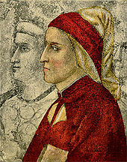
GIOTTO’S PAINTING OF DANTE
GIOTTO’S PAINTINGS IN A MORE NATURALISTIC STYLE THAN BYZANTINE ALONG WITH DANTE’S WRITINGS (THE DIVINE COMEDY) HELPED SHAPE & INSPIRE THE ITALIAN RENAISSANCE IDEALS.

Slide 29
RENAISSANCE “HUMANISM”
WORTH OF INDIVIDUALS AND THE HUMAN CONDITION.
THE INDIVIDUAL NO LONGER AN INTELLECTUAL SLAVE OF THE CHURCH OR STATE.
HUMANISM BECAME SCORNFUL OF SUPERSTITIONS.
SUPPRESSION OF THE POWER OF
CHURCH AND STATE

Slide 30
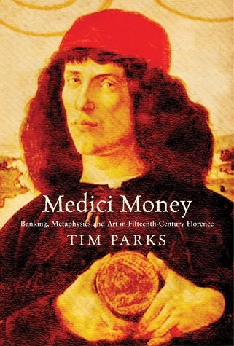
THE MEDICI
DYNASTY:
THE NEW
BANKERS TO THE POPE &
GODFATHERS
OF THE FLORENTINE
RENAISSANCE

Slide 31
IN 1400 FLORENCE, ITALY,
PATRONAGE OF THE
“MEDICI” DYNASTY BANKERS
EMERGED TO FINANCE THE
15TH CENTURY DEVELOPMENT OF ART, LITERATURE, EDUCATION, MUSIC, FASHION, ARCHITECTURE & INTERIOR DESIGN

Slide 32
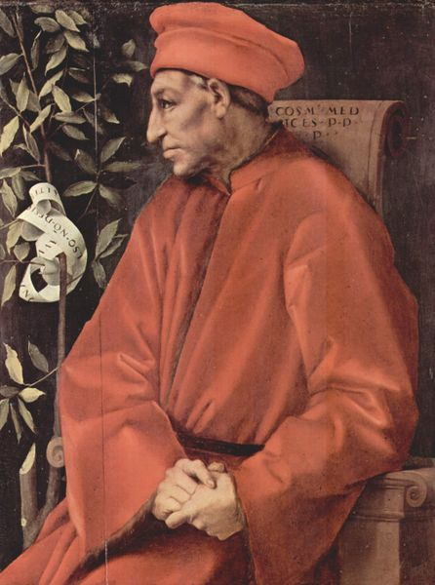
1ST MEDICI:
COSIMO DI GIOVANNI DE' MEDICI
1389-1464
IN 1414, BECAME OFFICIAL BANKER OF THE CATHOLIC CHURCH

Slide 33
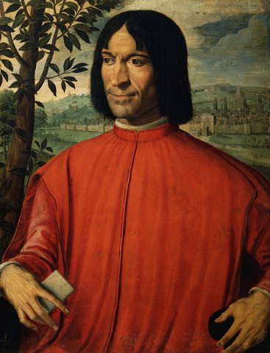
LORENZO DI MEDICI 1449 –1492
(COSIMO’S GRANDSON)
(COLUMBUS SET FOOT IN NORTH AMERICA, 1492)

Slide 34
“MEDICI” PATRONAGE:
BANK ROLLED ARCHITECTS & DESIGNERS CREATING PUBLIC WORKS CONSTRUCTION PROJECTS,
UNIVERSITIES FOR SCIENCES, BECAME PATRONS OF THE ARTS, MUSIC, FASHION & CULTURE

Slide 35
OTHER COMPETING “PATRONS” OF ITALY:
FLORENCE: PITTI & STROZZI
MILAN: STORZA & VISCONTI
ROME: BORGIA & BORGHESE
VENICE: FOSCARI & VENDRAMINI
THUS; ARCHITECTURE, FINE ART AND DECORATIVE ARTS FLOURISHSED IN RENAISSANCE ITALY

Slide 36
THE “RENAISSANCE”
A “REBIRTH”
FROM THE RUINS OF PLAGUE,
MINI-ICE AGE, FINNANCIAL COLLAPES, & REDUCED POPULATIONS
CAME NEW OPPORTUNITIES
BANK ROLLED BY AN EMERGING MERCHANT MIDDLE CLASS AND INTERNATIONAL TRADE

Slide 37
ANNENBERG
“ART OF THE WESTERN WORLD”
“THE EARLY RENAISSANCE”
“THE MEDICIS”
20:17 TO 23:18 http://www.learner.org/resources/series1.html?pop=yes&pid=230

Slide 38
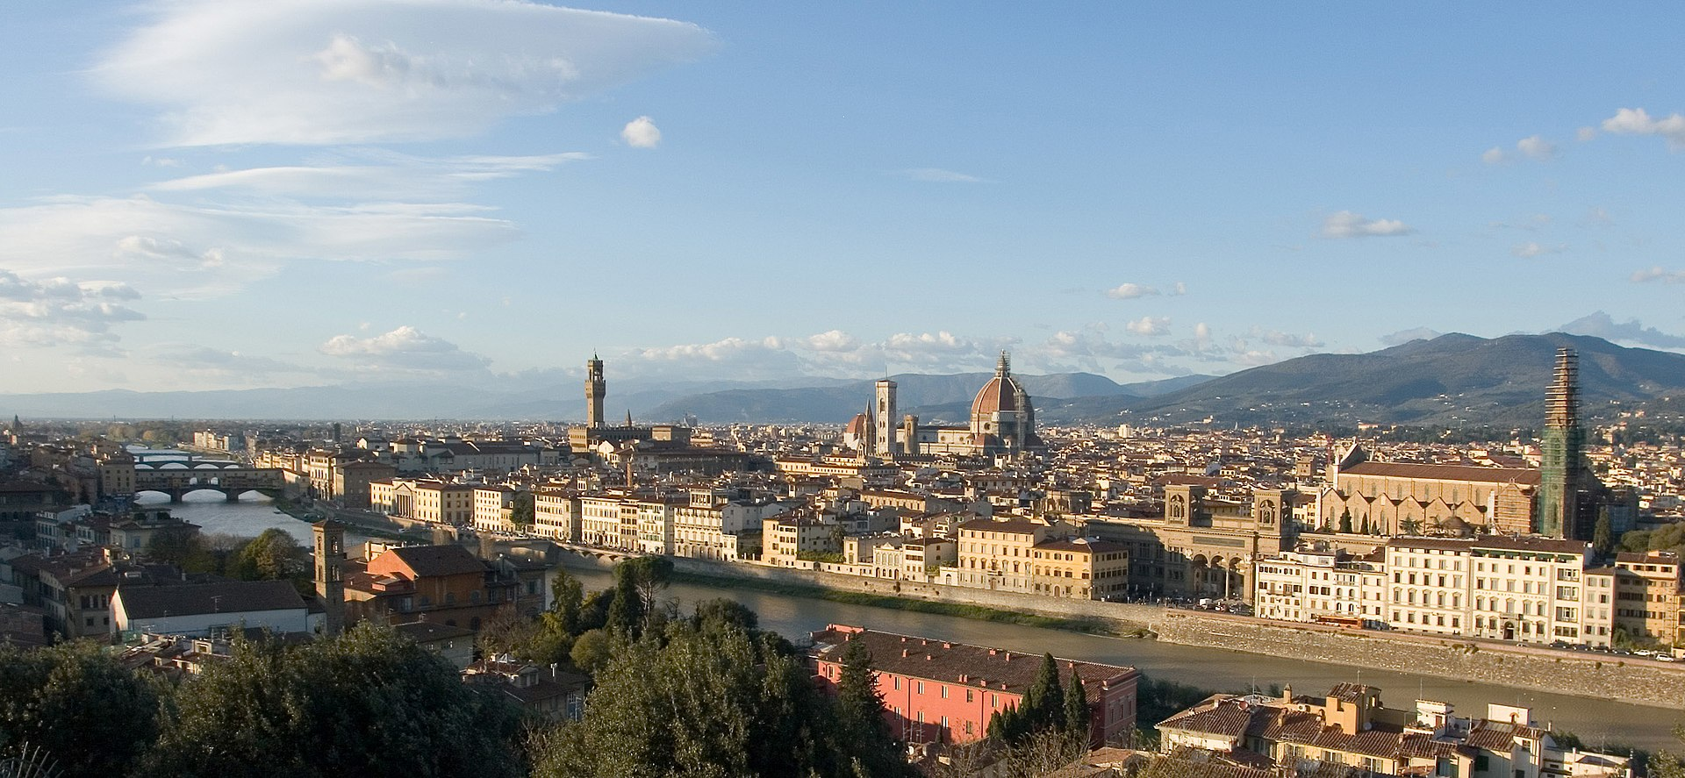
MODERN FLORENCE

Slide 39
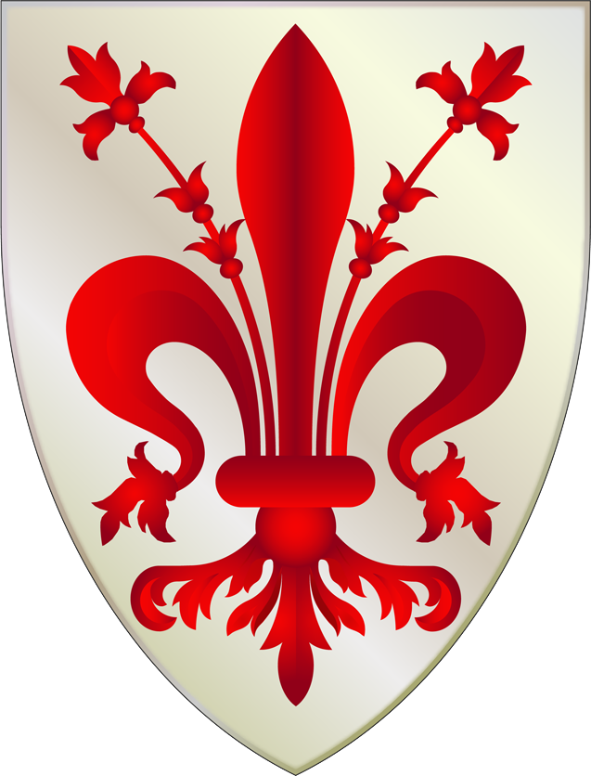
FIRENZE,
ITALY
FLEUR DE
LEYS
MOTIF
FOR CITY’S EMBLEM

Slide 40

FLORENTINE SYMBOL:
“FLEUR DE LEYS” MOTIF
ALSO USED BY FRENCH NOBILITY
AND
CITY OF
NEW ORLEANS
(NOTE STAMENS ON BLOSSOM FOR FLORENTINE ONE)

Slide 41
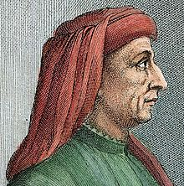
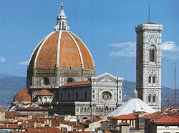
BRUNELLESCHI 1377-1446
AND HIS ICONIC “DUOMO”

Slide 42
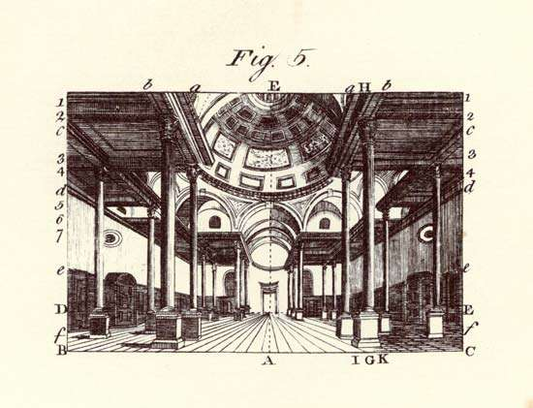
BRUNELLESCHI “INVENTED” LINEAR PERSPECTIVE IN 1415

Slide 43
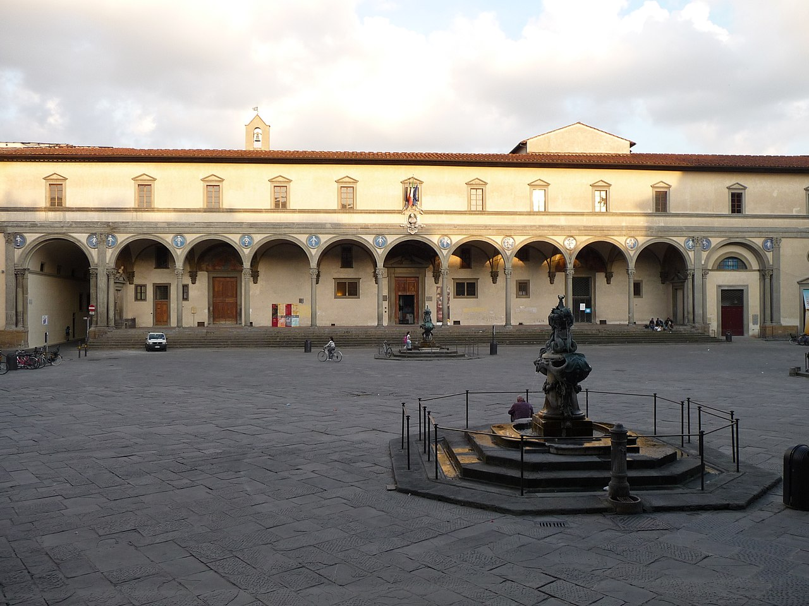
HOSPTIAL OF THE INNOCENTS
BRUNELLESCHI 1419

Slide 44
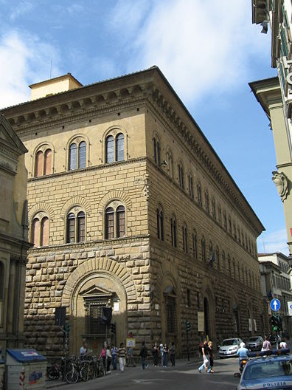
PALAZZO MEDICI-
RICCARDI
MEDICI
RESIDENCE, FLORENCE, ITALY
1425 AD

Slide 45
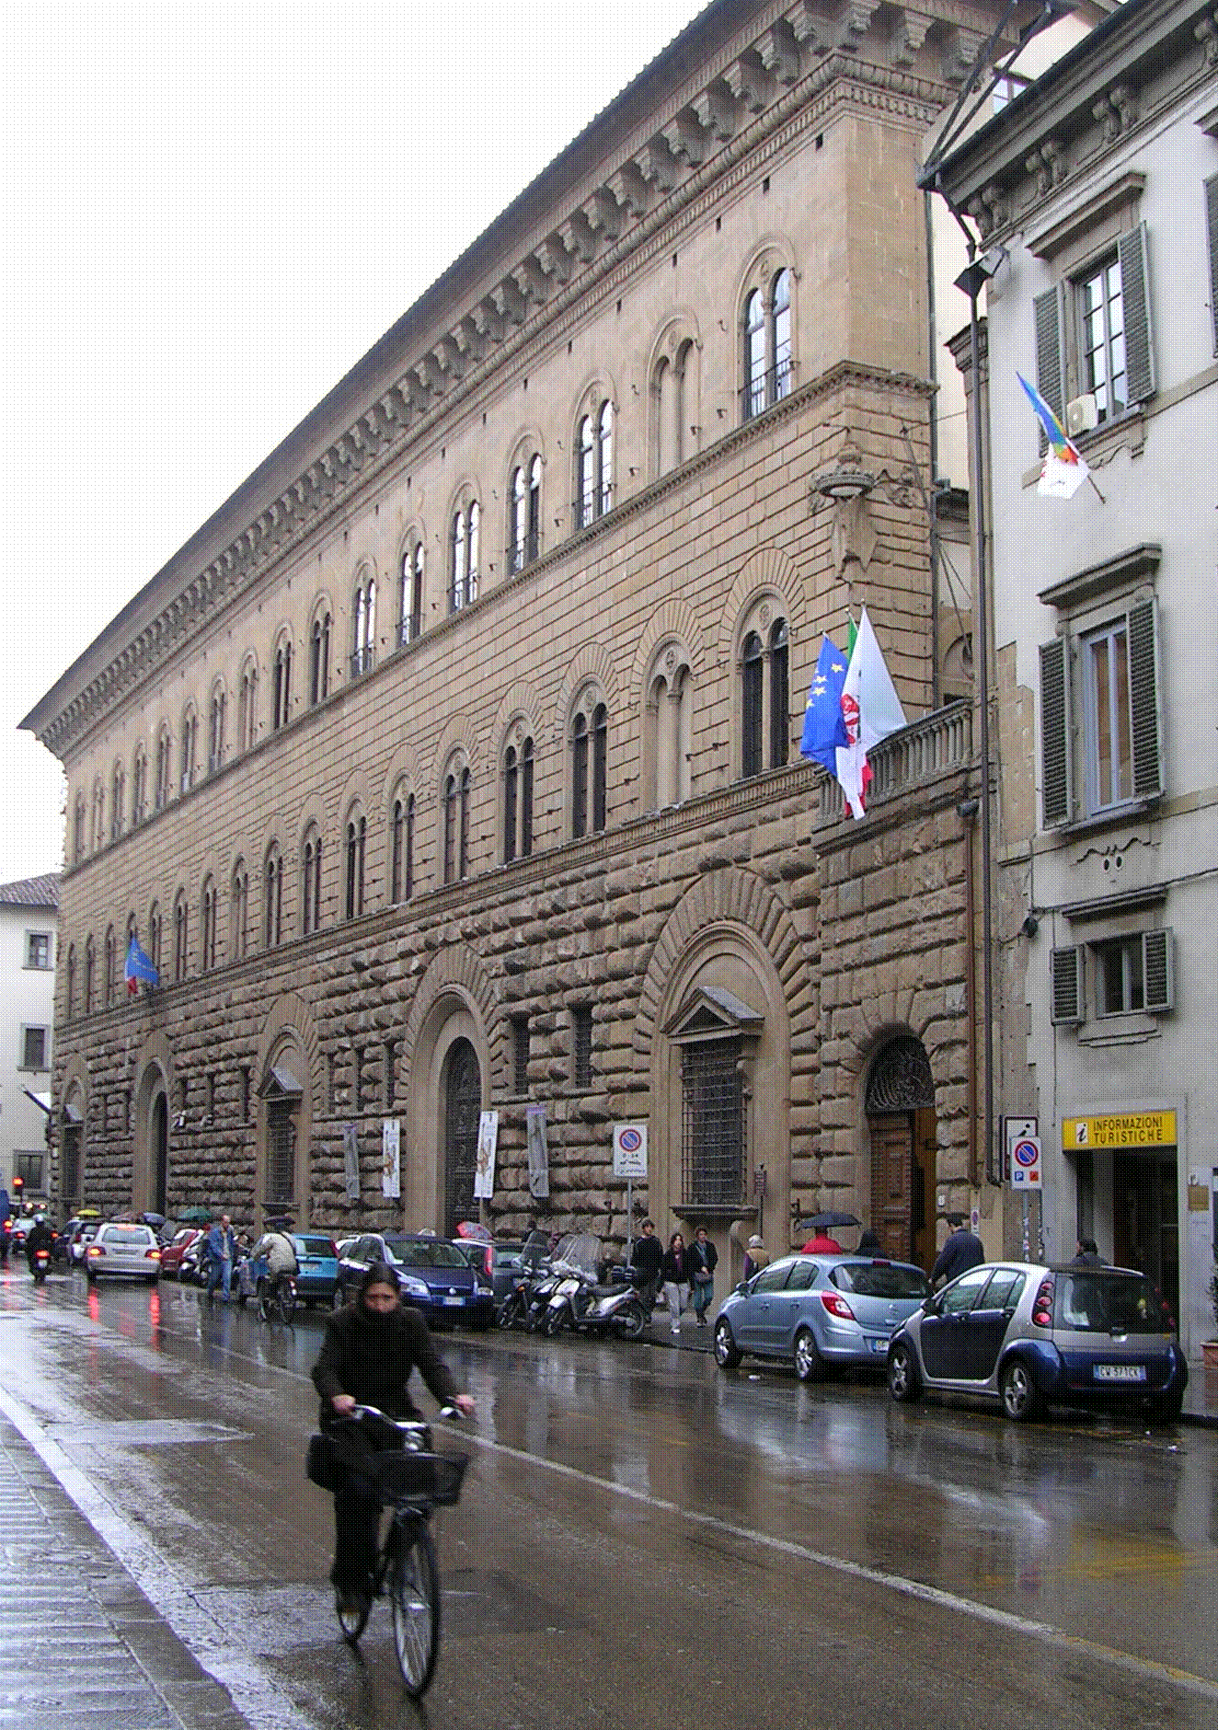
PALAZZO MEDICI
RICCARDI
ARCHITECT:
BARTOLOMEO
1425
MEDICI
RESIDENCE
FLORENCE, ITALY

Slide 46
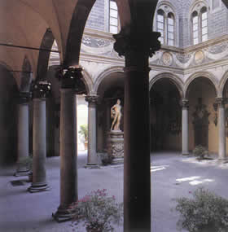
COURTYARD WITH “FLORENTINE ARCHES”
PALAZZO MEDICI-
RICCARDI
MEDICI
RESIDENCE FLORENCE
ITALY

Slide 47
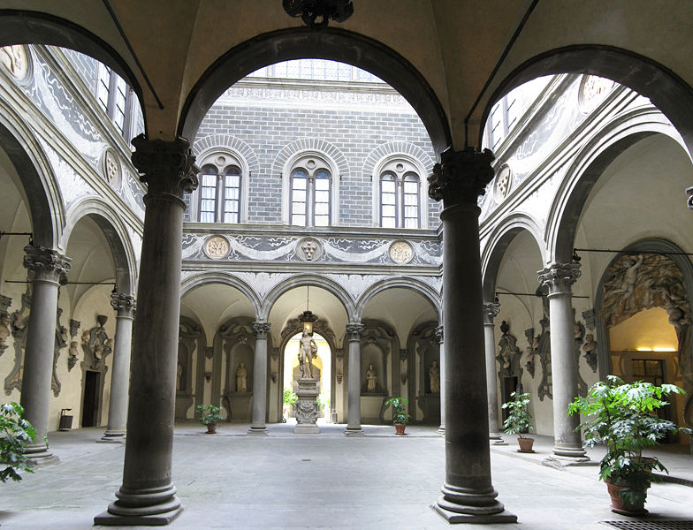
FLORENTINE ARCHES

Slide 48
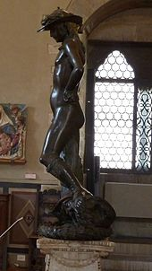
DONATELLO’S 1440’S STATUE OF DAVID (FIRST FREE STANDING NUDE MALE SINCE THE CLASSICAL ERA) WAS COMISSIONED BY THE MEDICI FAMILY FOR THE COURTYARD

Slide 49
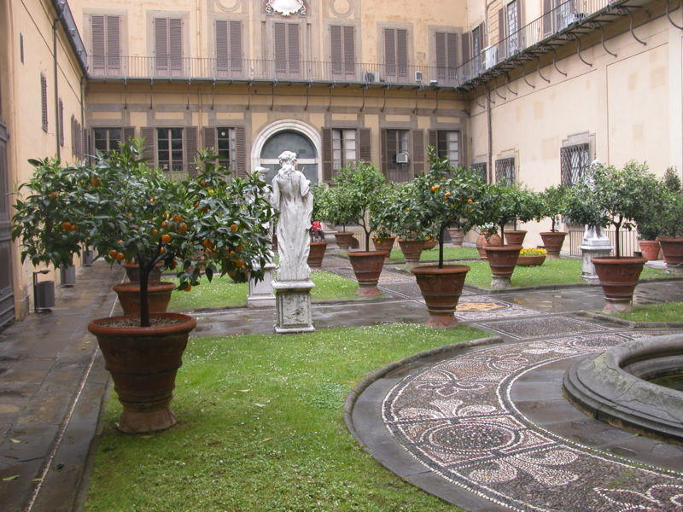

Slide 50
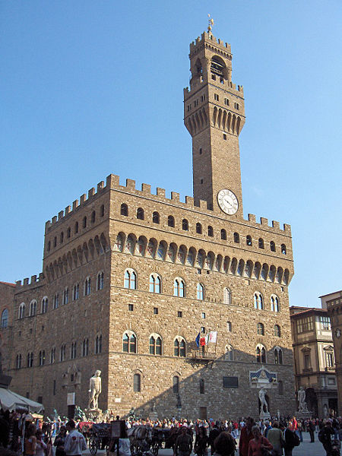
“ROMANESQUE”
PALAZZO VECCHIO,
(MEDICI HQ)
1299
PIAZZA DEL
VECCHIO
FIRENZE,
(FLORENCE)
ITALY

Slide 51
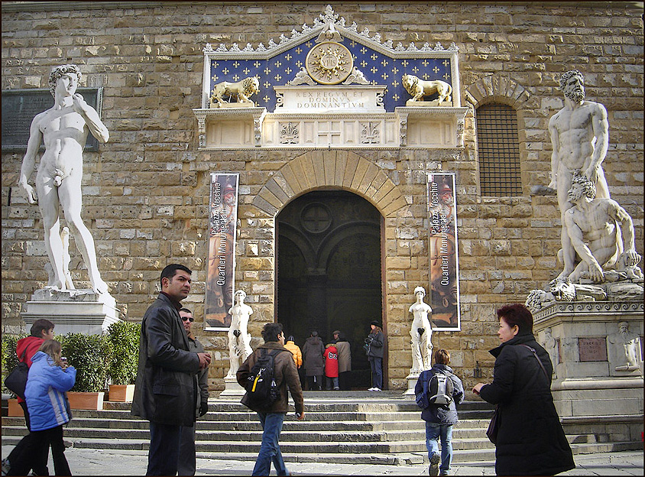
PALAZZO VECCHIO, (MEDICI HQ),
PIAZZA DEL VECCHIO ENTRANCE,
FIRENZE, (FLORENCE) ITALY

Slide 52
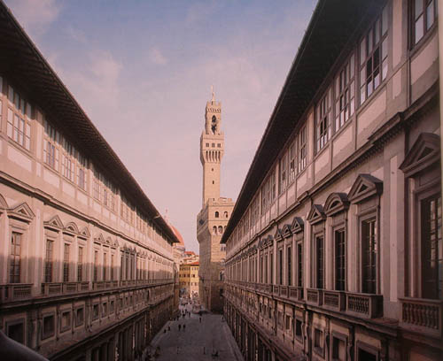
UFFIZI GALLERY MUSEUM
(MEDICI’S OFFICE)

Slide 53
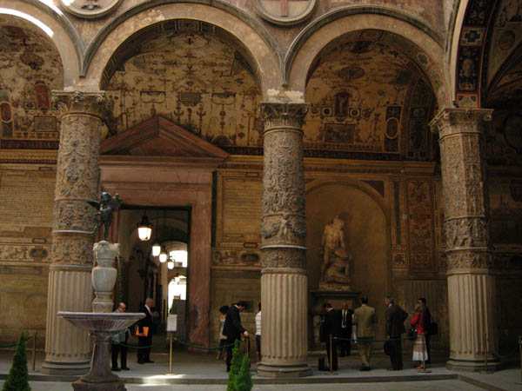
UFFIZI ENTRANCE

Slide 54
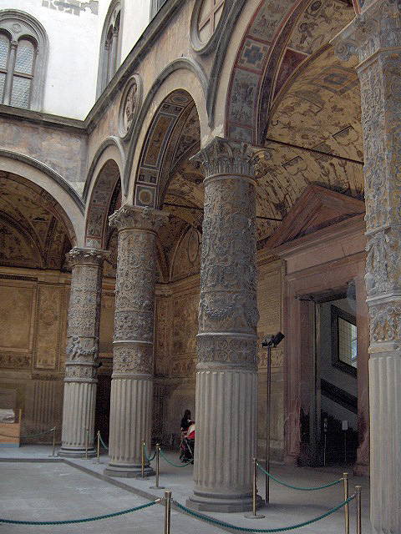
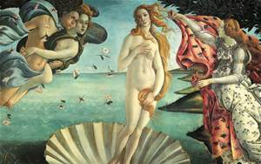
FLORENTINE
ARCHES
IN INTERIOR
COURTYARD OF UFFIZI.
“The Birth of Venus” One of the paintings in the current collection.
FIRENZE, IT

Slide 55
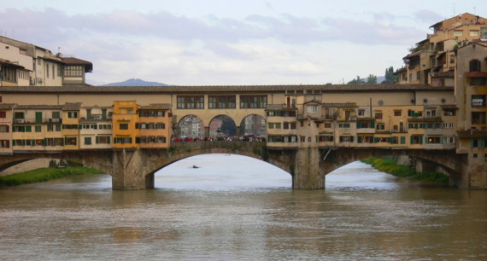
“PONTE VECCHIO” BRIDGED THE ARNO RIVER WITH PRIVATE PASSAGE FOR MEDICI FAMILY

Slide 56
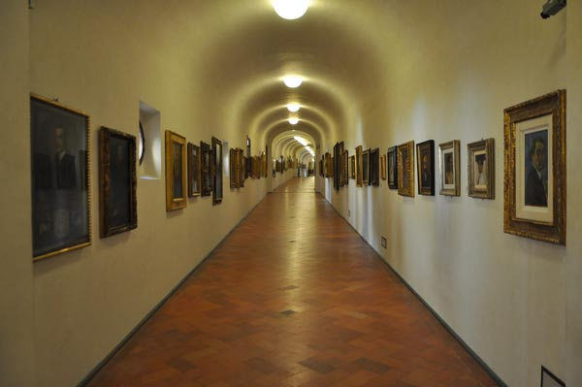
The Vasari Corridor provided a private passageway from Palazzo Vecchio to Pitti Palace. Contains collection of artist’s self portraits

Slide 57
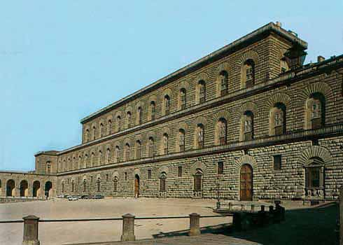
MEDICI’S “PITTI PALACE”
FLORENCE, ITALY

Slide 58
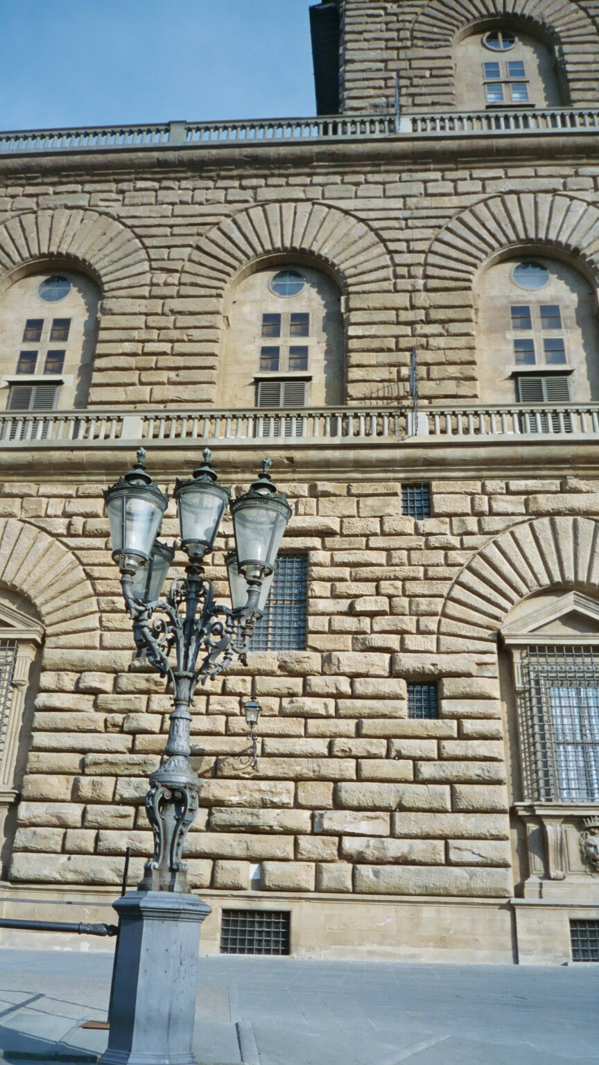
PITTI PALACE
BUILT BY
LUCA PITTI, 1458
ARCHITECTURE ATTRIBUTED TO:
BRUNELLESCHI
???
SOLD TO MEDICI
1549
“RUSTICATED” STONE FACADE

Slide 59
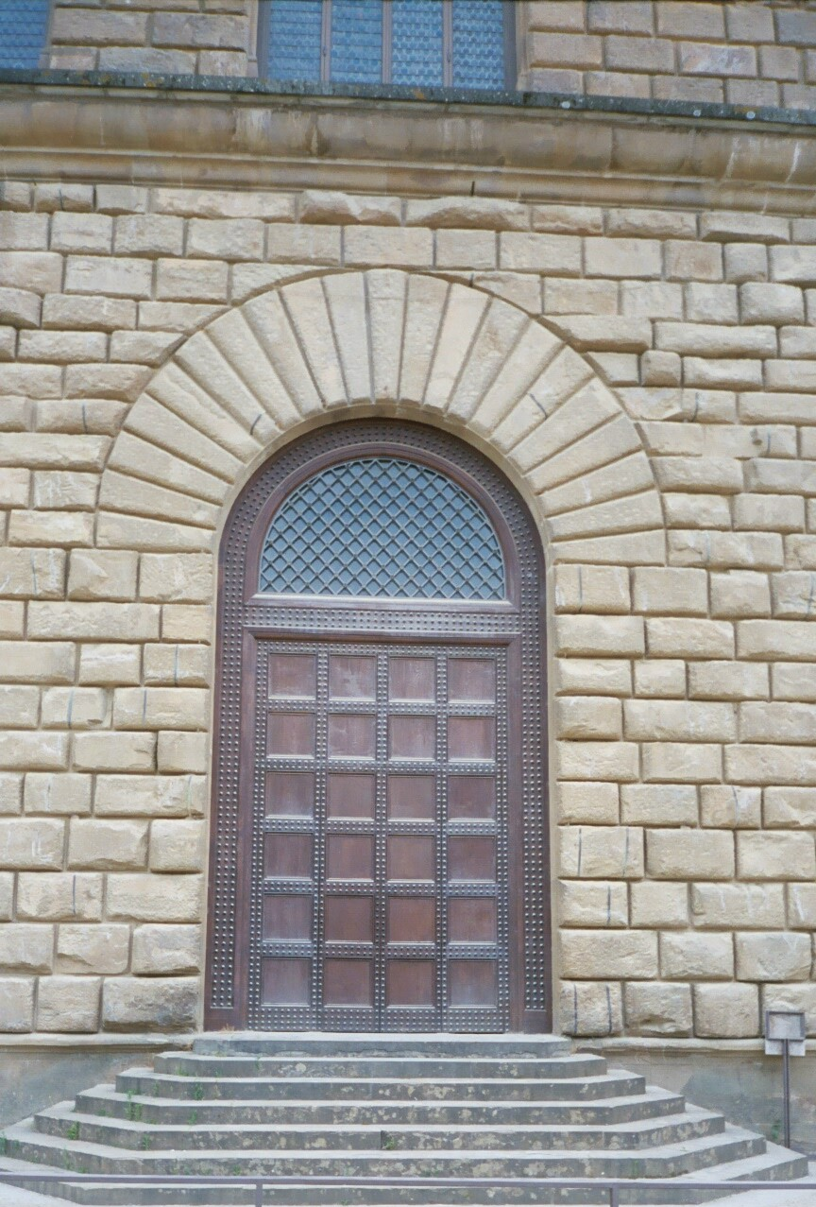
PITTI PALACE
ARCHED
SIDE DOOR
“RUSTICATED” STONE FACADE

Slide 60
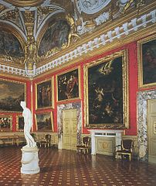
PITTI PALACE: INTERIOR
450 YEARS OF FINE ART COLLECTING

Slide 61
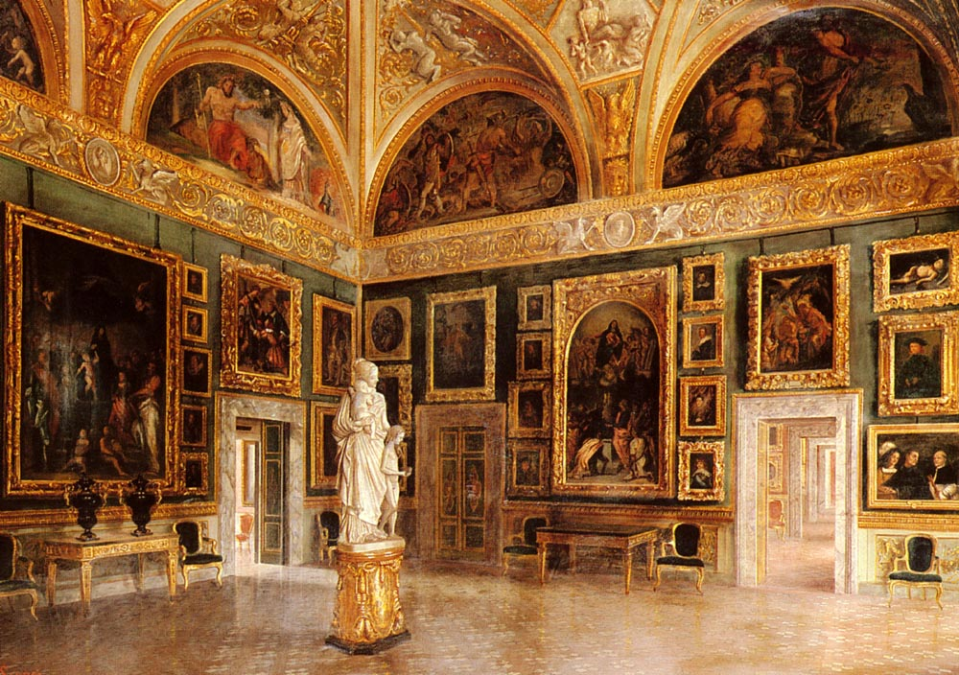

Slide 62
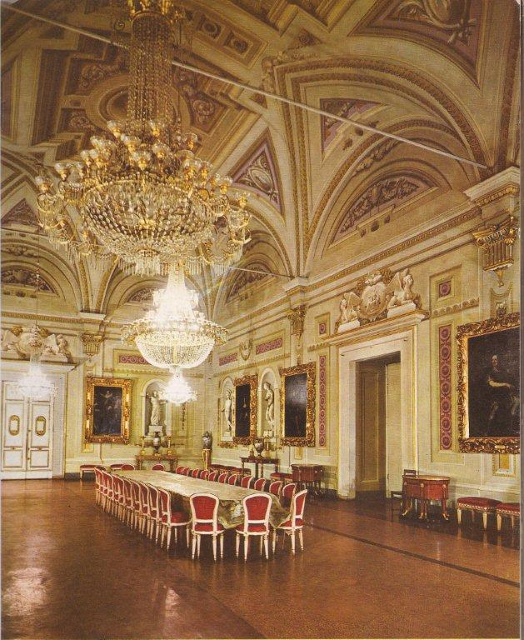
OPENED AS A PUBLIC MUSEUM IN 1920
APARTMENTSLAST OCCUPIED BY KING VICTORIO EMMANUEL,
1919

Slide 63
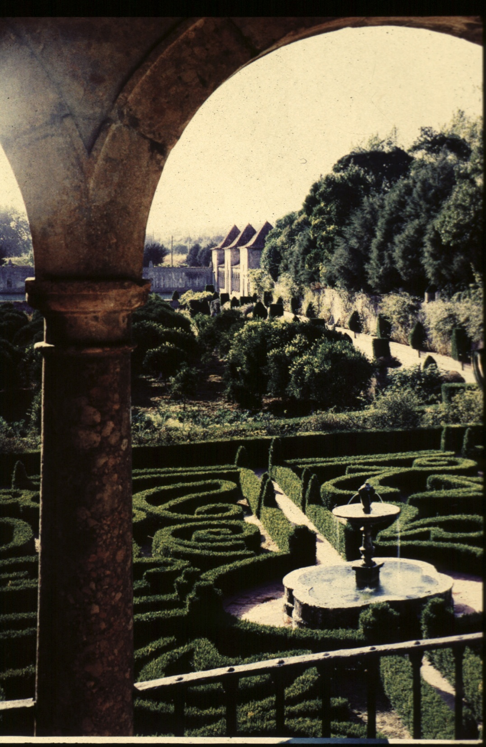
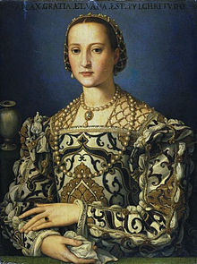
FORMAL
GARDENS
OF PITTI PALACE
FOR
ELONARA DI TOLEDO COSIMO MEDICI’S WIFE

Slide 64
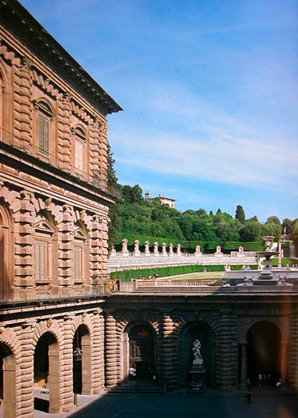
MEDICI’S PITTI
PALACE,
FLORENCE, IT
VIEW TO BOBOLI GARDENS

Slide 65
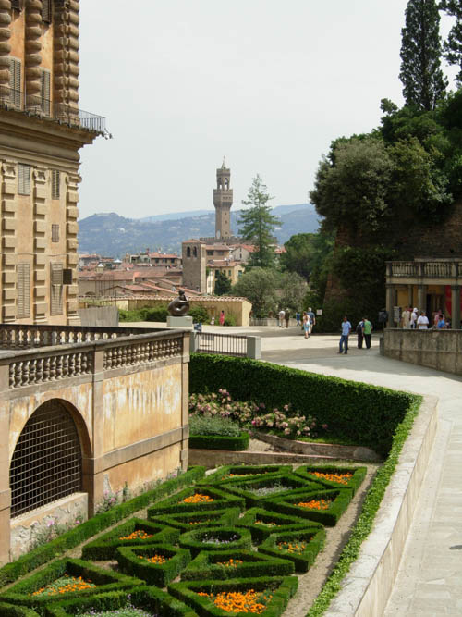
PITTI PALACE
&
80 ACRES
BOBOLI
GARDENS

Slide 66
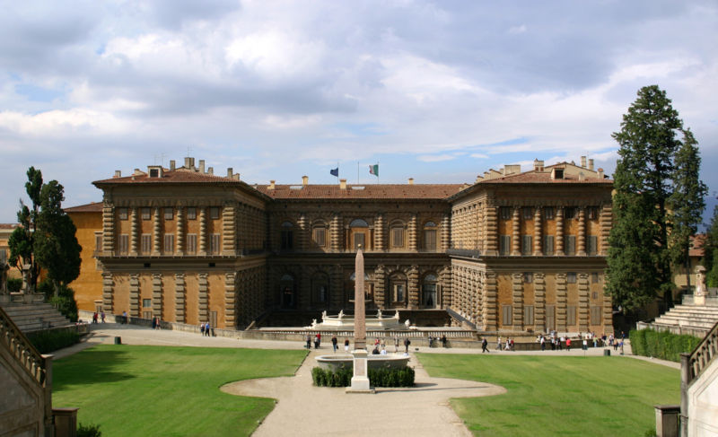
VIEW FROM BOBOLI GARDENS

Slide 67
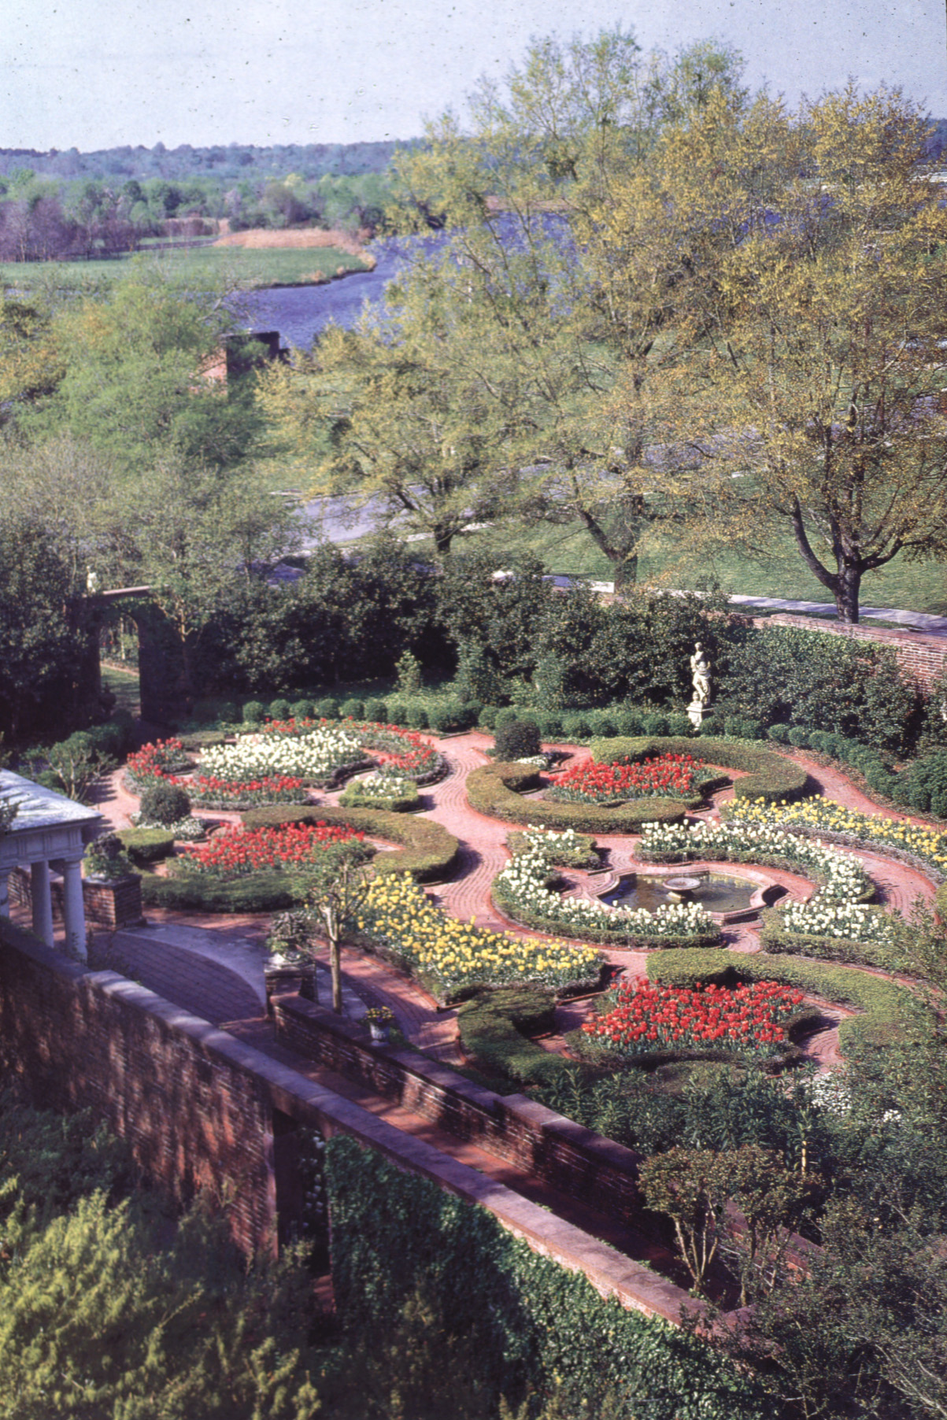
FORMAL
GARDENS
OF PITTI PALACE
FIRENZE,
ITALY

Slide 68
SOME OF THE “GREAT” ARTISTS, SCULPTORS, & ARCHITECTS:
GIOTTO 1266-1337
BRUNELLESCHI 1377-1446
ALBERTI 1404-1472
BRAMANTE 1444-1514
LEONARDO DA VINCI 1452-1519
MICHELANGELO 1475-1564
PALLADIO 1518-1580
TINTORETTO 1518-1594
BERNINI 1598-1680

Slide 69
“TRINITY” OF THE ITALIAN RENAISSANCE. THE RISE OF THE ARTIST FROM ANONYMOUS ARTISAN TO CELEBRATED CREATIVE GENIUS:
DA VINCI
RAPHAEL
MICHELANGELO

Slide 70

MICHELANGELO DI LODOVICO BUONARROTI SIMONI,
1475-1564

Slide 71

PIETA
1499

Slide 72

MICHELANGELO’S “DAVID”
AT THE
FLORENCE
ACADEMY
OF ART

Slide 73

DAVID
13’ 6” TALL; SCULPTED 1501-1504

Slide 74

THE SISTINE CHAPEL, (^) PART OF THE VATICAN MUSEUM COMPLEX

Slide 75

SISTINE
CHAPEL
INTERIOR
PAINTED BY
MICHEL-ANGELO
1508-1512
RESTORED
1979-1999

Slide 76

SISTINE
CHAPEL
INTERIOR
“FRESCOES”
PAINTED BY
MICHELANGELO
1508-1512
RESTORED
1979-1999

Slide 77

THE FRESCO
COMMISSIONED BY
POPE JULIUS II
PORTRAIT
BY RAPHAEL

Slide 78
FRESCO OR FRESCOES
ITALIAN MEANING “FRESH”
A TECHNIQUE CONSISTING OF PAINTING WITH MINERAL PIGMENTS MIXED WITH WATER
ON TO A THIN LAYER OF
WET, FRESH, LIME MORTAR
OR PLASTER BASE.

Slide 79

CENTER PIECE
“CREATION OF ADAM” MICHELANGELO

Slide 80
FRESCO OR FRESCOES
THE PIGMENT IS ABSORBED BY THE WET PLASTER; THE PLASTER DRIES AND REACTS WITH THE AIR: IT IS THIS CHEMICAL REACTION WHICH FIXES THE PIGMENT PARTICLES IN THE PLASTER.

Slide 81


Slide 82

FRESCOS PRIOR TO 1979-1994 RESTORATION

Slide 83
IT IS SHAPED AS A SIMPLE RECTANGLE, (135 FT. LONG BY 44 FT. WIDE)
SEE THE SISTINE CHAPEL ON
SACRED-DESTINATIONS.COM http://www.sacred-destinations.com/italy/rome-sistine-chapel-photos/

Slide 84

ALL ARCHITECTURAL DETAILS ARE “TROMPE L’ OEIL”; FOOL THE EYE

Slide 85

LATER WORK
MICHEL-
ANGELO'S
"THE LAST JUDGMENT" ON THE ALTAR WALL

Slide 86
THE SISTINE CHAPEL
WITH PUCCINI’S OPERA
“LA TRAVIATA”
3:20 MINUTES http://www.youtube.com/watch?v=aMEvmZhliH4&feature=PlayList&p=194F9045055B190B&index=0&playnext=1

Slide 87

LEONARDO DA VINCI
1452-1519
SELF-PORTRAIT CIRCA 1515

Slide 88
LEONARDO DA VINCI
HAS OFTEN BEEN DESCRIBED AS THE ARCHETYPE OF THE
“RENAISSANCE MAN”,
GREAT INVENTOR
A SCIENTIST: ANATOMY & BOTANY MATHEMATICIAN
ARCHITECT & ENGINEER
PAINTER & SCULPTOR
MUSICIAN & WRITER

Slide 89

“THE VIRGIN AND CHILD WITH
ST. ANNE AND ST. JOHN THE BAPTIST”
1499

Slide 90

“THE LAST SUPPER”
LEONARDO DA VINCI, 1495–1498
TEMPERA FRESCO, MILAN, ITALY

Slide 91

“MONA LISA”
AN EARLY 16TH CENTURY PORTRAIT PAINTED IN OIL BY LEONARDO DA VINCI DURING THE ITALIAN RENAISSANCE
CIRCA 1505

Slide 92

“MONA LISA”
DISPLAYED AT LOUVRE MUSEUM,
PARIS, FRANCE
21” WIDE
X
30” HEIGHT

Slide 93

RAPHAEL SANZIO
RENAISSANCE ARTIST
1483-1520
PORTRAIT BY
VASARI

Slide 94


Slide 95


RAPHAEL’S “THE SCHOOL OF ATHENS”

Slide 96

RAPHAEL’S VATICAN LOGGIE
1514-1519

Slide 97

RAPHAEL’S VATICAN LOGGIE
1514-1519

Slide 98

“GROTESQUE”
APPLIED TO FRESCO WALLS OF VATICAN LOGGIE
(HALLS)

Slide 99

RAPHAEL’S
TOMB
AT
ROMAN
PANTHEON:
LEAD THE CONSERVATION OF THE PANTHEON

Slide 100

THE FLORENCE CATHEDRAL
BAPTISTRY
&
GIOTTO’S BELL TOWER

Slide 101

THE FLORENCE CATHEDRAL BAPTISTRY AND BELL TOWER
LOCATED IN THE HEART OF FIRENZE, ITALY

Slide 102

BASILICA DI SANTA MARIA DEL FIORE
FLORENCE CATHEDRAL, 1296-1436
GIOTTO’S CAMPANILE, 1340
THE BAPTISTRY, 1059

Slide 103

THE OCTOGON BAPTISTRY CEILING, GOLD MOSAIC “TESSERA”

Slide 104

BAPTRISTRY DOORS
"GATES OF PARADISE“
1424
LORENZO GHIBERTI
(1378–1455)

Slide 105

GOTHIC AND RENAISSANCE FAÇADE OF FLORENCE CATHEDRAL
1296-1436
BLACK PLAGUE INTERRUPTED CONSTRUCTION
1348

Slide 106

GIOTTO’S “CAMPANILE”
OR
BELL TOWER
1340

Slide 107

GIOTTO’S “CAMPANILE”
OR
BELL TOWER
RED, WHITE & GREEN MARBLE

Slide 108

FLORENCE CATHEDRAL,
DOME
1420-1436,
FILIPPO
BRUNELLESCHI

Slide 109
ANNENBERG
“ART OF THE WESTERN WORLD”
FLORENCE CATHEDRAL
13:40 TO 19:25 http://www.learner.org/resources/series1.html?pop=yes&pid=230

Slide 110


Slide 111

DOME
DETAILS

Slide 112

http://www.pbs.org/wgbh/nova/ancient/great-cathedral-mystery.html

Slide 113

VIEW OF ST. LORENZO CATHEDRAL

Slide 114

VIEW OF
SAN LORENZO CATHEDRAL,
MEDICI CHAPEL
&
LAURENTIAN LIBRARY

Slide 115
MICHELANGELO DI LODOVICO BUONARROTI SIMONI,
1475-1564

Slide 116

MANNERISM:
“LAOCOON”
RE-DISCOVERED IN 1506
HIGH RENAISSANCE ARTISTIC MOVEMENT FROM MID-LATE 1500’S EMBRACING MORE DRAMA, LARGER SCALE, MOVEMENT, VIVID COLORS.
BENDING CLASSICAL RULES

Slide 117


MICHELANGELO’S MANNERISM
“LIBYAN SIBYL” FROM SISTINE CHAPEL
VESTIBULE, LAURENTIAN LIBRARY

Slide 118

MICHELANGELO’S
INTERIOR OF BACILICA OF
SAN LORENZO,
FLORENCE,
ITALY

Slide 119

MICHELANGELO’S MEDICI TOMB
CHAPEL AT SAN LORENZO, 1519

Slide 120

VESTIBULE STAIRS,
TEXT PAGE250 & 259

Slide 121


Slide 122

LAURENTIAN LIBRARY “BLIND WINDOWS”

Slide 123

MEDICI CHAPEL
PIETRA DURA
OF MEDICI’S COAT OF ARMS

Slide 124

“OPIFICIO DELLE PIETRA DURA” (workshop of semi-precious stones) begun in Florence in 1588 by Medici Family and still exists today.

Slide 125

MEDICI CHAPEL INTERIOR

Slide 126

“COSMATI” FLOOR
NAMED FOR THE COSMATI FAMILY OF CRAFTSMEN IN ROME MAKING BYZANTINE INFLUENCED INLAY MARBLE FLOORS OFTEN USING RECYCLED ROMAN COLUMNS.

Slide 127

ANDREA PALLADIO 1518-1580
HIGH RENAISSANCE ARCHITECT:
RETURN TO CLASSICS

Slide 128

ANDREA PALLADIO 1518-1580
Loggia Del
Capitianio,
Vincenza, IT

Slide 129

Tempietto Barbaro

Slide 130


Slide 131

VILLA CORNARO, PIOMBINO DESE, IT

Slide 132

ANDREA PALLADIO’S, “VILLA CAPRA”, VICENZA, IT, 1557

Slide 133

ALSO KNOWN AS THE
“VILLA ROTUNDA”, VICENZA, IT

Slide 134


Slide 135


Slide 136


MAIN SALON AND GALLERY

Slide 137

VILLA CAPRA
INTERIOR
WITH FRESCO
“TROMPE
L’ OEIL”
DETAILS
(FOOL THE EYE)

Slide 138


BASILLICA PALLADINA “PALLADIAN ARCH/WINDOW”

Slide 139
RENAISSANCE ARCHITECT
ANDREA PALLADIO
1508-1580
3:23 MINUTES http://www.youtube.com/watch?v=WVZE0069eCw&feature=related

Slide 140

“SCAMOZZI” ORDER INSPIRED BY TEMPLE OF SATURN IN ANCIENT ROME

Slide 141

PALLADIO MENTORED VINCENZO SCAMOZZI WHO POPULARIZED THE USE OF THIS ORDER IN HIS BOOK ON ARCHTECTURE.

Slide 142


SCAMOZZI ORDER ON COLUMNS AND PILASTERS

Slide 143

MONTICELLO INSPIRED BY PALLADIO’S WORK

Slide 144

INTARSIA (WOOD INLAY) PANELS, STUDIO OF DUKE’S PALACE, CIRCA 1476

Slide 145

DELLA ROBBIA WORK
Luca Della Robbia developed a pottery glaze that made his creations more durable in the outdoors and thus suitable for use on the exterior of buildings.

Slide 146


DELLA ROBBIA WORK
TEXT PAGE 268

Slide 147


DELLA ROBBIA WORK
EXTERIOR GLAZED TERRA COTTA DECORATION FOR ARCHITECTURAL USAGE

Slide 149
Luca Della Robbia
1399-1482
FLORENCE, ITALY
4:04 MINUTES http://www.youtube.com/watch?v=wjY5tFr2m0g&NR=1

Slide 150

DAVANZATI PALACE, 1350:
MUSEUM OF THE ANCIENT FLORENTINE HOME

Slide 151

PALAZZO DAVANZATI:
CUTAWAY SHOWING INTERIOR COURTYARD OR ATRIUM (“INSULA”) OR ROMAN
APARTMENT

Slide 152

MULTI STORY
INTERIOR COURTYARD

Slide 153

BED AND
FRESCO WALLS
SALA DI
PAPPAGALLI
DAVANZATI PALACE
MUSEUM THE ANCIENT FLORENTINE HOME

Slide 154


Slide 155

ITALIAN RENAISSANCE
ARCHITECTURE FORMS & FURNITURE

Slide 156


Slide 157
INTERIOR DECORATIVE DETAILS INCLUDED FRESCOS, INTARSIA, PIETRA DURA, MOSAICS, TAPESTRIES ALONG WITH FABRIC DOOR AND WALL HANGINGS

Slide 158

FABRIC WALL HANGINGS TO SOFTEN WALLS BEHIND DINERS

Slide 159

“PORTIERE”
OR FABRIC DRAPED IN FRONT OF DOORWAYS TO ELIMINATE DRAFTS

Slide 160

ITALIAN
RENAISSANCE
BED
1550
“LETTO BALDACHINO”

Slide 161


Slide 162

DECORATIVE CEILING BEAM AND COFFER DETAILS

Slide 163

DAVANZATI PALACE
MASTER
BEDROOM AT MUSEUM OF FLORENTINE HOME

Slide 164

MODERN INTERIOR

Slide 165

ITALIAN
RENAISSANCE
FURNITURE

Slide 166

ANCIENT ROMAN SARCOPHAGUS

Slide 167

ROMAN SARCOPHAGUS
WITH ATTACHED BACK PANEL

Slide 168

CASSAPANCA (CHEST WITH BACK)

Slide 169

CASSAPANCA CHEST BENCH;
FLORENCE, ITALY CIRCA 1550

Slide 170


Slide 171

PAIR OF ITALIAN CASSAPANCA RICHLY CARVED
IN WALNUT IN THE FLORENTINE RENAISSANCE MANNER

Slide 172


Slide 173


Slide 174

ITALIAN RENAISSANCE DECORATIVE MOTIFS
&
DETAILS

Slide 175

CASSONE (BRIDE’S HOPE CHEST)
LATE RENAISSANCE, WALNUT

Slide 176

CASSONE THE ITALIAN
WORD “HOUSE BENCH”
FLORENCE , ITALY, CIRCA 1500

Slide 177

ITALIAN CASSONI, 1500

Slide 178

CASSONE W/ INTARSIA PANELS AND GADROONING

Slide 179

INTARSIA PANEL DETAIL

Slide 180

VENECIAN CASSONE CHEST, 1500, OTTOMAN INFLUENCE

Slide 181

CASSONE , ITALIAN 15TH CENTURY

Slide 182

CREDENZA, 15TH CENTURY

Slide 183

ITALIAN RENAISSANCE CREDENZA

Slide 184

WALNUT CREDENZA
ITALIAN
RENAISSANCE 1550

Slide 185

ITALIAN
CREDENZA
16TH CENTURY

Slide 186

ITALIAN
RENAISSANCE
CARVED
WALNUT
CANDELABRUM
(NOT MUCH CHANGE FROM ROMAN CANDELABRA)

Slide 187

DANTE
CHAIR
OR
“CURULE” CHAIR INSPIRED BY ROMAN SELLA CURULIS

Slide 188

DANTE
X-FRAME
FOLDING
CHAIR

Slide 189

DOMINICAN FRIAR:
FRA “SAVONAROLA”
PREACHED OF IMPENDING APOCALYPES;
1497 “BONFIRES OF
THE VANITIES”

Slide 190
They sent boys from door to door collecting items associated with moral laxity: mirrors, cosmetics, lewd pictures, pagan books, immoral sculptures, gaming tables, chess pieces, lutes and other musical instruments, fine dresses, women’s hats, and the works of immoral and ancient poets, and burnt them all in a large BONFIRE!

Slide 191

SAVONAROLA
CHAIR
X-FOLDING INTERLACED
VERTICAL SLATS

Slide 192

“BONFIRE OF THE VANITIES”
1497, PIAZZA DELLA SIGNORIA

Slide 193
FRA “SAVONAROLA”
ENEMY OF THE
MEDICI DYNASTY &
POPE ALEXANDER V1
EXCOMMUNICATED BY THE POPE
AND PUBLICALY EXECUTED AT
“PIAZZA DELLA SIGNORIA”
1498, BURNED TO DEATH

Slide 194

SAVONAROLA FOLDING CHAIR
PORTABLE FOR MONASTARIES
AND
HOUSE
PARTIES

Slide 195


Slide 196


THE SAVONAROLA CHAIR IS A UNIQUE DESIGN FROM 15TH CENTURY FLORENCE
“CERTOSINA” INLAY

Slide 197

ITALIAN
RENAISSANCE
SEDIA CHAIR

Slide 198

ITALIAN SEDIA,
ARMCHAIR WITH STRETCHERS

Slide 199

SEDIA
ARMCHAIR:
NORTH ITALIAN, ABOUT 1600
CARVED AND GILDED WALNUT, LEATHER, BRASS

Slide 200

SEDIA
ARM CHAIR
WITH
CARVED
APRON AND
STRETCHERS

Slide 201


Slide 202

SGABELLO,
1489–1491
ITALIAN (FLORENCE)
3 LEGGED

Slide 203

“SGABELLO”
A SMALL ITALIAN
RENAISSANCE
SIDE CHAIR:
STOOL WITH A BACK

Slide 204

SGABELLO:
DRAWER BELOW SEAT

Slide 205

LATE
RENAISSANCE
PAINTED STOOL
NOTE:
CARTOUCHE

Slide 206

“REFECTORY” TABLE;
PLANK TOP WITH BALUSTER SUPPORTS

Slide 207

DETAIL
OF
TABLE SUPPORT

Slide 208

WALNUT REFECTORY TABLE WITH TRESTLE SUPPORTS

Slide 209

RENAISSANCE FLORENTINE REFECTORY TABLE WITH TRESTLE SUPPORTS

Slide 210


Slide 211

REFECTORY TABLE WITH DECORATIVE TRESTLE SUPPORTS SIENA, ITALY, CIRCA 1550

Slide 212

“FLORENTINE
TABLE”
WALNUT
(REMEMBER MONOPODIUM TABLE OF ROMAN TIMES)

Slide 214

FLORENTINE MAJOLICA
TIN-GLAZED CERAMIC WARE

Slide 215

MAJOLICA
PLATE
FROM URBINO
1520-1530 AD

Slide 216


Slide 217

TEXTILES
OF RENAISSANCE ITALY
1450 TO 1600

Slide 218
THE 4 MAIN ITALIAN CITIES FOR SILK PRODUCTION WERE FLORENCE, VENICE, LUCCA AND GENOA. MOST DRAPERIES AND UPHOLSTERY WERE MADE OF SILK AND CUT/UNCUT VELVETS.

Slide 219


Slide 220

15TH C. TEXTILE FROM FLORENCE
FOR MEDICI FAMILY

Slide 221

VENETIAN “CLOTH OF GOLD” OR “DRAP D’OR”
A SILK PATTERN AGAINST A GOLD BACKGROUND

Slide 222


Slide 223

PERSIAN POMEGRANATE PATTERN INSPIRED RENAISSANCE “ARTICHOKE” DESIGNS

Slide 224


GERMAN PAINTING OF A YOUNG WOMAN WEARING ITALIAN VELVET 1582 AD

Slide 225

15th century “Cristallo” glass from Venetian island of Murano

Slide 226



Slide 227

VENETIAN GLASS MIRRORS WERE ORDERED BY ROYALTY AND CONSIDERED MORE VALUABLE THAN A FINE OIL PAINTING BY A MASTER ARTIST

Slide 228

GLASSMAKING TECHNIQUES A CLOSELY GUARDED SECRET AND GLASSMAKERS UNABLE TO LEAVE THE ISLAND UPON PAIN OF DEATH

Slide 229

THESE RESTRICTIONS KEPT VENICE THE GLASS MAKING CAPTIAL OF THE WORLD DURING THE RENAISSANCE.

Slide 230


Slide 231
ANNENBERG
“ART OF THE WESTERN WORLD”
“REALMS OF LIGHT”
BAROQUE
1:00 TO 8:25 http://www.learner.org/resources/series1.html?pop=yes&pid=230

Slide 232
ITALIAN BAROQUE PERIOD
(1600-1720)
“GRAND GESTURE”
“GLORY OF GOD”
RE-ASSERTION OF
CATHOLIC CHURCH
“COUNTER-REFORMATION”

Slide 233
"BAROQUE“
MEANS "CURIOUS, ODD,
OR STRANGE" IN FRENCH
“BARROCO”
PORTUGUESE FOR
‘MISSHAPEN PEARL’

Slide 234


BAROQUE PEARL

Slide 235
THE “BAROQUE PERIOD”, KNOWN FOR THE
“GRAND GESTURES”
“GLORY OF GOD”
AND EMOTIONALSIM WERE THE LEADING FACTORS INFLUENCING ARCHITECTURE, ART, AND DESIGN

Slide 236
THE REFORMATION:
A REBELLION OF IDEAS AGAINST THE ESTABLISHMENT,
THE CATHOLIC CHURCH AND WEAKENING GRASP OF THE HOLY ROMAN EMPIRE

Slide 237

PROTESTANT REFORMATION WAS A CHRISTIAN REFORM MOVEMENT IN EUROPE. IT IS THOUGHT TO HAVE BEGUN IN 1517 WITH MARTIN LUTHER'S NINETY-FIVE THESES

Slide 238

MARTIN LUTHER
1483-1546
A GERMAN MONK, THEOLOGIAN, UNIVERSITY PROFESSOR & PRIEST
HIS IDEAS STARTED THE PROTESTANT REFORMATION & CHANGED THE COURSE OF WESTERN CIVILIZATION.

Slide 239

LUTHER’S 95 THESIS, 1517

Slide 240

1439, JOHANNES GUTENBERG INVENTED FIRST PRINTING PRESS WITH MOVABLE TYPE.
GUTENBERG BIBLE WAS PRINTED
IN 1455.
NEW IDEAS SPREAD QUICKLY BY PRINTING MULTIPLE COPIES.
LITERACY=
THOUGHT

Slide 241

IN 1522, LUTHER TRANSLATED AND PUBLISHED THE BIBLE IN GERMAN MAKING IT MORE ACCESSIBLE TO ORDINARY PEOPLE

Slide 242
THE “BAROQUE PERIOD” WAS
THE RE-ASSERTION OF THE HOLY ROMAN EMPIRE AND CATHOLIC CHURCH AGAINST THE
“PROTESTANT REFORMATION”, OTHERWISE KNOW AS THE
“COUNTER-REFORMATION”

Slide 243
BAROQUE STYLE WAS ALSO SET AGAINST THE BACKGROUND OF GREAT SCIENTIFIC DISCOVERY. GALILEO AND NEWTON REPRESENTED A NEW APPROACH TO SCIENCE BASED IN THE UNION OF MATHEMATICS AND EXPERIMENT.

Slide 244
AS THE “RENAISSANCE”
(1407 TO1660) FOSTERED A REBIRTH OF INDIVIDUAL THOUGHT, EDUCATION, HUMANISM AND RELIGIOUS REFORM

Slide 245
ARCHITECTURE, ART, AND DESIGN BECAME A STRONG VISUAL REMINDER OF THE STRENGTH OF THE POPE OF ROMAN CATHOLIC CHURCH

Slide 246
AND THE LETHAL INTOLERANCE TOWARDS OTHER
RELIGIOUS GROUPS:
(THE ITALIAN AND
SPANISH INQUISITION)

Slide 247

GALILEO GALILEI
1564- 1642
"FATHER OF MODERN OBSERVATIONAL ASTRONOMY"
THE "FATHER OF MODERN PHYSICS" THE "FATHER OF SCIENCE"

Slide 248

GALILEO WAS FORCED TO RECANT “COPERNICUS THEORY” OF HELIO-CENTRISM AND SPENT THE LAST YEARS OF HIS LIFE UNDER HOUSE ARREST BY ORDERS OF THE ROMAN INQUISITION.

Slide 249

GALILEO’S TOMB

Slide 250
BAROQUE ARTISTS SUCH AS
BERNINI
RUBENS
REMBRANDT
CARAVAGGIO
EXPLOITED THEIR MATERIALS TO EXPAND THE POTENTIAL OF COLORS, DETAIL, ORNAMENT,
MOVEMENT AND DEPTH.

Slide 251
PAINTERS, SCULPTORS, MUSICIANS WERE CONCERNED WITH FILLING UP THE SPACE ON THEIR SCORES AND CANVAS AND MAKING THEIR ART LIKE AN ELABORATE STAGE SETTING.

Slide 252

REMBRANDT’S “NIGHT WATCH”

Slide 253

ARTIST:
PETER
PAUL
RUBENS

Slide 254

“ADORATION”BY
PETER PAUL RUBENS

Slide 255
IN MUSIC, THE BAROQUE STYLE FLOURISHED FROM ABOUT 1600 TO 1750
GEORGE FREDERIC HANDEL
1685-1759
JOHANN SEBASTIAN BACH
1685-1750
ANTONIO VIVALDI
1678-1741

Slide 256
ESSENTIAL BAROQUE
MUSIC, ARCHITECTURE, ART AND SCULPTURE
4:14 MINUTE http://www.youtube.com/watch?v=a5HFNvi3ZwU

Slide 257

BRAMANTE’S TIEMPEITTO
(“SMALL TEMPLE”) 1502
USHERED IN HIGH RENAISSANCE
STYLE

Slide 258

TIEMPIETTO INSPIRED THE DESIGN OF “NEW SAINT PETER’S” DOME DESIGNED BY MICHELANGELO

Slide 259

ST. PETER CATHEDRAL, ROME, IT
CONSTRUCTION 1506 TO 1615

Slide 260


Slide 261


Slide 262

BERNINI’S
PIAZZA
AND COLONNADE
SCULPTURES
ST. PETER'S, ROME, ITALY

Slide 263

GIAN LORENZO BERNINI
1598-1680
BAROQUE SCULPTOR, ARCHITECT, PAINTER

Slide 264

BERNINI’S PIAZZA, COLONNADE
& SCULPTURES
ST. PETER'S, ROME, ITALY

Slide 265

“FONTANA DELLA PIGNA”
1ST CENTURY AD ROME.
MOVED TO OLD SAINT PETER’S THEN SINCE 1608 IN A COURTYARD AT NEW SAINT PETER’S
VATICAN OR
“HILL OF THE ORACLES”

Slide 266


Slide 267


Slide 268


Slide 269


Slide 270

MICHAEL-
ANGELO’S
DOME OF
ST. PETERS, ROME
LOOKING PAST BERNINI’S BALDACCHINO

Slide 271
ST. PETERS, ROME http://www.sacred-destinations.com/italy/rome-st-peters-basilica-photos/

Slide 272

GIANLORENZO BERNINI’S
“BALDACCHINO”
OVER THE TOMB OF ST. PETER, BUILT FROM THE BRONZE OF THE PANTHEON
ST. PETER'S BASILICA, ROME

Slide 273

“SOLOMNIC COLUMNS” GIVEN TO OLD ST. PETER’S BY CONSTANTINE
AND USED ON THE ALTAR

Slide 275

BAROQUE COLUMNS, 1624-33

Slide 276

BERNINI'S ECSTASY OF ST. TERESA

Slide 277

BERNINI’S PIAZZA NAVONA,
FONTANA DEL MORO IN ROME

Slide 278


Slide 279


Slide 280

BERNINI’S
SAN ANDREA AL QUIRINALE
(NOTE A SENSE OF MOVEMENT IN THE FAÇADE)
ROME, ITALY

Slide 281

TREVI FOUNTAIN, ROME, ITALY

Slide 282

FOUNTAIN CREATED AT THE END POINT OF A ROMAN AQUEDUCT

Slide 283


Slide 284


BORROMINI’S SAN CARLOS ALLE QUATTRO FONTANE, ROME
BAROQUE “VISUAL MOVEMENT”

Slide 285

ROME: VILLA BORGHESE
1620, HIGH BAROQUE

Slide 286

ROME: VILLA BORGHESE
1620, HIGH BAROQUE

Slide 287

ROME: VILLA BORGHESE
1620, HIGH BAROQUE

Slide 288


Slide 289

ROME: VILLA BORGHESE
1620, HIGH BAROQUE

Slide 290

ROME: VILLA BORGHESE
1620, HIGH BAROQUE

Slide 291

ROME: VILLA BORGHESE
1620, HIGH BAROQUE

Slide 292

ROME: VILLA BORGHESE
1620, HIGH BAROQUE

Slide 293

THE LOOK OF MOTION
BERINI’S
“APOLLO
AND
DAPHNE”
1622-1625

Slide 294


Slide 295

CLOSE UP DETAIL AS DAPHNE ‘BECOMES A TREE’
BERNINI’S
MARBLE STATUE

Slide 296



Slide 297


Slide 298


Slide 299


Slide 300

ST. PETERS PORTICO
MARBLE DRAPED AS FABRIC

Slide 301

BAROQUE
MARBLE
CEILING

Slide 302


Slide 303

BAROQUE
FURNITURE DETAIL

Slide 304

BAROQUE
VENETIAN
CHAIR OF STATE
1670

Slide 305

ARMCHAIR VENICE, ITALY
CIRCA 1700

Slide 306

ARMCHAIR
VENICE
ITALY
CIRCA 1700
“C” SCROLL ARM SUPPORTS AND LEGS

Slide 307

DETAIL

Slide 308

ITALIAN BAROQUE
COMMODE

Slide 309

ITALIAN BAROQUE
SOFA

Slide 310

BAROQUE
DROP FRONT DESK
PEDIMENT TOP,
BUN FEET,
INTARSIA

Slide 311

BAROQUE
DROP FRONT DESK
PEDIMENT TOP
FLEMISH “S” SCROLL LEGS

Slide 312

BAROQUE
TALL STORAGE CHEST ON LEGS
SMALL
PEDIMENT TOP
PEDESTAL LEGS WITH CARYATIDS & STRETCHERS

Slide 313

BAROQUE
TALL STORAGE CHEST ON LEGS
DETAIL:
COLUMNS IN CORK SCREW SHAPE WITH PEDIMENT,
INTARSIA

Slide 314

ITALIAN
BAROQUE
PEDESTAL
LEG DETAIL

Slide 315


BAROQUE ITALIAN
PIETRA DURA

Slide 316

FLORENTINE
PIETRA DURA

Slide 317

BAROQUE
FLORENTINE
TABLE
WITH ‘SCAGLIOLA’ TOP OF COLORED MARBLE,
SEMI PRECIOUS STONES
TEXT PAGE 274

Slide 318
ITALIAN ROCOCO
1715 – 1750
FLOURISHED IN VENICE
FOLLOWED FRENCH LOUIS XV (15TH) ROCOCO

Slide 319

ITALIAN ROCOCO INTERIORS

