Slide 1
Byzantine & Islamic Design Lecture 5
History of Built Environment

Slide 2
EARLY CHRISTIAN 1-800 AD BYZANTINE PERIOD 330-1453 AD

Slide 3
EUROPEAN MIDDLE AGES ABOUT A 1,000 YEAR PERIOD OVERALL: AN HISTORIC PERIOD FROM THE DECLINE OF THE ROMAN EMPIRE UNTIL THE 15TH CENTURY RENAISSANCE AND REFORMATION

Slide 4
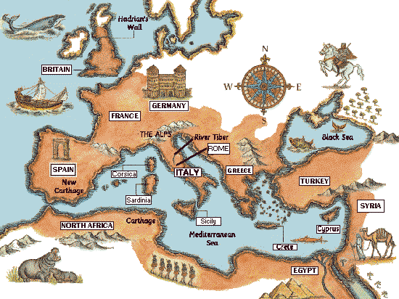
ROMAN EMPIRE CIRCA 250 AD

Slide 5
ANNENBERG MEDIA “THE CLASSICAL IDEAL” PART 2 FALL OF ROMAN EMPIRE; RISE OF CHRISTIANITY (47:50 TO 53:55) http://www.learner.org/resources/series1.html?pop=yes&pid=228

Slide 6
IN 285 AD, THE EMPEROR DIOCLETIAN “SPLIT” THE ROMAN EMPIRE INTO EASTERN AND WESTERN AREAS FOR ADMINISTRATION AND MANAGEMENT

Slide 7
THE EASTERN ROMAN EMPIRE CAPITAL SEAT BECAME THE CITY OF BYZANTIUM (MODERN DAY ISTANBUL) LOCATED IN A KEY POSITION LINKING EUROPE AND ASIA

Slide 8
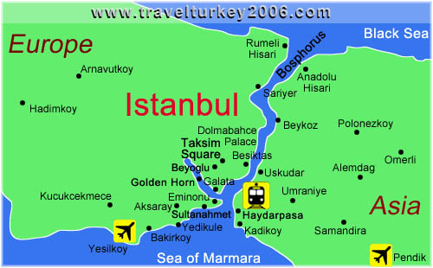

Slide 9
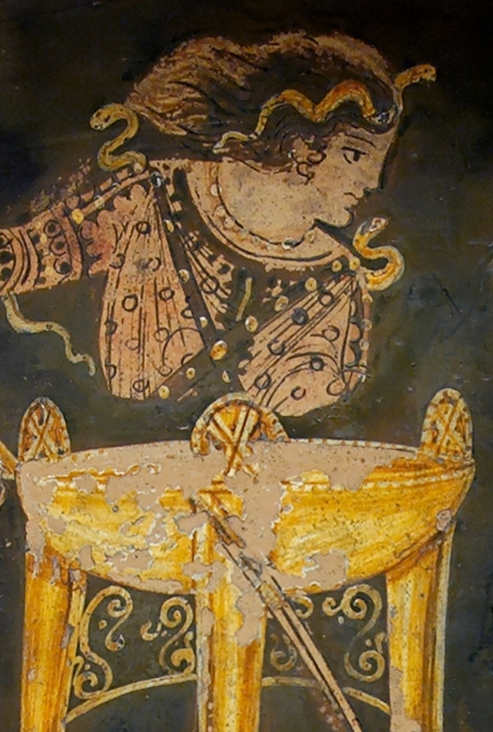
BYZANTIUM WAS FOUNDED BY THE GREEK KING BYZAS ON ADVICE FROM THE ORACLE OF DELPHI IN 657 BC

Slide 10
WESTERN ROMAN EMPIRE MOVED FROM ROME TO MILAN 286-402 AD RAVENNA 402-476 AD BECOMES THE CAPITAL SEAT

Slide 11
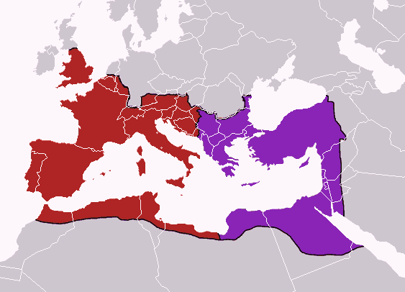
285 CE: ROMAN EMPIRE SPLIT

Slide 12
BYZANTINE DESIGN EMERGED FROM THE CHRISTINIZED GREEK CULTURE OF THE EASTERN ROMAN EMPIRE. BYZANTINE ART BECAME MORE SYMBOLIC AND LESS NATURALISTIC AND REFLECTED ASIAN INFLUENCES AS WELL.

Slide 13
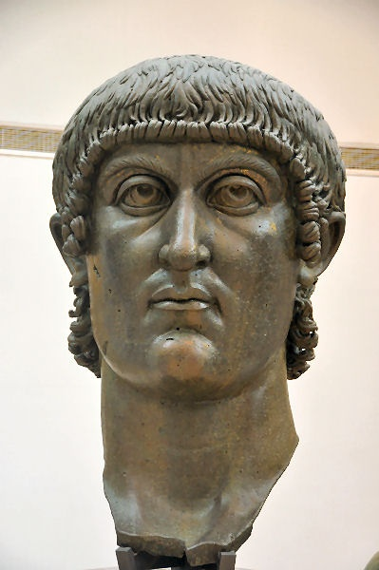
IN 313 AD, “EDICT OF MILAN” DECREED A TOLERANCE OF THE NEW “CHRISTIAN” RELIGION CONVERSION OF ROMAN EMPEROR CONSTANTINE TO CHRISTIANITY AFTER A VISION IN BATTLE OF A SHIELD EMBLAZONED WITH A CROSS IN 312 AD.

Slide 14
BYZANTIUM IS RENAMED CONSTANTINOPLE IN HONOR OF CONSTANTINE IN 330 AD

Slide 15
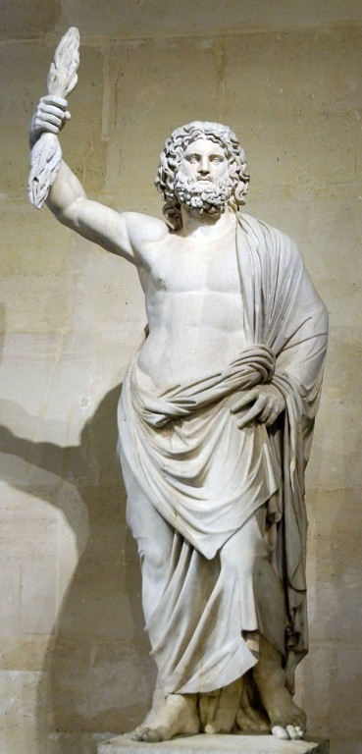
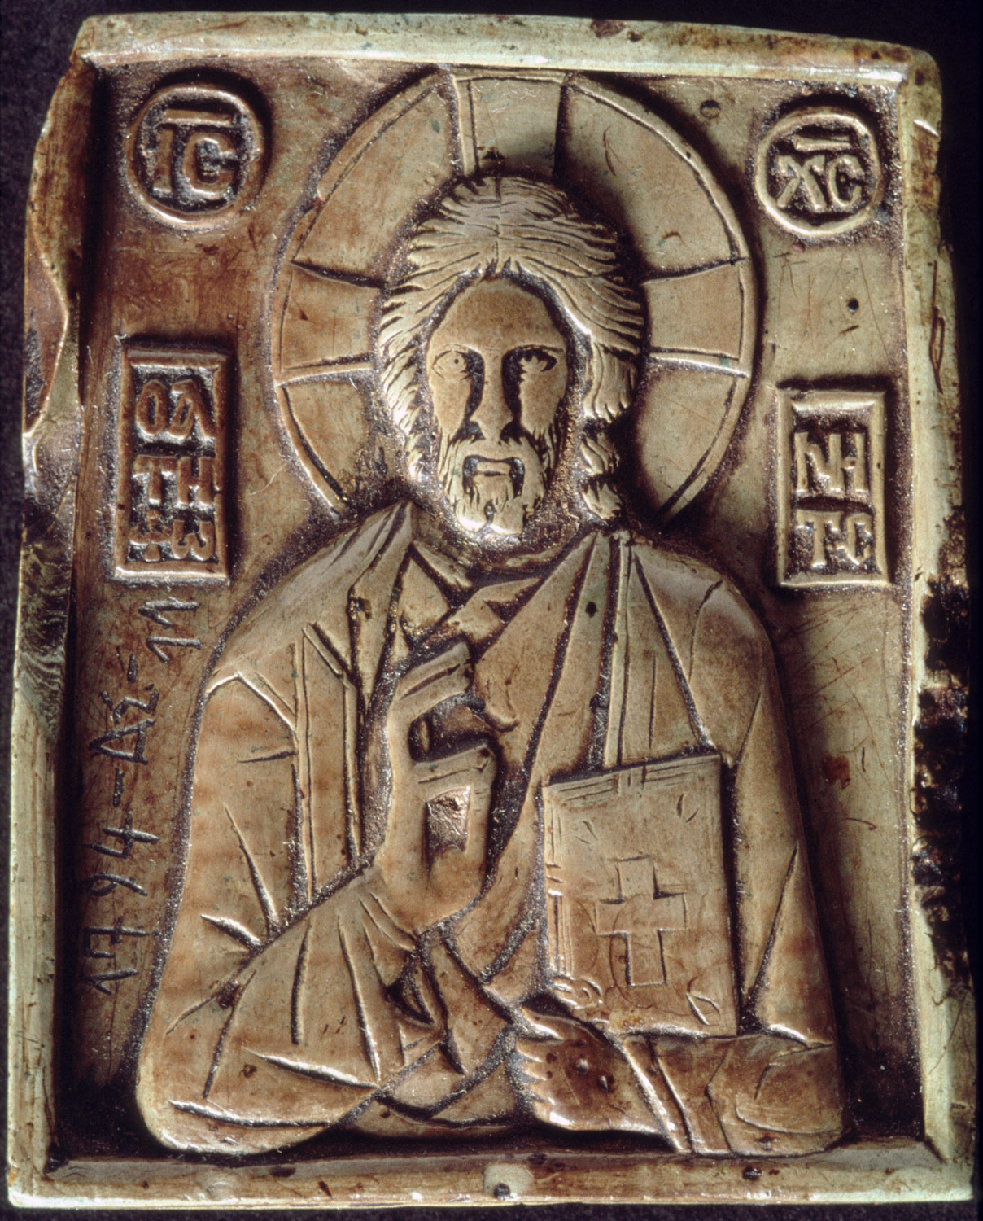
GREEK & ROMAN RELIGIOUS PAGANISM & ARCHITECTURAL CLASSICISM FELL OUT OF FAVOR BYZANTINE & “CHRISTIAN” DESIGN BLOSSOMED

Slide 16
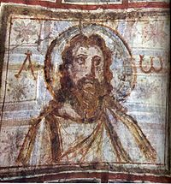
CATACOMB OF COMMODILLA, ROME ONE OF THE EARLIEST IMAGES OF A BEARDED CHRIST

Slide 17
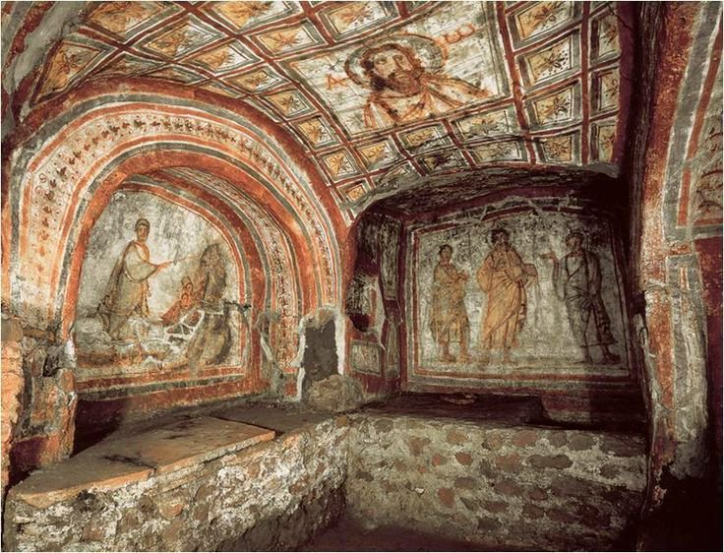

Slide 18
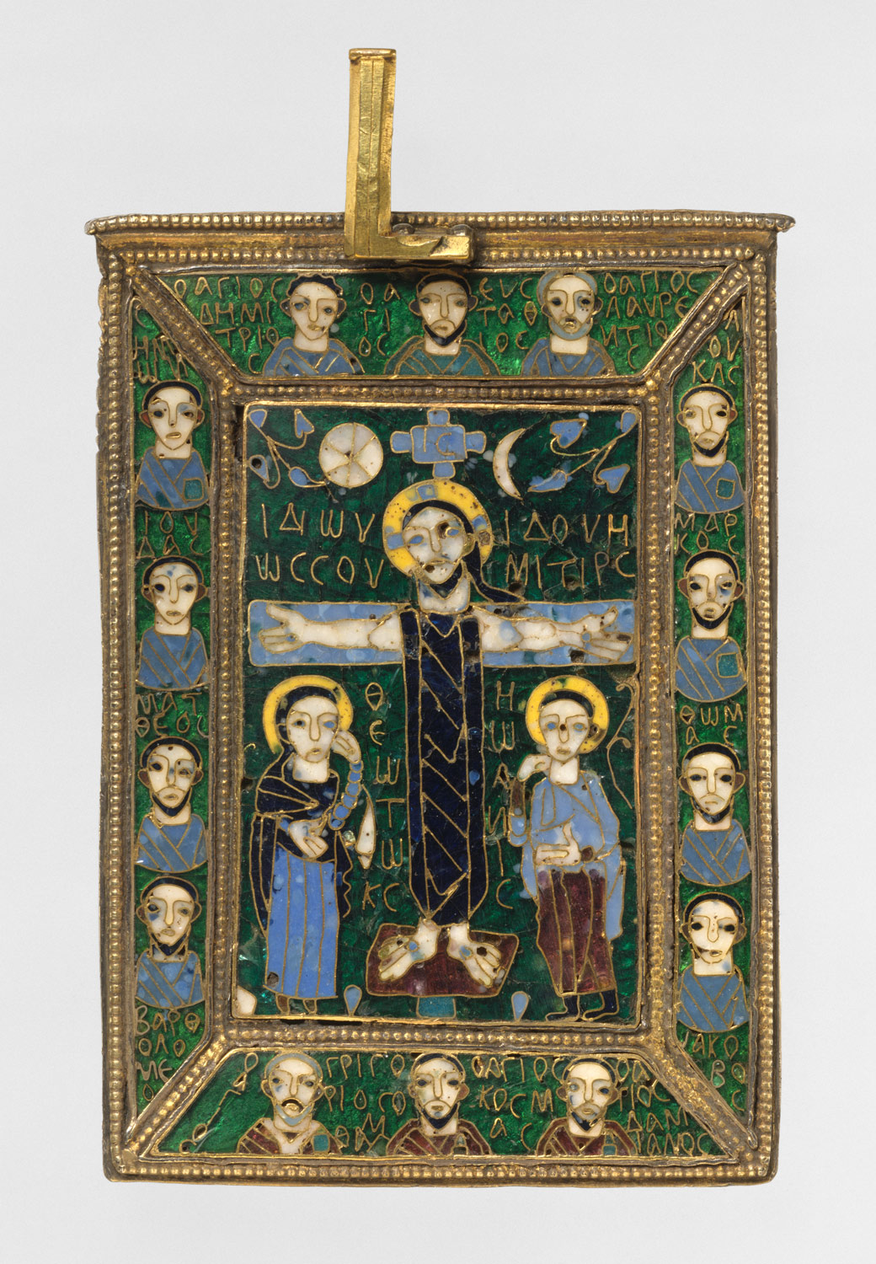
BYZANTINE ICONS REPLACED CLASSICAL SCULPTURES “IN THE ROUND” TO DEPICT SCENES FROM SAINTS, CHRIST AND THE VIRGIN MARY.

Slide 19
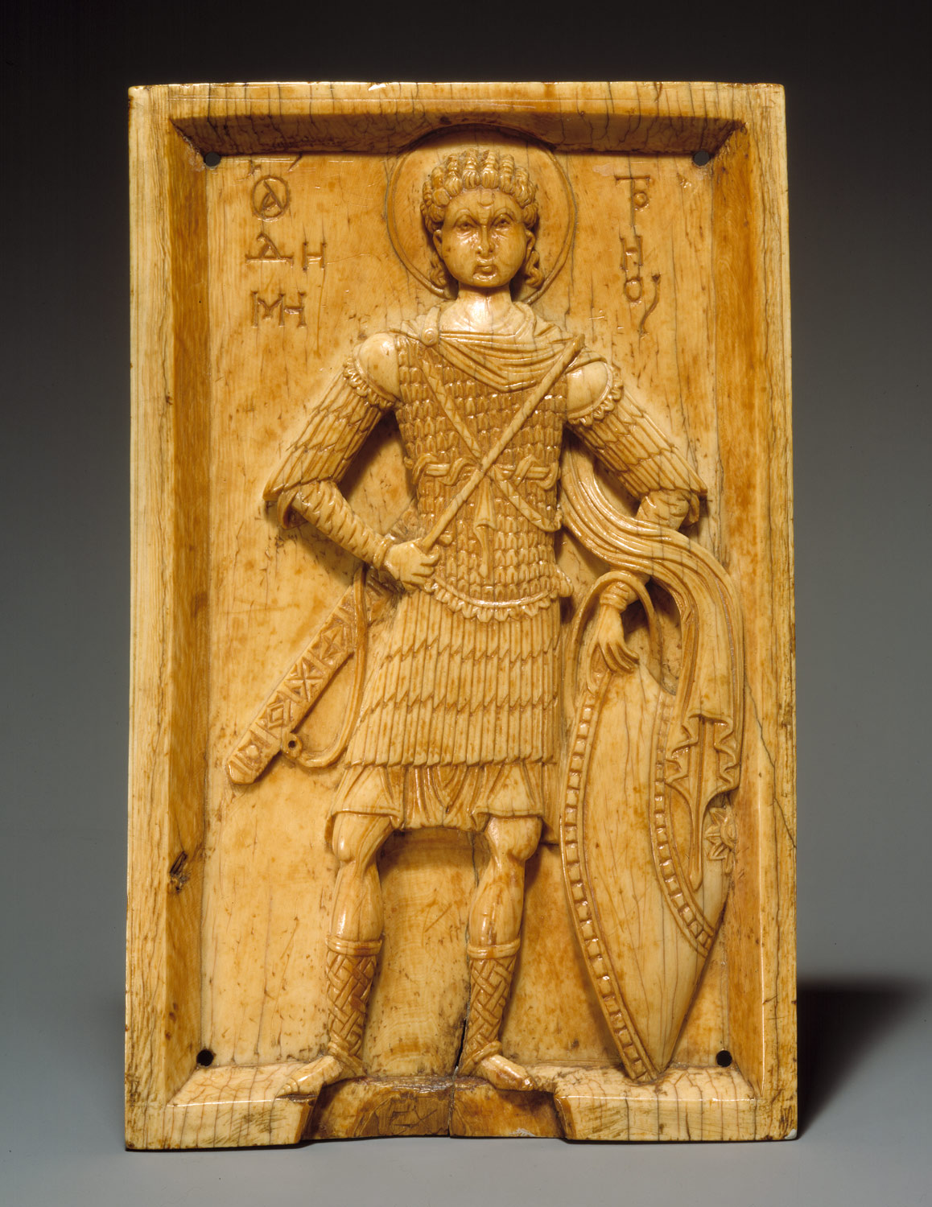
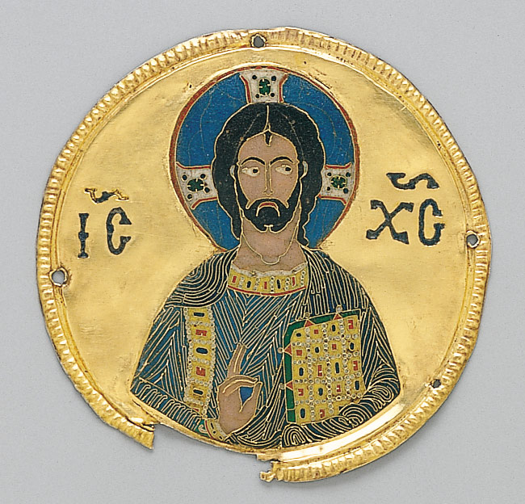

Slide 20
300 CE, ITALY AND ROME INCURRED INVASIONS FROM THE BARBARIANS: “GOTHS”, “VANDELS” & “HUNS” FROM THE OUTER AREAS OF THE OLD ROMAN EMPIRE

Slide 21
THE MOST FAMOUS INVASION CULMINATED IN THE “SACK OF ROME” BY THE VISIGOTHS IN 410 CE DESTRUCTION OF ROMAN FORUM THE FIRST TIME IN ALMOST 800 YEARS THAT ROME HAD FALLEN TO AN ENEMY.

Slide 22
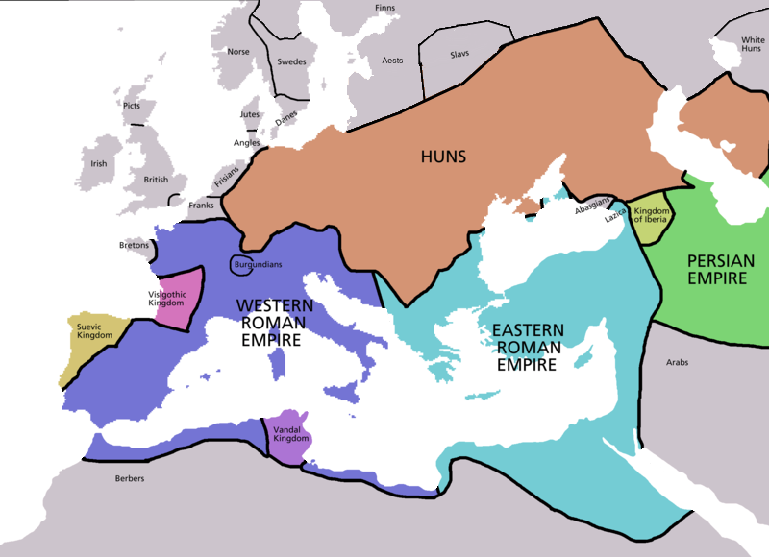
300 CE, BARBARIAN INVASIONS OF ROME

Slide 23
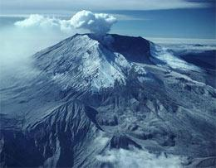
“MEDIEVAL” OR “DARK AGES” GENERAL PERIOD OF ANARCHY: FEUDAL SYSTEM OF SMALL LORDS & KINGDOMS REGIONAL INVASIONS & WARS. GLOBAL EFFECTSOF VULCANISM ? AVERAGE LIFE EXPECTANCY: 35 YRS

Slide 24
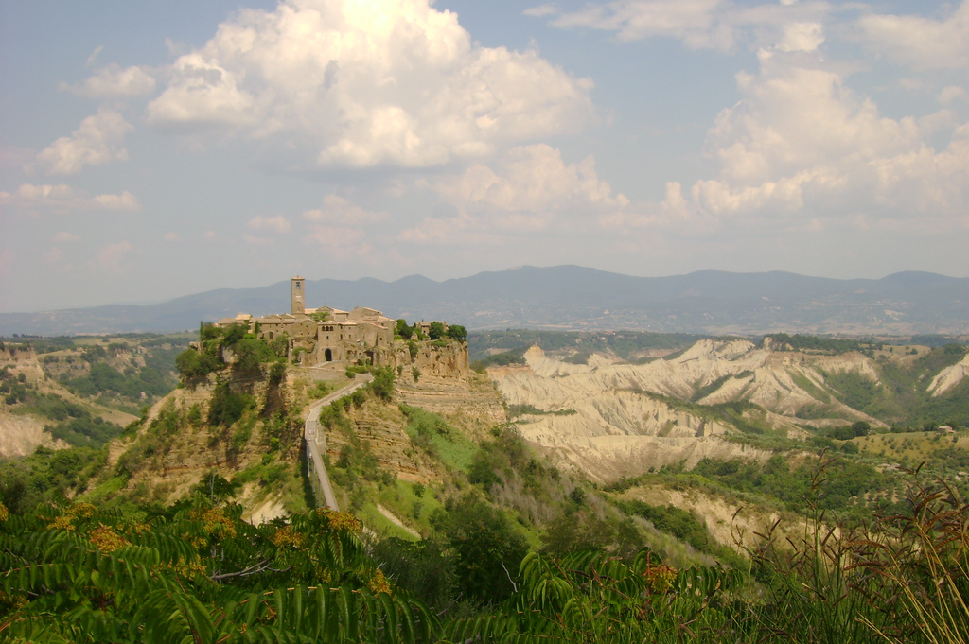
MEDIEVAL FORTRESS “HILL TOWNS”

Slide 25
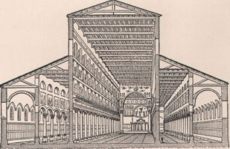
OLD ST. PETER’S BASILICA OF ROME, 300 AD MODELED AFTER BASILICA ULPIA FROM ROMAN FORUM
SIDE AISLES & NAVE

Slide 26
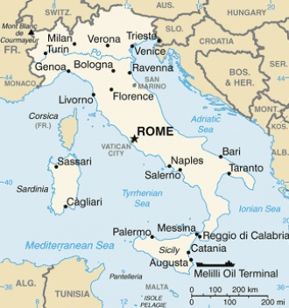

Slide 27
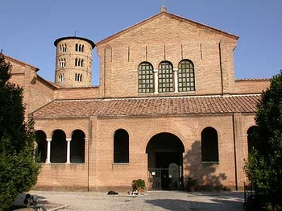
SANT 'APOLLINARE, RAVENNA, ITALY

Slide 28
EARLY CHRISTIAN CHURCHES USED BRICK RATHER THAN STONE ON THE EXTERIOR AND THE ORNAMENTATION TURNED INWARD WITH APPLIED ADORNMENT OF FRESCOS, MOSAICS AND CARVINGS ON MOST SURFACES IN THE INTERIOR. ELEMENTS FROM OLDER ROMAN BUILDINGS WERE RE-PURPOSED FOR THE NEW CHURCHES.

Slide 29
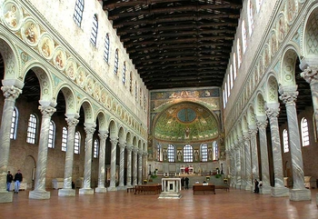
INTERIOR VIEW, LOOKING EAST TOWARDS THE APSE

Slide 30
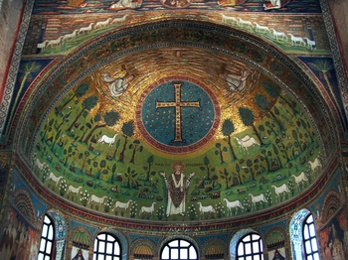
APSE MOSAIC OF SANT'APOLLINARE

Slide 31
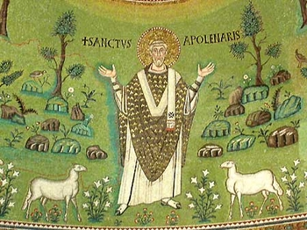

Slide 32
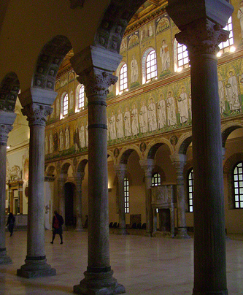
VIEW FROM THE SIDE AISLE

Slide 33
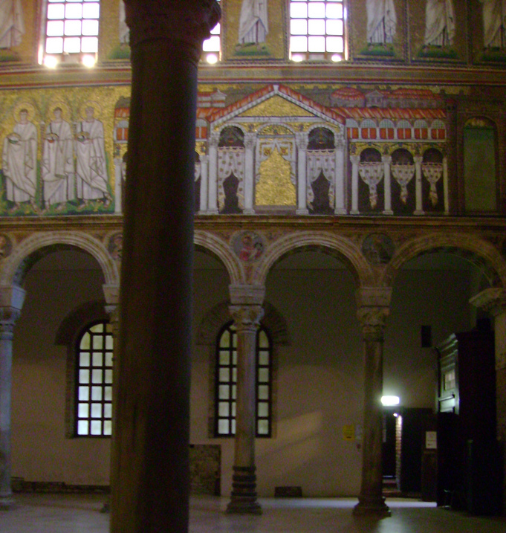
EMPRESS THEODORA PALACE WITH HANGING CURTAINS

Slide 34
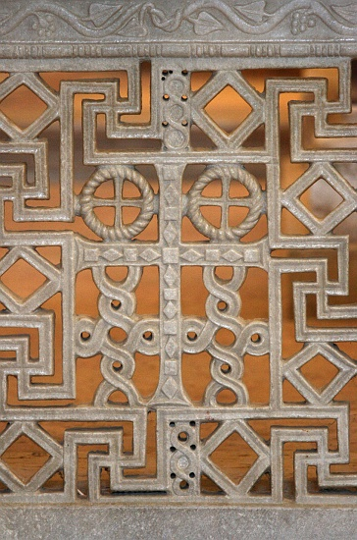
DETAIL OF PIERCED STONE GRILL WORK WITH CHRISTIAN SYMBOLS

Slide 35
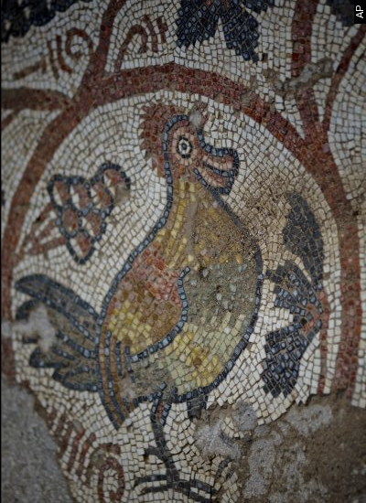
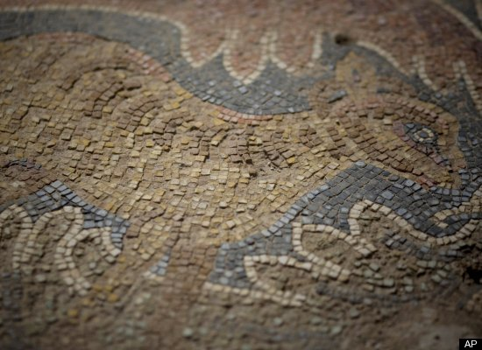
“CHRISTIAN” MOSAICS WITH SYMBOLISM

Slide 36
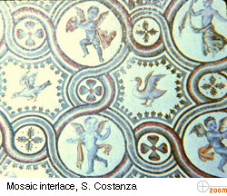
PAGE 109

Slide 37
Sant'Apollinare Nuovo, Ravenna http://www.sacred-destinations.com/italy/ravenna-sant-apollinare-nuovo-photos/index.htm

Slide 38
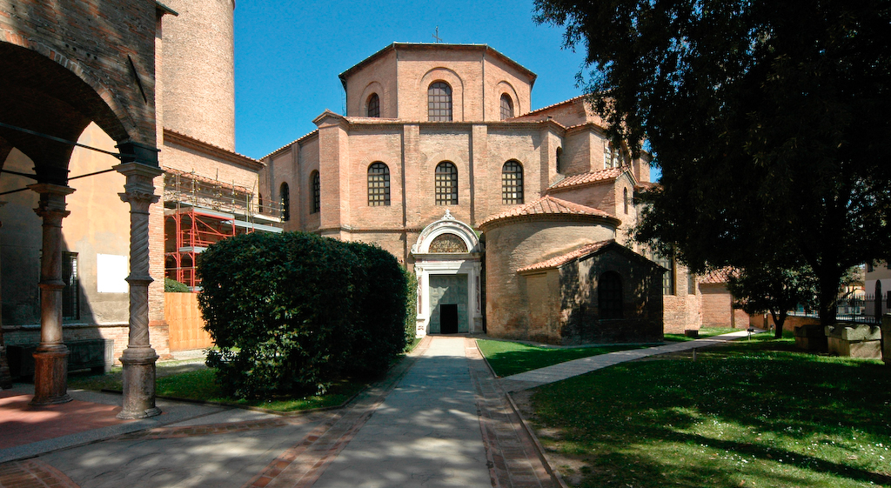
SAN VITALE BASILICA, BUILT BY EMPEROR JUSTINIAN RAVENNA, ITALY 526-548 AD

Slide 39
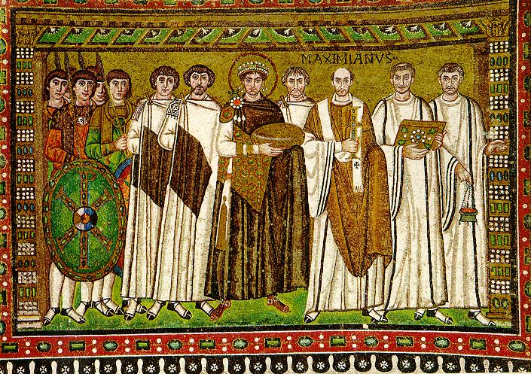
THE EMPEROR JUSTIANIAN ( 527-565 CE)

Slide 40
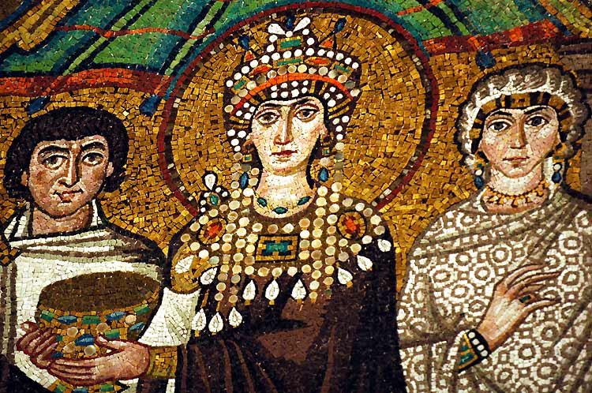
EMPRESS THEODORA

Slide 41
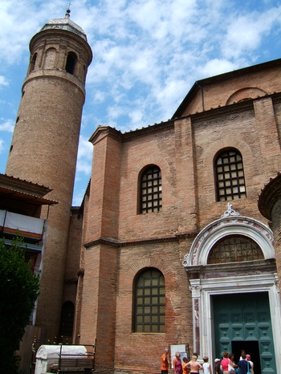
BELL TOWER AND “LUNETTE” OVER ENTRANCE DOOR

Slide 42
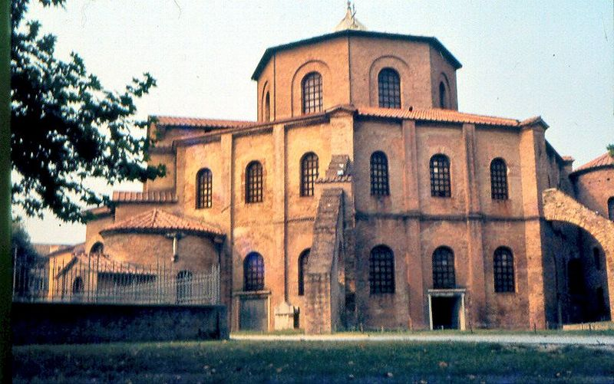
NOTE: FLYING BUTTRESS LATER USED IN GOTHIC CATHEDRALS

Slide 43
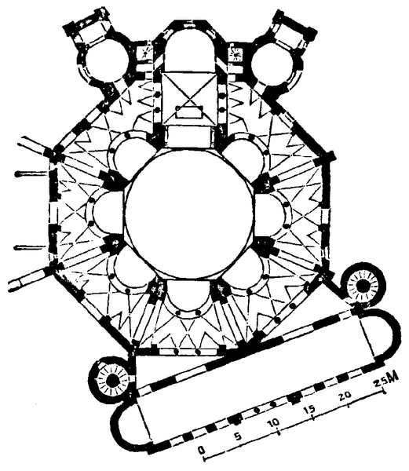
OCTAGONAL CENTRALIZED FLOOR PLAN OF SAN VITALE BASILICA, REVENNA, IT

Slide 44
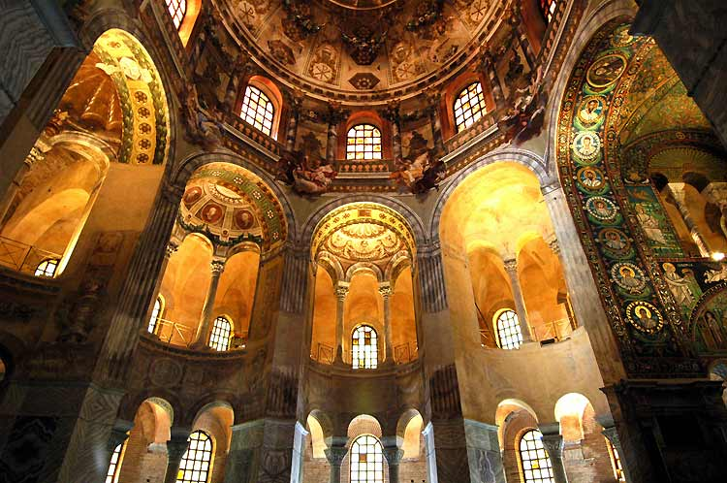
INTERIOR VIEW WITH APSE ON RIGHT

Slide 45
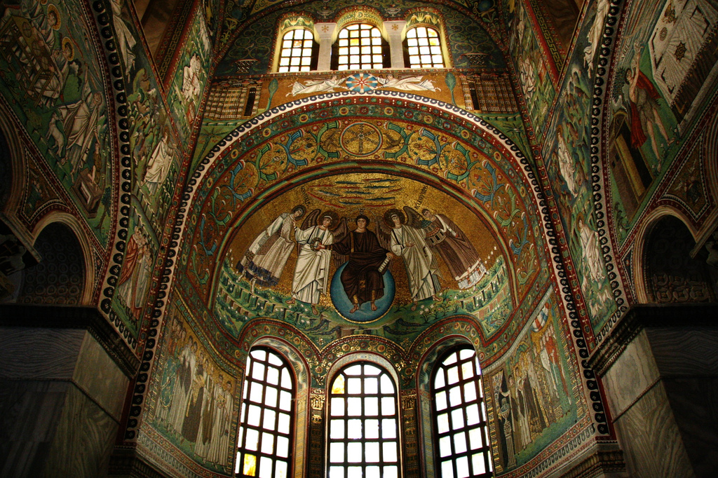
MAGNIFICENT MOSAICS IN APSE

Slide 46
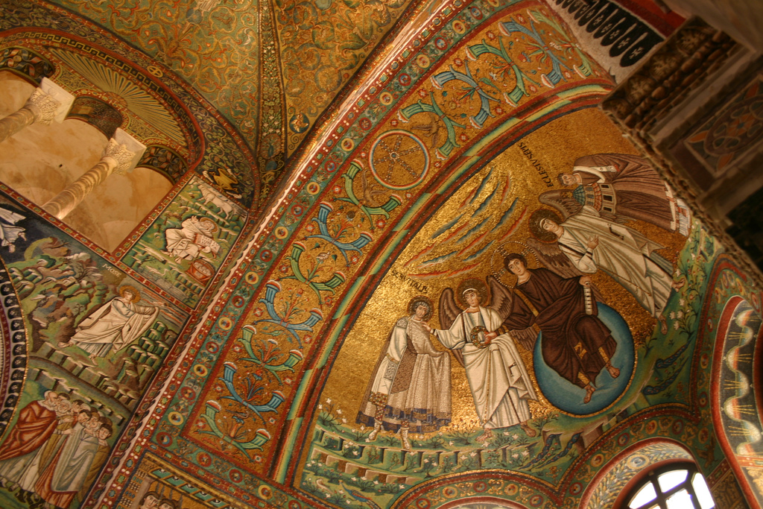
MOSAICS ON APSE AND CEILING

Slide 47
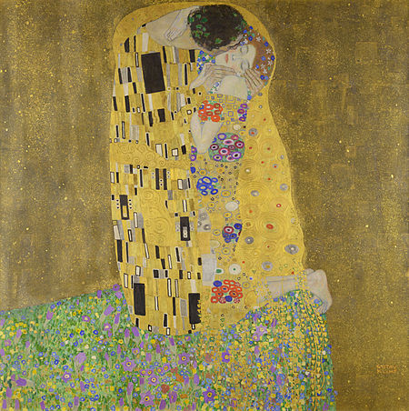
KLIMT’S “THE KISS”(1909) INSPIRED BY MOSAICS OF SAN VITALE

Slide 48
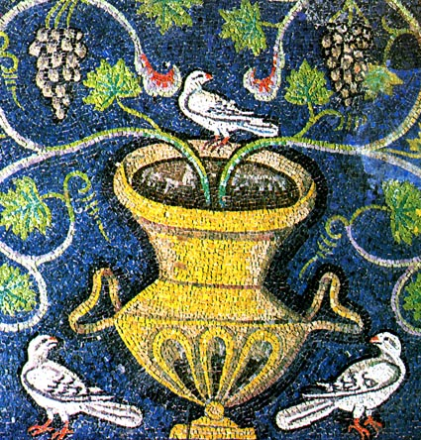
MOSAIC FROM SAN VITALE RAVENNA, ITALY

Slide 49
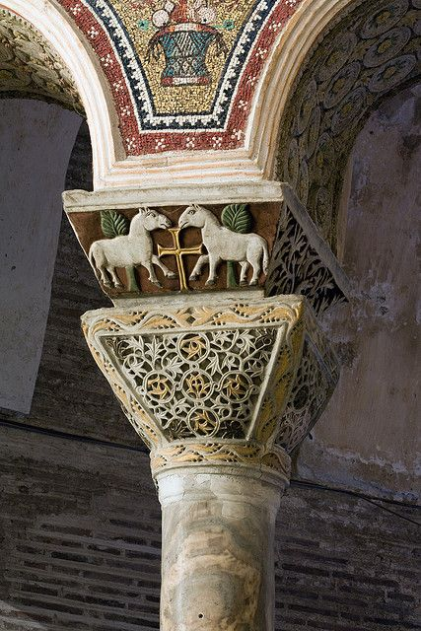
BYZANTINE “PROTOMAI” CAPITALS WITH ANIMAL FORMS IN HIGH RELIEF

Slide 50
San Vitale Basilica, Ravenna http://www.sacred-destinations.com/italy/ravenna-san-vitale-photos/

Slide 51
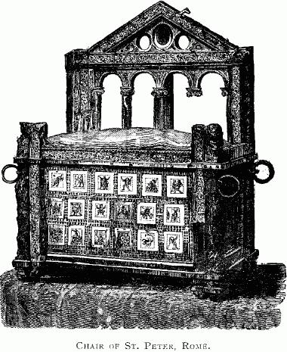
DRAWING OF CHAIR OF ST. PETER OF ROME

Slide 52
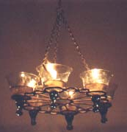
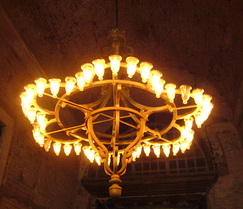
BYZANTINE POLYKANDELON (GREEK: MANYCANDLES)
OIL-FILLED
GLASS CUPS
SUSPENDED FRAME

Slide 53
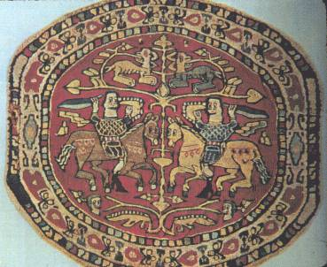
6TH CENT. “COPTIC” RONDEL TEXTILE

Slide 54
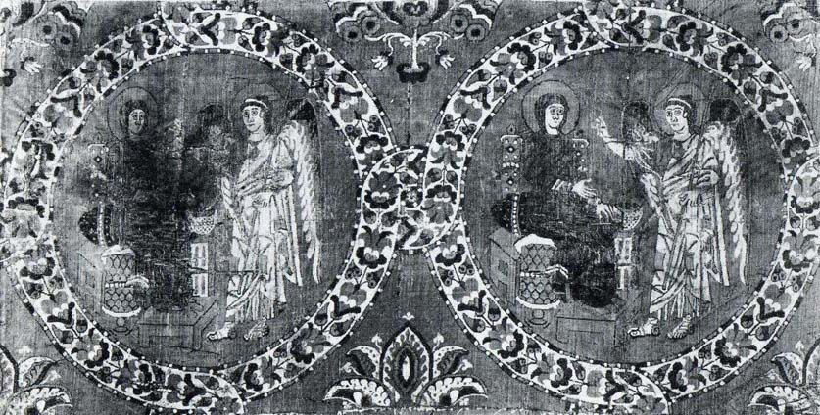
6TH CENT. “COPTIC” RONDEL TEXTILE

Slide 55
BYZANTINE EMPIRE 330 TO 1453 EMPEROR CONSTANTINE MOVED THE CAPITAL OF THE EASTERN ROMAN EMPIRE TO “BYZANTIUM”, LATER RE-NAMED “CONSTANTINOPLE”

Slide 56
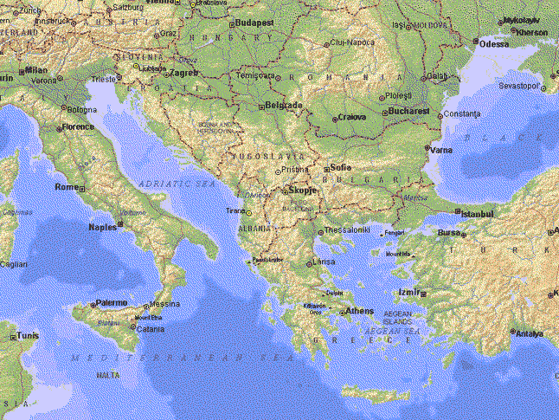

Slide 57
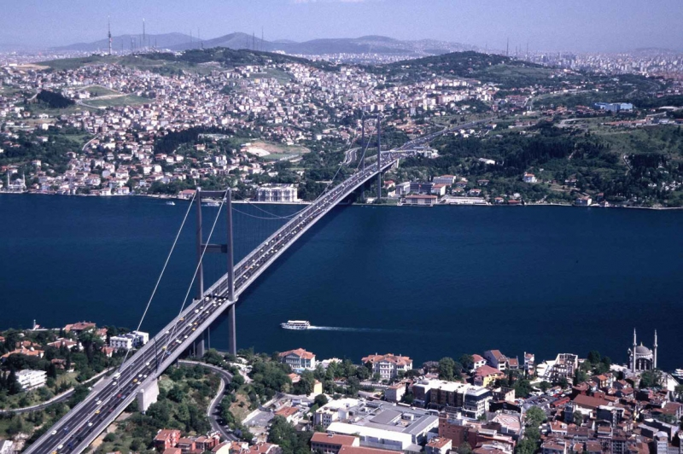
ISTANBUL BRIDGES EUROPE & ASIA

Slide 58
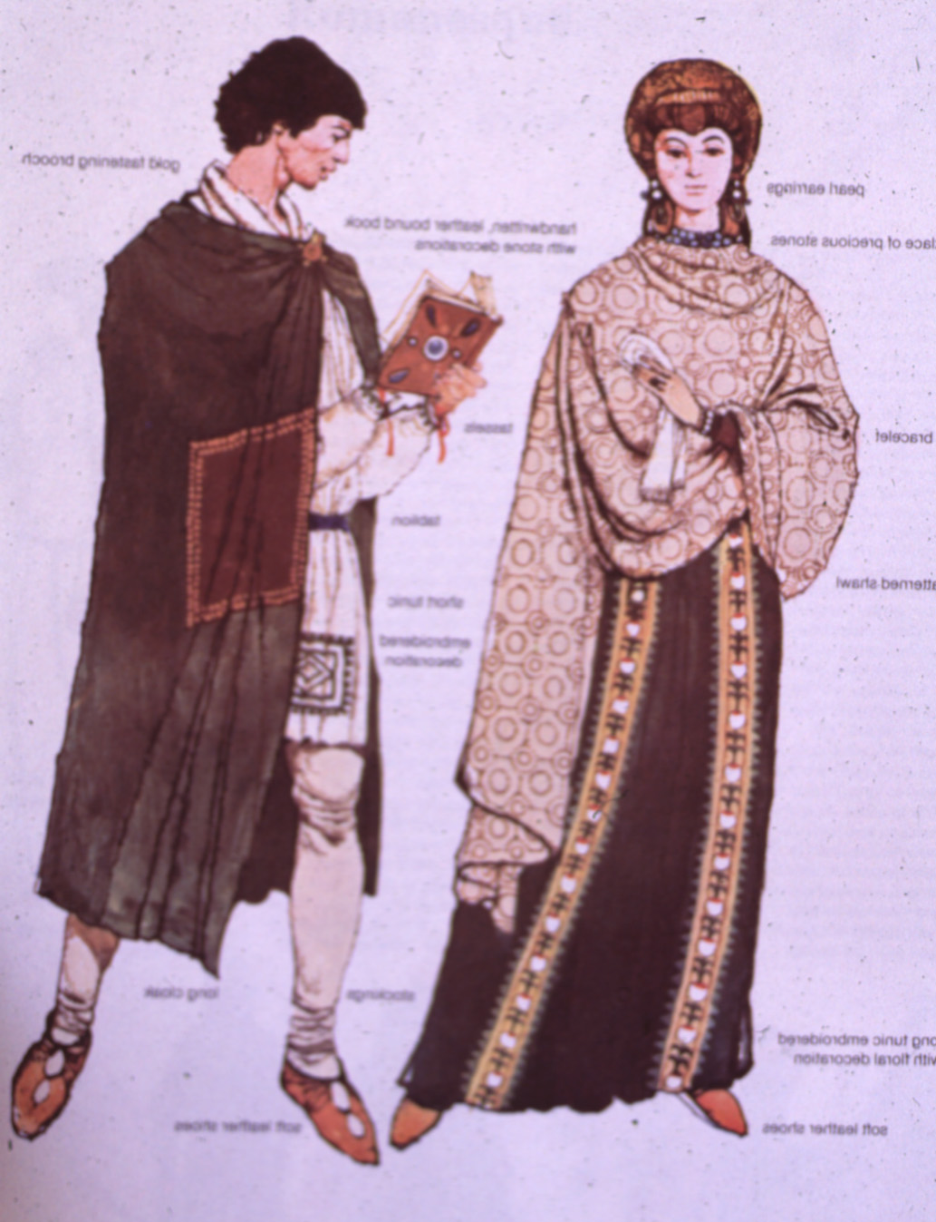
CLOTHING OF NOBILITY BYZANTINE EMPIRE (EASTERN ROMAN EMPIRE)

Slide 59
HAGIA SOPHIA “HOLY WISDOM” WAS BUILT IN 532-537 AD UNDER THE PERSONAL SUPERVISION OF EMPEROR JUSTINIAN “Soloman, I have out-done thee!”

Slide 60
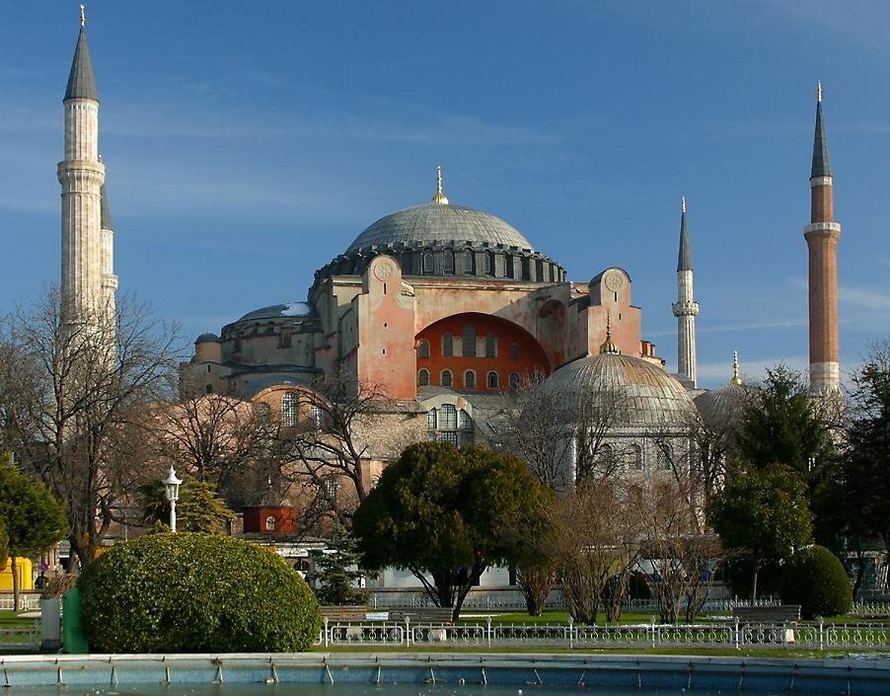
HAGIA SOPHIA; ISTANBUL, TURKEY

Slide 61
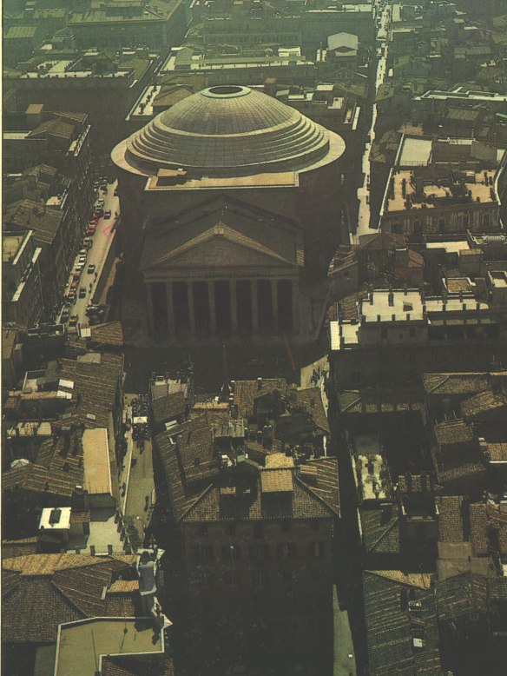
ROMAN PANTHEON BUILT 120 AD WAS INSPIRATION FOR HAGIA SOPHIA

Slide 62
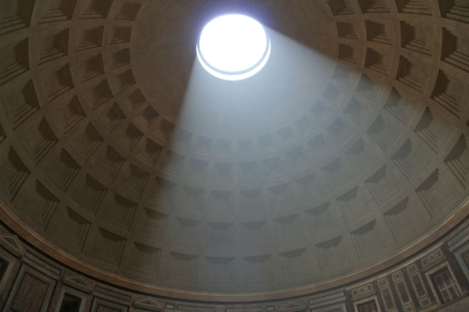
PANTHEON DOME 142’ DIA.

Slide 63
102’ DIAMETER DOME OF HAGIA SOPHIA WITH PENDENTIVES

Slide 64
“HAGIA SOFIA” CHRISTIAN CATHEDRAL & “AYA-SOFYA” ISLAMIC MOSQUE ISTANBUL, TURKEY https://www.youtube.com/watch?v=5DTh1c-f1uc

Slide 70
CEILING FRESCOS

Slide 71
DETAIL OF A BRONZE DOOR AT HAGIA SOPHIA: GREEK KEY RINCEAU LEAF / DART GUILLOCHE

Slide 72
IMPOST CAPITAL OF CARVED STONE HAGIA SOPHIA CREATE SENSE OF WEIGHTLESSNESS TO DOMED CEILING

Slide 73
HAGIA SOPHIA INLAID MARBLE FLOORS

Slide 74
SERAPHIM ON PENDENTIVES

Slide 75
MOSAIC OF ARCHANGEL GABRIEL

Slide 77
GOLD TESSERA MOSAIC IN APSE

Slide 78
“TESSERA” A TINY STONE OR GLASS SQUARE PIECE CREATES MOSAIC

Slide 79
MOSAIC OF VIRGIN AND CHILD WITH JOHN II AND IRENE

Slide 80
EARLY BYZANTINE MOSAIC DETAILS

Slide 81
IN 1453 AD, CONSTANTINOPLE FELL TO THE OTTOMAN TURKS AND WAS CONVERTED TO ISLAMIC “AYA SOFYA” MOSQUE AND ARABIC SCRIPTS AND “MINARETS” WERE ADDED

Slide 84
“AYASOFYA MOSQUE” INTERIOR IZNIK TILES

Slide 85
IZNIK TILES ON DISPLAY AT SAN DIEGO’S MUSEUM OF ART

Slide 86
DECORATIVE “PIERCED- WORK” MASHRABIYA SCREEN ON GROUND LEVEL OF THE “AYASOFYA MOSQUE”

Slide 87
PIERCED-WORK MASHRABIYA SCREENS, SAN DIEGO MUSEUM OF ART

Slide 88
CEILING MEDALLION DETAIL, “AYA SOFYA MOSQUE”

Slide 89
CELTIC/CHRISTIAN ORNAMENT

Slide 90
Hagia Sophia, Istanbul http://www.sacred-destinations.com/turkey/istanbul-hagia-sophia-photos/

Slide 91
BYZANTINE IVORY THRONE OF MAXIMIAM 550 AD CARVED STRAPWORK & TWIST OF FOLIAGE

Slide 92
DETAIL OF THRONE PANELS

Slide 93
BYZANTINE THRONE

Slide 94
BYZANTINE STYLE OF SAN MARCO, 1063 TO 1085 AD, VENICE, ITALY

Slide 95
ST. MARK’S OR SAN MARCO BASILICA “GREEK CROSS” PLAN WITH TRANCEPT

Slide 96
INTERIOR NAVE & AISLE OF SAN MARCO BASILICA VENICE, IT

Slide 97
INTERIOR DOMES OF SAN MARCO, VENICE, ITALY GOLD TESSERA MOSAICS

Slide 98
“LUNETTE” MOSAICS OVER ENTRY OF SAN MARCO BASILICA “TESSERAE”

Slide 99
GOTHIC ROOF LINE DETAILS OVER BYZANTINE STYLE MOSAICS

Slide 100
THE HORSES OF SAN MARCO

Slide 101
DETAIL OF LION HEAD KNOCKERS. THE MAIN DOOR OF SAN MARCO, VENICE

Slide 102
MOSAIC FLOORS, SAN MARCO

Slide 104
Basilica di San Marco, Venice http://www.sacred-destinations.com/italy/venice-san-marco-photos/

Slide 105
"SEAT OF ST. MARK," (GNOSTIC THRONE OF ALEXANDRIA) 825 BCE

Slide 106
GOLD PANELS OF THE PALA D'ORO IN THE “RELIQUERY”

Slide 107
BYZANTINE CLOISONNE ICON OF SAINT MICHAEL IN THE TREASURY

Slide 108
BYZANTINE POLYKANDELON (GREEK: MANY CANDLES)
OIL-FILLED
GLASS CUPS
SUSPENDED FRAME

Slide 109
MOSAIC OF ST. MARK; BYZANTINE BED

Slide 112
^{7TH} CENTURY BYZANTINE ILLUMINATED MANUSCRIPT OF MEDICINAL PLANTS

Slide 113
BYZANTINE COLORS & MOTIFS

Slide 115
The Crusades (1095-1291AD) Re-opened trade routes and re-mixing of cultures

Slide 116
Church of the Holy Sepulchre, Jerusalem
This Byzantine design influenced the design of many European churches throughout Europe.

Slide 117
Temple (Templar) Church, London Design inspired by Templar Knights crusade to Church of Holy Sepulchre, Jerusalem

Slide 118
BYZANTINE ARCHITECTURE CHANGED LITTLE 1,000 YEARS AND SPREAD TO OTHER REGIONS SUCH AS GREECE AND RUSSIA WHERE IS EMPLOYED OTHER FORMS. RUSSIANS WERE ENGAGED IN TRADE WITH CONSTANTINOPLE AND IN 988 PRINCE VLADIMIR OF KIEV MARRIED ANNA, SISTER OF BYZANTINE EMPEROR BASIL II BRINGING CHRISTIANITY TO THE REGION

Slide 119
SAINT BASIL’S MOSCOW A FAMOUS EXAMPLE OF THESE INFLUENCES UNESCO SITE

Slide 121
BYZANTINE DOMES WERE ADOPTED AND MODIFIED OVER CENTURIES TO ADAPT TO REGIONAL BUILDING MATERIALS AND CLIMATE. DRUMS AND DOMES BECAME TALLER AND CLUSTERED INTO GROUPINGS WITH FLAIRED SHAPES SUCH AS THE ONION DOME AND HELMET DOME COMBINING NORDIC AND BYZANTINE INFLUENCES.

Slide 123
BASILICA OF THE NATIONAL SHRINE, WASHINGTON, D.C. AT CATHOLIC UNIVERSITY http://www.sacred-destinations.com/usa/washington-basilica-of-national-shrine.htm

Slide 129
UMAYYAD MOSQUE 715 AD DAMASCUS, SYRIA

Slide 130
THE ISLAMIC RELIGION 622 AD TO PRESENT TEXT PAGE, 166 “MUSLIM”: A FOLLOWER OF “ISLAM” FOR A BASIC UNDERSTANDING, ISLAM 101 http://en.wikipedia.org/wiki/Islam

Slide 131
ISLAMIC SECTS & DEPICTION OF HUMAN FORM: SUNNI SECT (85%): ELECTED LEADERSHIP: HUMAN FORM STRICTLY FORBIDDEN SCRIPT, GEOMETRIC & FLORAL FORMS SHIA (SHIITE) SECT (13%): LEADERSHIP BY DIRECT HEIRS: HUMAN, FLORAL AND ANIMAL FORM PERMITTED

Slide 132
PROPHET MUHAMMAD 570-632 CE, MEDINA, SAUDI ARABIA THE MOSQUE OF THE PROPHET 2ND HOLIEST SITE OF ISLAM MEDINA, SAUDI ARABIA

Slide 133
THE KAABA, IN MECCA, SAUDI ARABIA HOLIEST SITE FOR ISLAMIC FAITH

Slide 135
10th Century Mausoleum, Bukhara, Uzbekistan Brick Construction

Slide 137
ISLAMIC EMPIRE 750 CE; MAPS TEXT PAGE 668

Slide 138
DOME OF THE ROCK, 691 CE ISLAMIC SHRINE, JERUSALAM

Slide 139
DOME MEASURES 60’ DIAMETER

Slide 140
INSIDE THE DOME OF THE ROCK

Slide 143
SULEYMANIYE MOSQUE, 1557 ISTANBUL, TURKEY, TEXT PAGE 169

Slide 148
SULTAN AHMED MOSQUE OR “THE BLUE MOSQUE” 1616 AD

Slide 150
http://www.sacred-destinations.com/turkey/istanbul-suleymaniye-camii-pictures/index.htm

Slide 151
“MIHRAB” A PRAYER NICHE FACES EAST DIRECTION TO MECCA TEXT PAGE 168 HAGIA SOFIA ISTANBUL, TURKEY

Slide 152
MIHRAB FROM “BLUE MOSQUE” OR SULTAN AHMED MOSQUE.

Slide 153
“MINBAR” OR PULPIT FROM SULTAN AHMED MOSQUE (NOTE ADJACENT MIHRAB)

Slide 154
RELIGIOUS SCHOOLS “MADRASA” BUKHARA, UZBEKISTAN

Slide 155
HORSESHOE ARCHES, TEXT PAGE 127

Slide 156
TOPKAPI PALACE, ISTANBUL, TURKEY

Slide 157
"TOPKAPI" PALACE IN ISTANBUL, TURKEY, THE OFFICIAL AND PRIMARY RESIDENCE IN THE CITY OF THE OTTOMAN SULTANS FROM 1465 TO 1853

Slide 158
ORIGINAL CENTRAL PALACE

Slide 161
SULTAN’S INNER SALON WITH “DIWAN”

Slide 164
MASHRABIYA FROM TOPKAPI PALACE

Slide 165
MASHRABIYA COMMONLY USED AS AN “ORIEL WINDOW” TO PROJECT MORE AREA ON THE SECOND FLOOR WHILE MAINTAINING PRIVACY

Slide 166
MASHRABIYA SEEN FROM INTERIOR

Slide 167
QAPU PALACE, ISFAHAN, IRAN, 1600

Slide 168
MUQUARNAS OF THE MUSIC ROOM, ALI QAPU PALACE, TEXT PAGE 175

Slide 172
“ARAB-ESQUE” AS IN “PICTURE-ESQUE” STUCCO-WORK (SPAIN YESERIA)

Slide 173
ALHAMBRA, SEVILLE, SPAIN

Slide 174
TO SEE THE MAKING OF THESE BEAUTIFUL DETAILS SEE BELOW LINK https://www.youtube.com/watch?v=Og6cTlwBTrk

Slide 175
GEOMETRIC PATTERN: CERAMIC TILES “PERSIAN STYLE”

Slide 176
Iranian ceramic panel, 14th century; painted under glaze with color & gilding

Slide 177
IRANIAN TILE 14TH CENTURY “PERSIAN BLUE” WITH LUSTER GLAZE COLOR OF WATER

Slide 178
“LUSTER WARE”

Slide 179
THE “ALHAMBRA VASE” 1350 CE EARTHENWARE: PAINTED OVER GLAZE SPAIN

Slide 180
DAMASCUS, SYRIA VASE WITH FOUR HANDLES 1325-50 CE PERSIAN GLASS ENAMELED AND GILDED

Slide 181
TURKISH TILES 1625 CE ARABESQUE PATTERNS

Slide 182
TURKISH “IZNIK” TILE WITH “HANCERI”- LONG LEAVES WITH SERRATED EDGES 1575 CE

Slide 183
Chinese Porcelain Motifs drew inspiration from Islamic Pottery and Visa Versa
Iznik Stone Paste Ceramic with Chinese Motifs, 16th century “Chinese grapes”
Chinese Porcelain, 15th c
Ming Dynasty “Islamic Blue”

Slide 184
Chinese Porcelain and Islamic motifs inspired production in Europe
Chinese “Ming Dynasty”
Italian “Porcelain” 1520AD

Slide 185
IZNIK-WARE TILES

Slide 186
DETAIL: COURT SCENE WITH DANCING AND FEASTING, IRAN, CERAMIC, 1900–1910 MUSEUM OF ART, SAN DIEGO

Slide 187
FOUNTAIN IN BALBOA PARK

Slide 188
IRANIANPLATE 7th century Bronze

Slide 189
IRANIAN BOWL 7th Cent. Silver and gilt

Slide 190
NORTHERN IRAQ CANTEEN MID-13TH CENTURY BRASS WITH SILVER INLAY

Slide 191
SYRIAN “EWER” 1232 CE BRASS WITH SILVER INLAY “DAMASCENING”

Slide 192
IRANIAN BUCKET, 1550 CE BRONZE INLAID WITH SLIVER

Slide 194
TURKISH TEXTILE CUSHION COVER 1600 CE COMPOUND SATIN AND VELVET

Slide 195
TURKISH: CUSHION COVER 1600 CE SILK & METALIC VELVET

Slide 196
UZBEKISTAN WALL HANGING 1850-1875 IKAT DYED SILK WARP, UNDYED COTTON WEFT

Slide 197
UZBEKISTAN WALL HANGING 19TH CENTURY IKAT DYED SILK WARP, UNDYED COTTON WEFT

Slide 198
Freer Gallery of Art Arthur M. Sackler Gallery Smithsonian Institution “ARTS OF THE ISLAMIC WORLD” http://www.asia.si.edu/collections/results.cfm?group=Islamic&start=12

Slide 199
IRANIAN 17TH CENT “BOOK OF KINGS”

Slide 200
MAN FILLING A WINE CUP 17TH CENTURY INK, COLOR WASH, AND GOLD ON PAPER IRAN

Slide 201
IRANIAN PORTRAIT OF MIRZA MUHAMMAD KHAN QAJAR 1855-1856 OPAQUE WATERCOLOR AND INK ON PAPER

Slide 203
RESIDENCE IN MID-EAST PERIOD STYLE. ISLAMIC RUGS TEXT PAGE 183

Slide 204
MOSQUE INTERIOR MID-EAST PERIOD STYLE. ISLAMIC CARPETS TEXT PAGE 183

Slide 205
“ORIENTAL RUGS” (ISLAMIC CARPETS IS THE PREFERRED NAME)

Slide 206
ISLAMIC “MID-EASTERN” RUG WEAVING: RUGS NAMED FOR EACH LOCALITY OR REGION

Slide 207
PERSIAN & TURKISH KNOT TEXT PAGE 182-188

Slide 208
HAND WOVEN RUGS

Slide 209
VARIETIES OF RUGS ARE ENDLESS AND ARE REGIONAL DESIGNS

Slide 211
“BOTEH” MOTIF

Slide 215
ANTIQUES ROADSHOW TABRIZ RUG http://www.pbs.org/wgbh/roadshow/archive/200502A26.html

Slide 217
QUESTAR DVD TAJ MAHAL AGRA, INDIA 1:40:00 TO 1:48:40

Slide 218
TAJ MAHAL, AGRA, INDIA BUILT IN 1648 UNDER MUGHAL EMPEROR SHAH JAHAN IN MEMORY OF HIS FAVORITE WIFE, MUMTAZ MAHAL

Slide 220
GATEWAY TO THE TAJ MAHAL, AGRA, INDIA

Slide 222
Islamic “Paradise Garden” with water features, axial plan and 4 “rivers” going the 4 cardinal directions. Derived from the concept of “The Garden of Eden” and said to symbolize eternal life.

Slide 225
ANOTHER EXAMPLE OF AN ISLAMIC “PARADISE GARDEN”

Slide 228
PIETRA DURA INLAID SEMI-PRECIOUS STONE IN WHITE MARBLE

Slide 230
CENOTAPHS, (TOMBS) INTERIOR OF TAJ MAHAL

Slide 231
INTERIOR CEILING DETAILS: MUQUARNAS

Slide 233
Opaque watercolor and gold on paper, ca. 1845 India

Slide 234
Opaque watercolor and gold on paper, ca. 1800 India

Slide 235
Begum Shahi Mosque is Lahore's earliest dated Mughal period mosque 1611 AD

Slide 237
ISLAMIC DESIGNS IN SPAIN MUQUARNA BELOW ZELLIGE TO RIGHT

