Slide 1
Greece and Rome
History of Built Environment

Slide 2
EARLY GREEK PERIODS SEE TIMELINE; PAGE 55 GEOMETRIC: 1000-700 BCE ORIENTALIZING: 700-610 BCE ARCHAIC: 610-490 BCE EARLY CLASSICAL: 490-450 BCE “CLASSICAL”: 450-323 BCE HELLENISTIC: 323-31 BCE

Slide 3
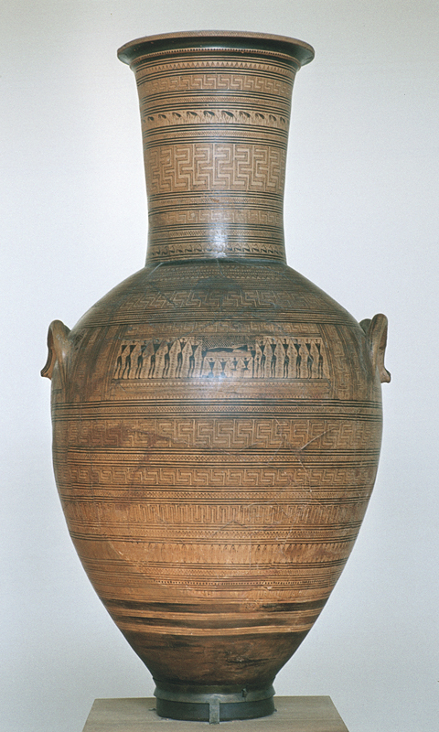
LATE GEOMETRIC AMPHORA: DIPYLON VASE 5’ TALL 900 BCE MYCENAEN

Slide 4
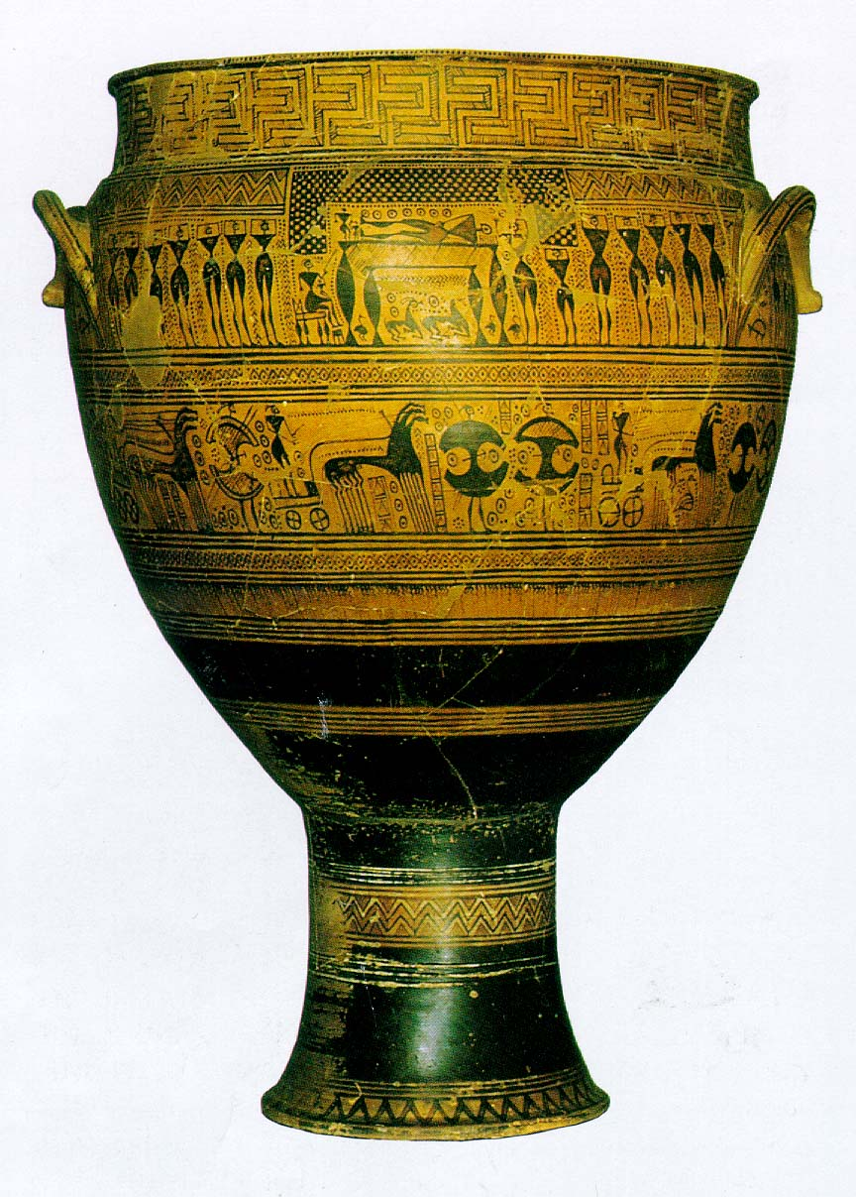
GEOMETRIC KRATER FROM THE DIPYLON CEMETARY, ATHENS, 740 BC

Slide 5
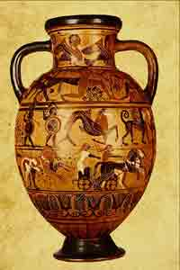
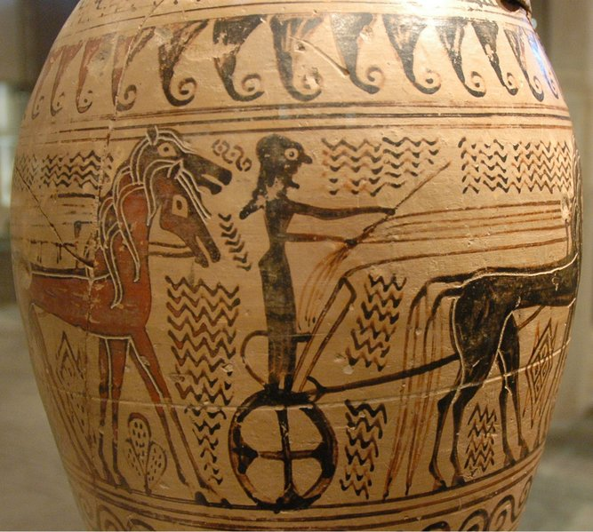
GREEK ORIENTALIZING PERIOD; VASE WITH PROCESSION OF A TWO HORSE CHARIOT, 690 BC.

Slide 6
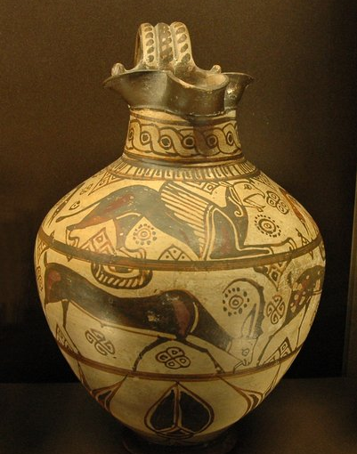
GREEK ORIENTALIZING PERIOD; PITCHER IN THE WILD GOAT STYLE FROM CAMIROS 600 BCE

Slide 7
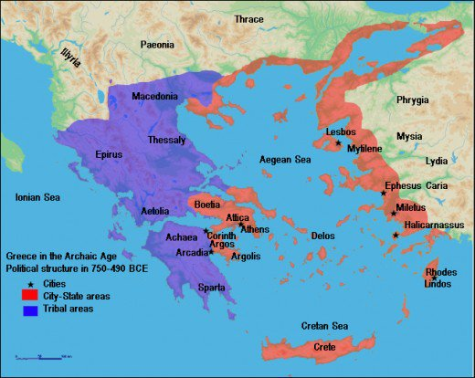

Slide 8
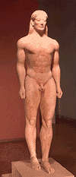
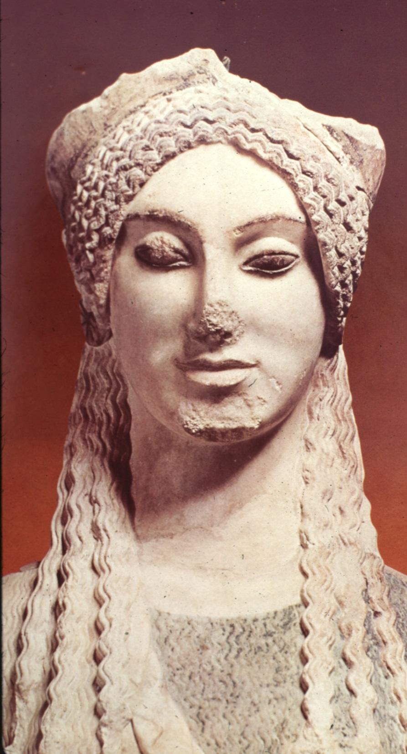
“KOUROS” GREEK ARCHAIC PERIOD SCULPTURE 630 BC

Slide 9
“ARCHAIC GREEK” 650 BCE LEFT LEFT: KOUROS OF PAROS RIGHT: LADY OF AUXERRE

Slide 10
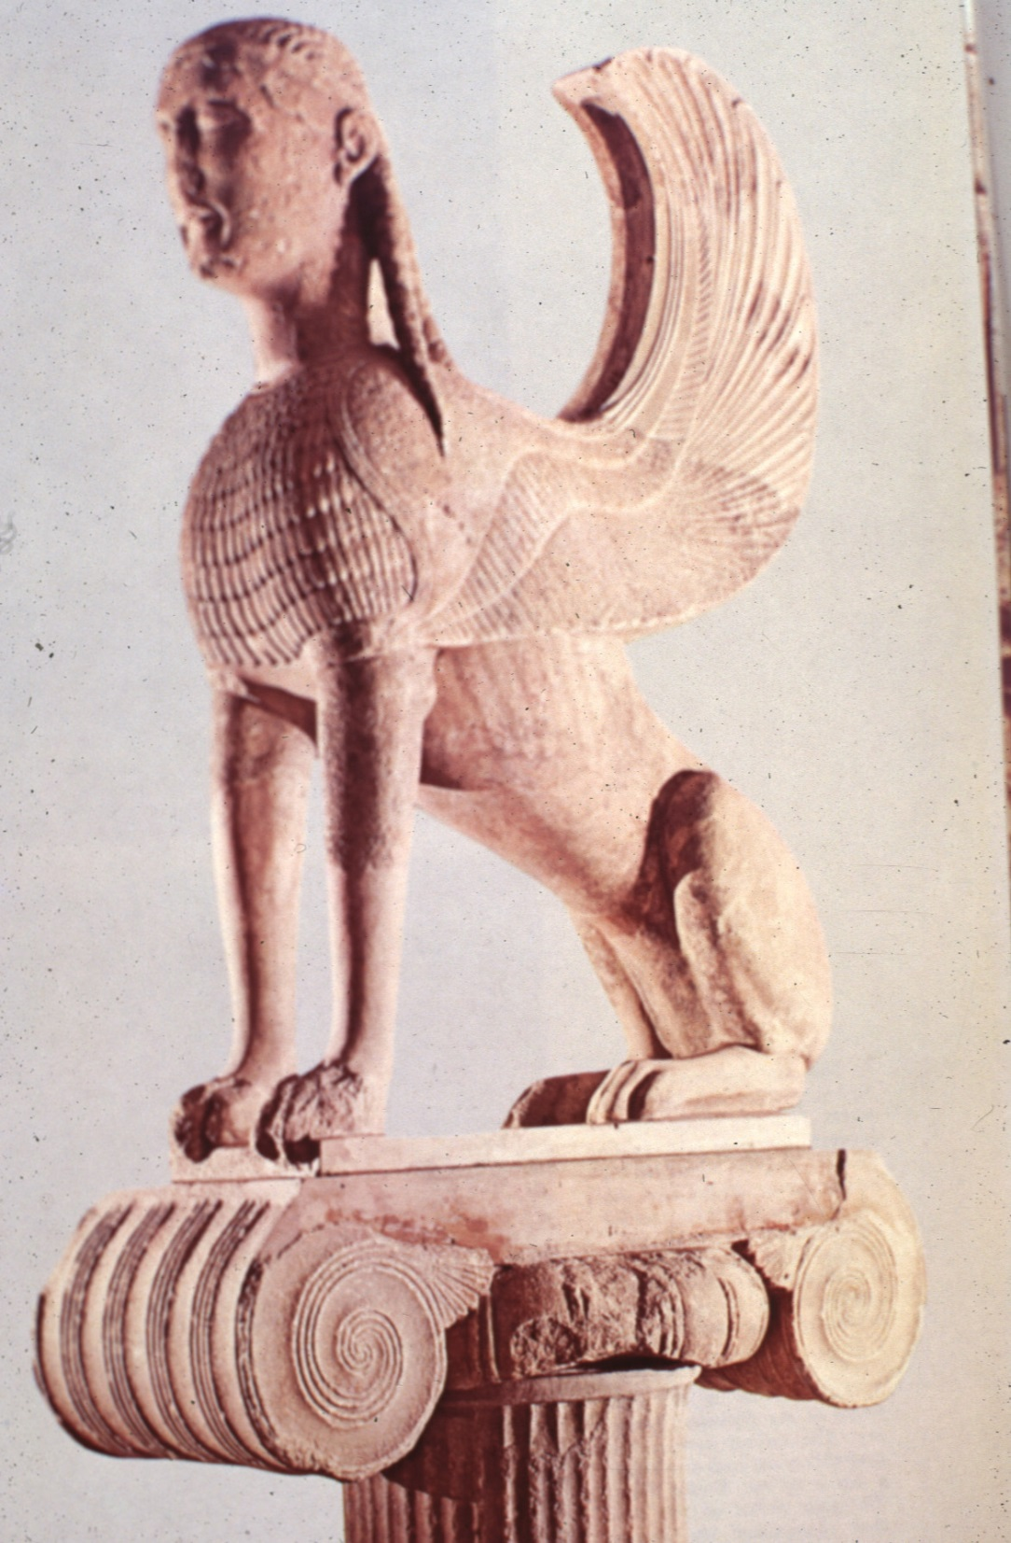
LATE “ARCHAIC GREEK” MYSTICAL NAXIAN SPHINX OF DELPHI ON IONIC CAPITAL 560 BC

Slide 11
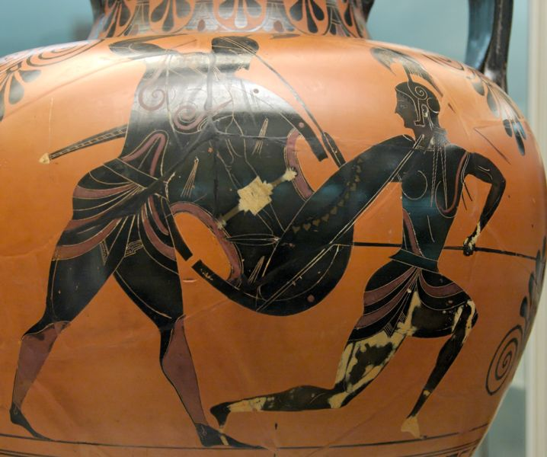
ARCHAIC PERIOD: BLACK FIGURE VASE PAINTING, 540 BCE

Slide 12
GREEK MATURE PERIOD CLASSICAL GREEK PERIOD “GOLDEN AGE OF GREECE” OR “AGE OF PERICLES” 490-404 BCE

Slide 14
UNDER PERICLES (495-429 BCE) THE ATHENS CITY/STATE OR “POLIS” REACHED IT’S ZENITH OF CULTURE, ART AND POLITICAL POWER. HAD ATHENS REBUILT AFTER PERISAN INVASION IN

Slide 15
CLASSIC PERIOD: HUMAN FIGURE “ZEUS” 460 BCE

Slide 16
CLASSICAL PERIOD “LEBES GAMIKOS” OR “MARRIAGE” VASE RED-FIGURE POTTERY 450 BCE

Slide 17
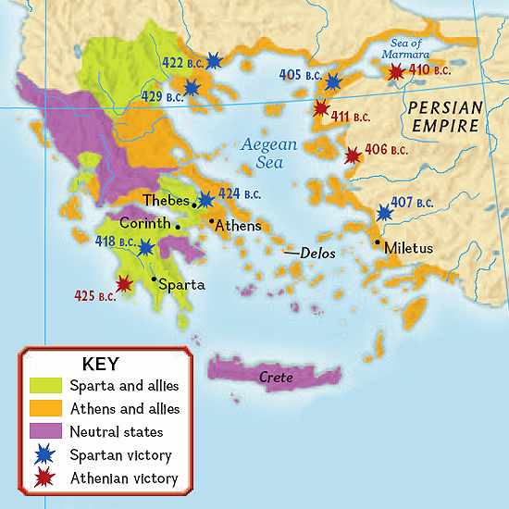

Slide 18
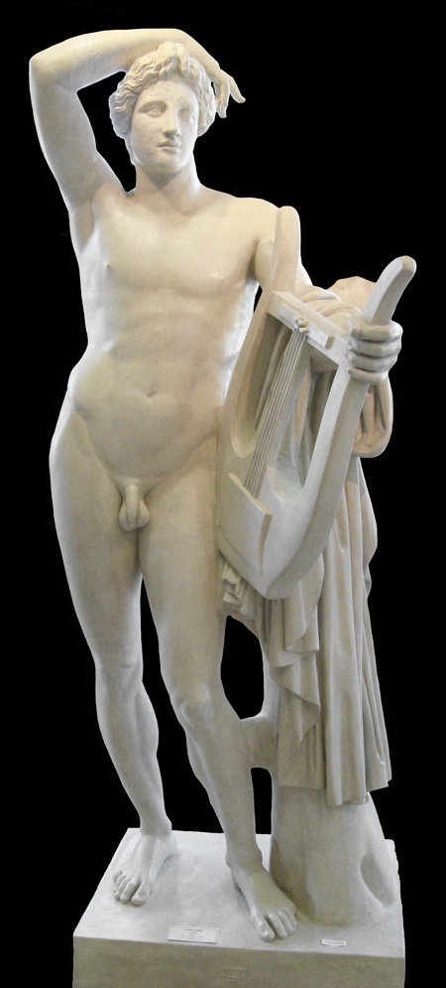
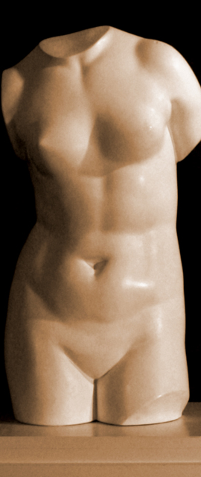
CLASSICAL PERIOD LEFT APOLLO LYKEIOS: RIGHT APHRODITE OF CNIDOS: 360 BCE

Slide 19
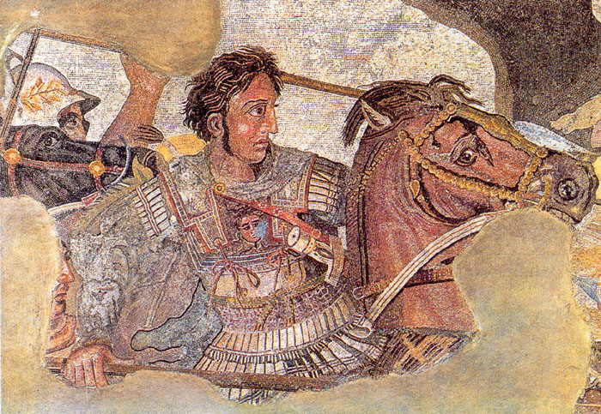
ALEXANDER THE GREAT (GREEK) CONQUESTS SPREAD GREEK CULTURE ACROSS A WIDE AREA OF TERRITORY

Slide 20
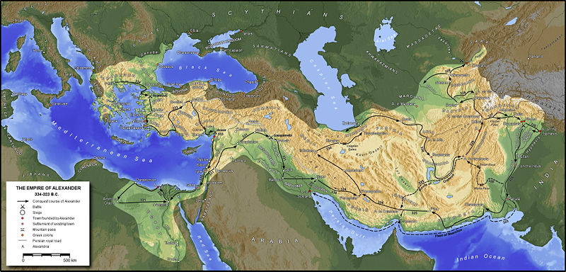
ALEXANDER THE GREAT EMPIRE

Slide 21
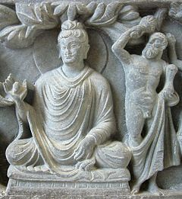
AN EXAMPLE OF GREEK CULTURE AND ART COMBINED WITH EASTERN PHILOSOPLY “GRECO-BUDDHISM” 2ND CENTURY BCE

Slide 22
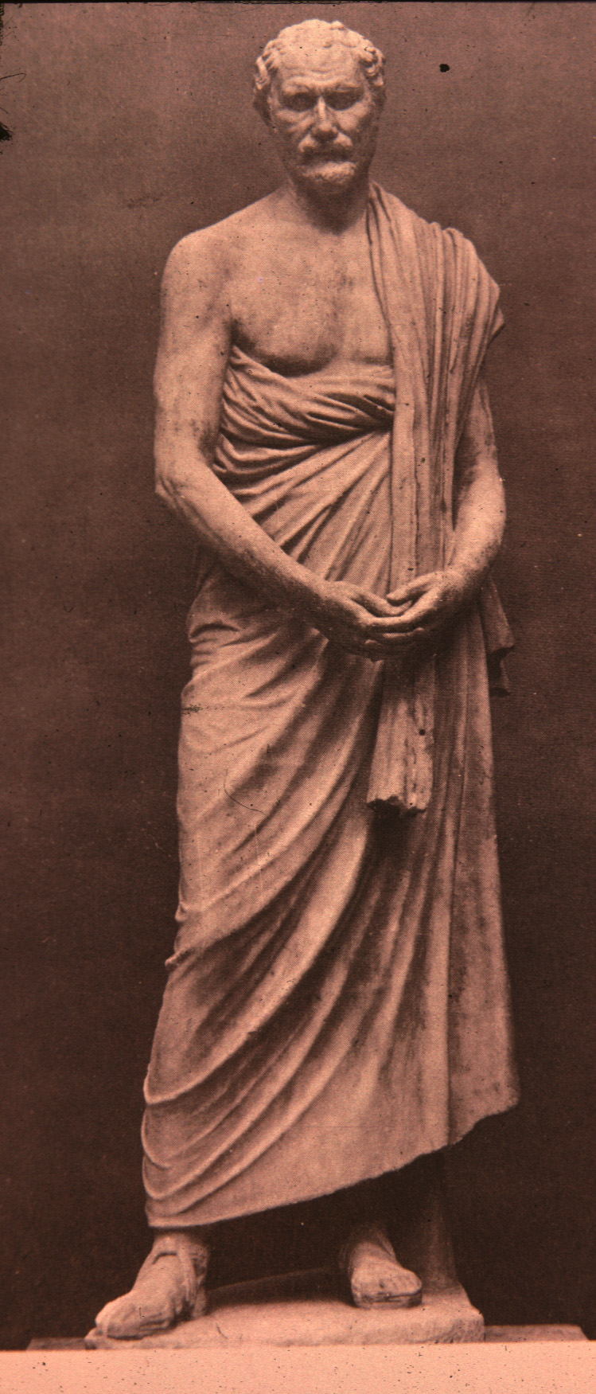
HELLENISTIC PERIOD STATUE OF DEMOSTHENS (GREAT ORATOR) 280 BC

Slide 23
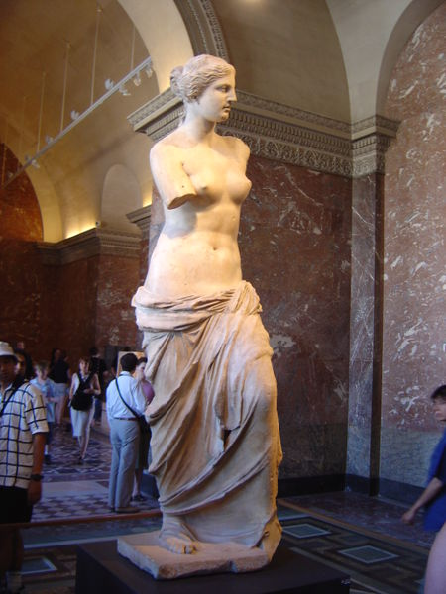
HELLENISTIC PERIOD VENUS DE MILO 130 BCE LOUVRE, PARIS

Slide 24
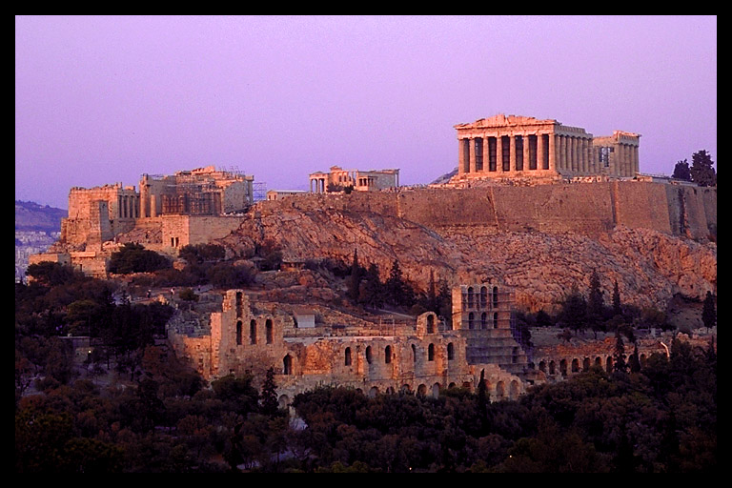
ATHENS, GREECE: ACROPOLIS

Slide 25
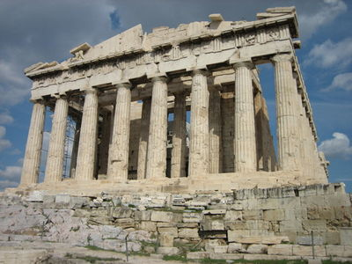
PARTHENON ON THE ACROPOLIS

Slide 26
GREEK ARCHITECTURE KNOWN FOR: 1. POST AND LINTEL CONSTRUCTION 2. SYMMETRY AND AXIAL LAYOUT 3. ADJUSTMENTS FOR VISUAL PERCEPTION 4. USE OF ORDERS 5. COLONADES 6. HIGH RELIEF SCUPTURES IN PEDIMENTS 7. TRUSS FORMS FOR ROOF 8. USE OF HUMAN FIGURES AS COLUMNS 9. VISUAL HARMONY AND PROPORTION

Slide 27
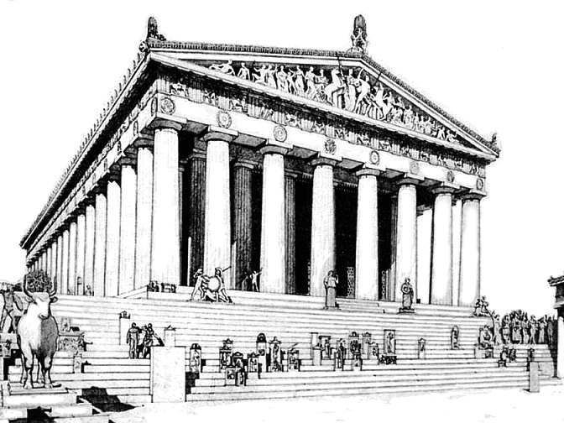
ATHENS, GREECE: ACROPOLIS PARTHENON, 438 BCE

Slide 28
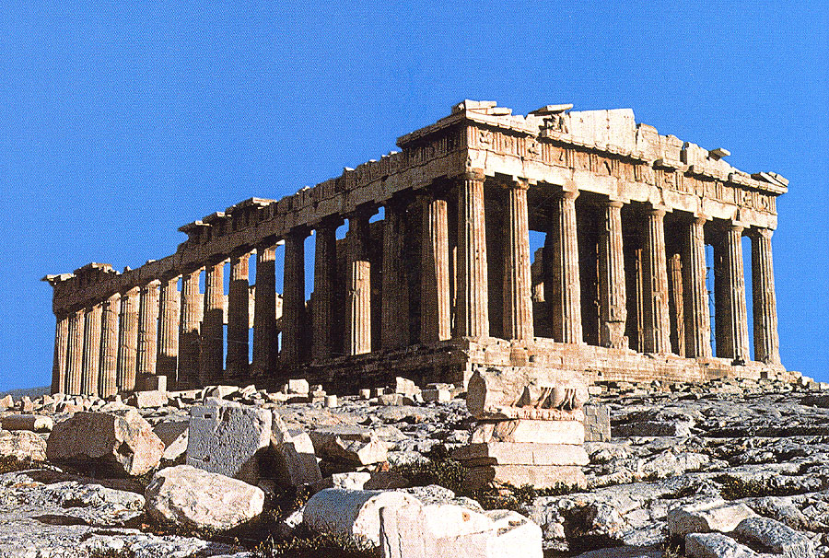

Slide 29
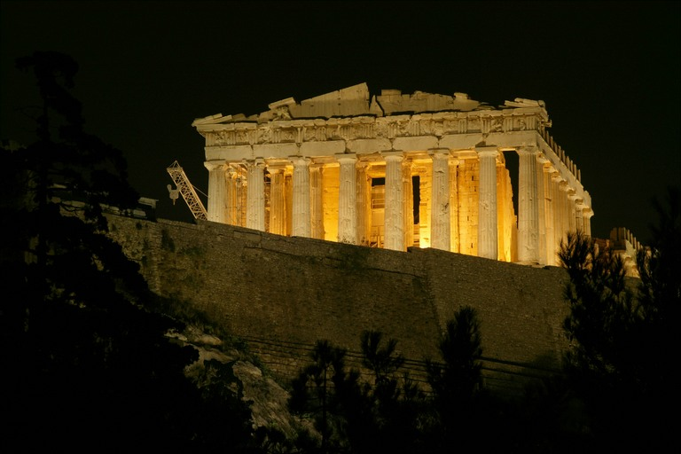

Slide 30
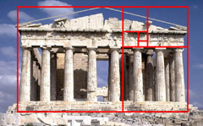
The Golden Ratio “Phi” in the design of the Parthenon. Phi named for Phidias the sculptor of the Parthenon frieze

Slide 31
Parthenon Frieze Panels Classical Greek, 438 BCE

Slide 32
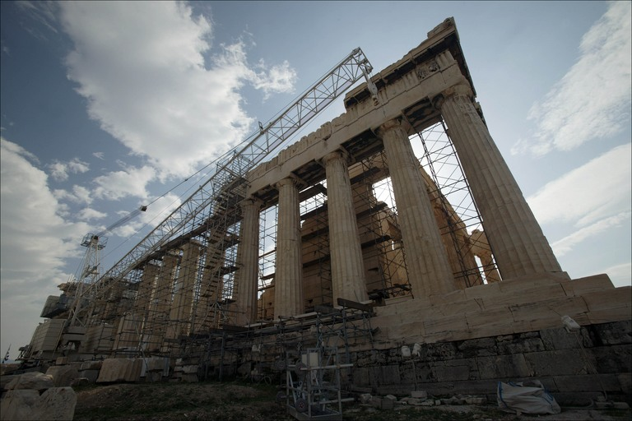

Slide 33
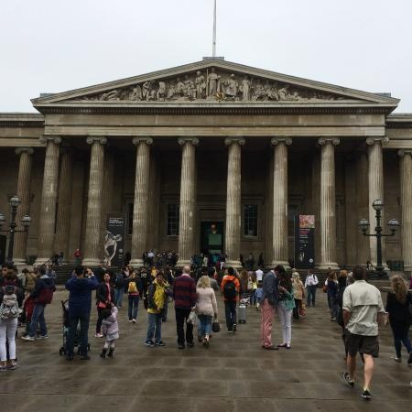
THE BRITISH MUESUM - CURRENT HOME OF THE “ELGIN MARBLES”

Slide 34
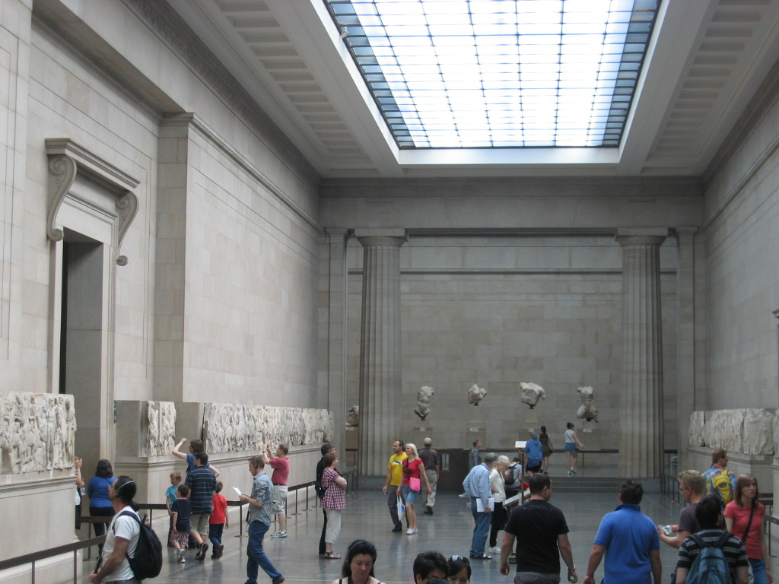

Slide 35
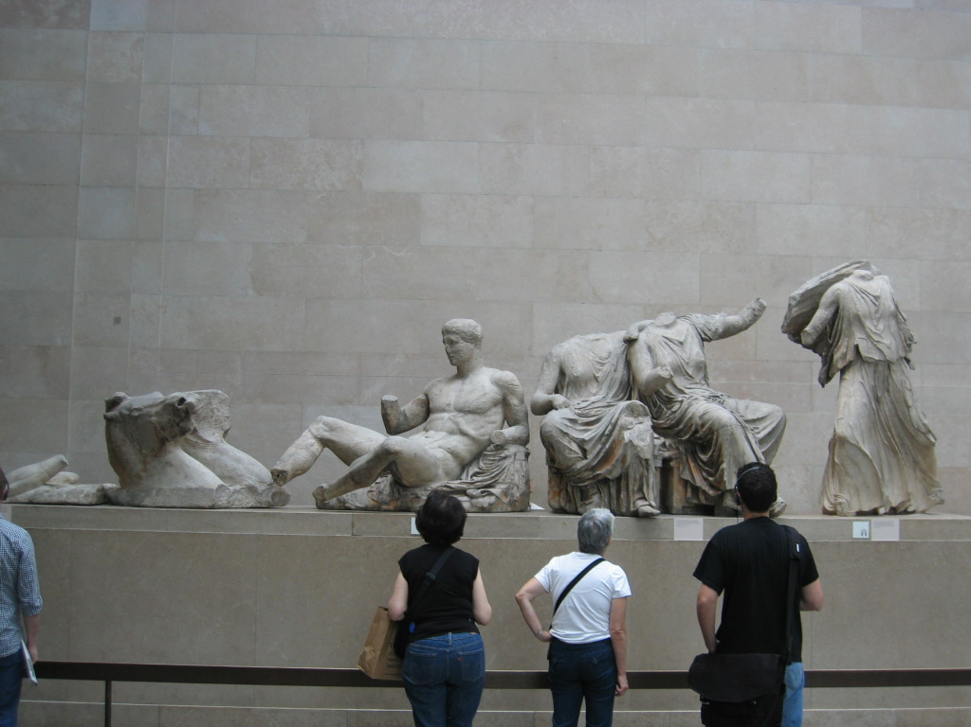

Slide 36
PBS NOVA “SECRETS OF THE PARTHENON” BEGINNING TO 6:28 http://www.pbs.org/wgbh/nova/parthenon/program.html

Slide 37
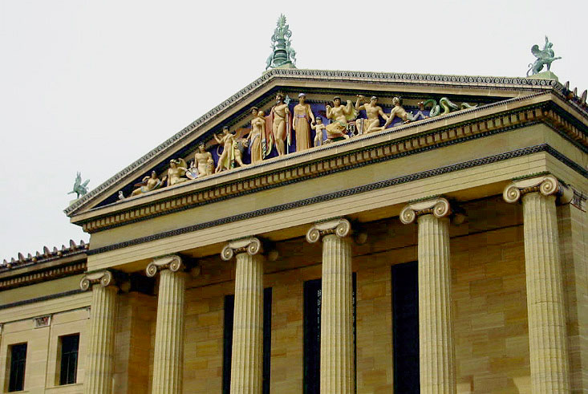
PHILADELPHIA MUSEUM OF ART, 1876

Slide 39
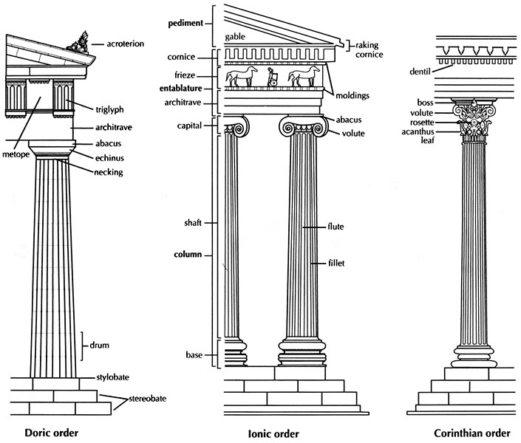

Slide 40
DORIC ORDER: SIMPLEST OF ALL GREEK ORDERS

Slide 41
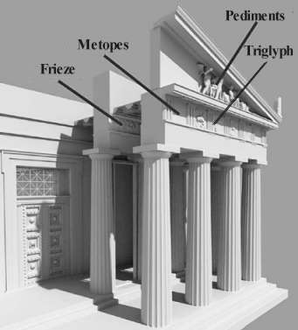

Slide 42
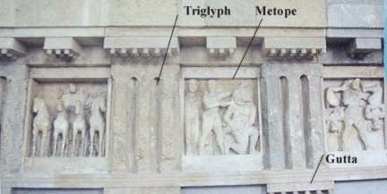

Slide 43
IONIC ORDER:

Slide 44
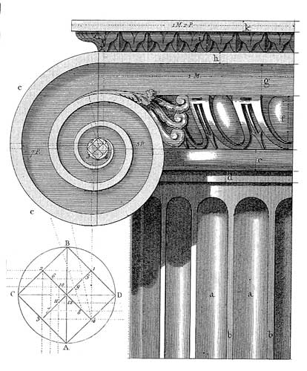
IONIC ORDER: CAPITOL TOPPED WITH VOLUTE AND EGG & DART DETAILS

Slide 45
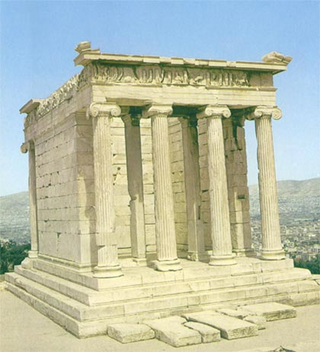
TEMPLE OF ATHENA NIKE ACROPOLIS, ATHENS, GREECE

Slide 46
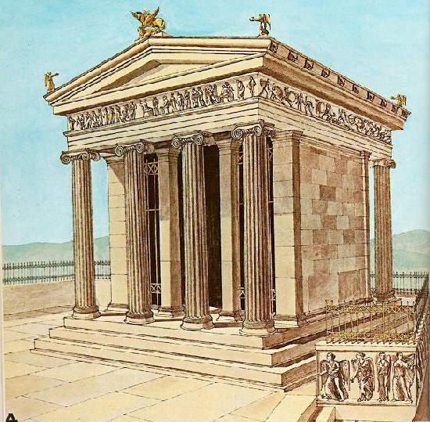

Slide 47
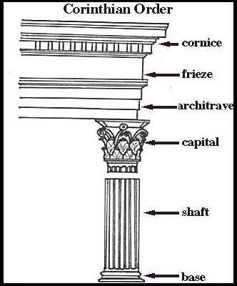

Slide 48
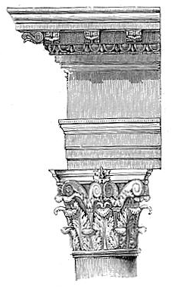
CORINTHIAN ORDER: LATE GREEK & ROMAN

Slide 49
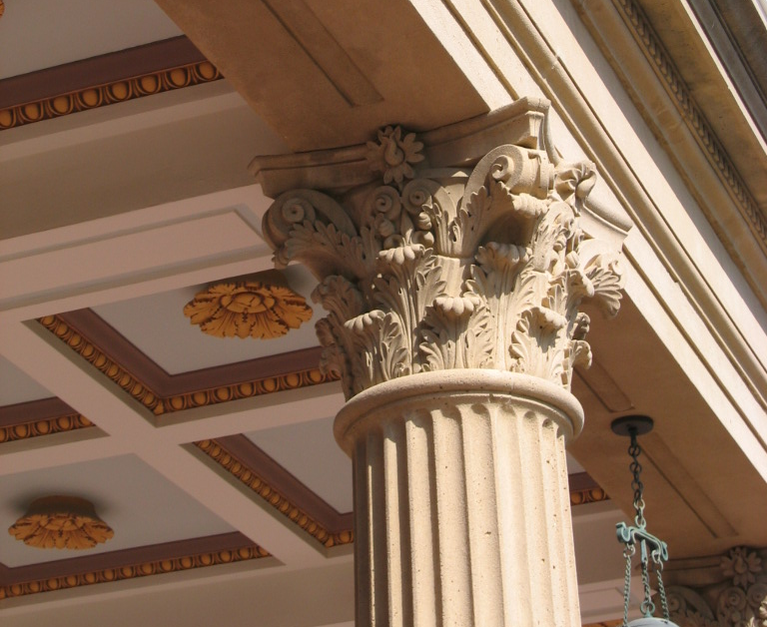

Slide 50
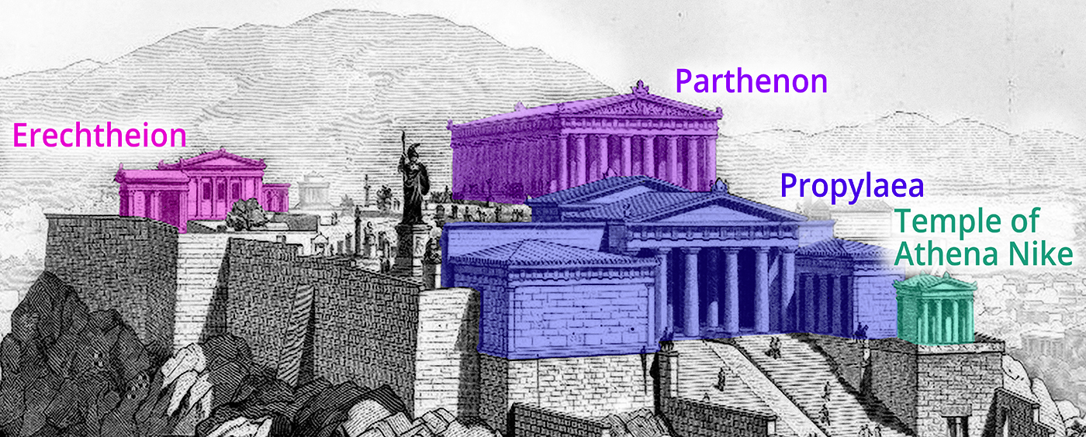

Slide 51
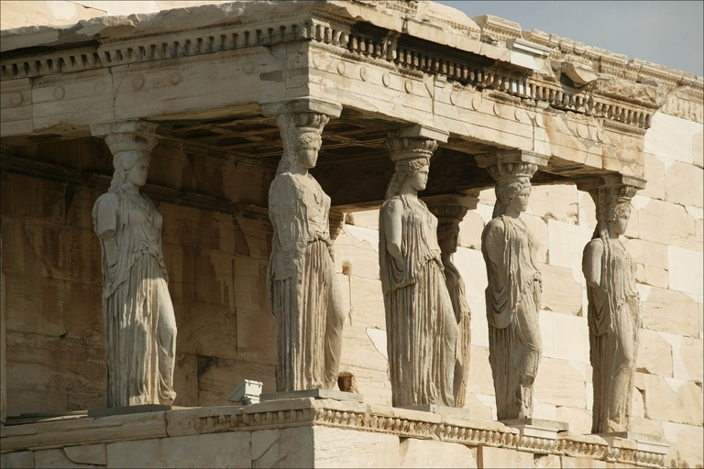
ERECHTHEUM 421 TO 405 BC CARYATID

Slide 52
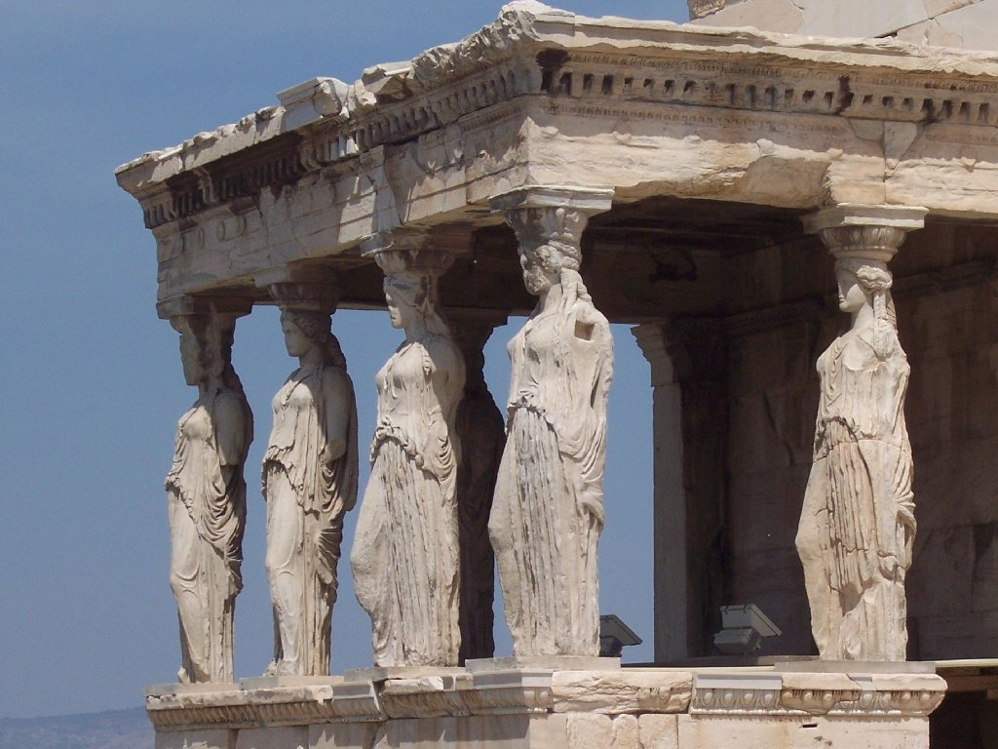
CARYATIDS ON ERECHTHEUM, ACROPOLIS, ATHENS, GREECE

Slide 53
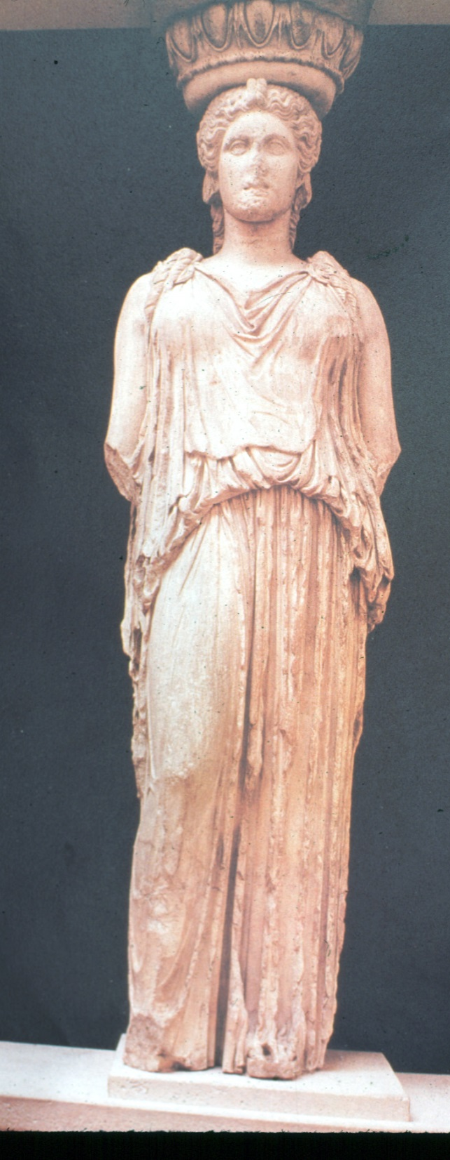
CLOSEUP DETAIL OF CARYATID “MAIDENS OF KARYAI” TEXT PAGE 58

Slide 54
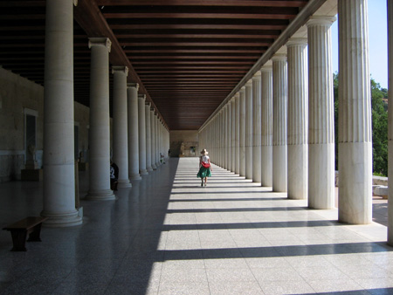
GREEK STOA (SHOPPING MALL) TEXT PAGE 59-60

Slide 55
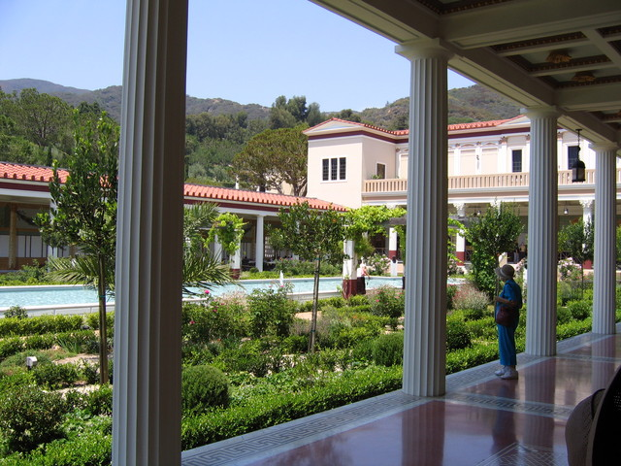
STOA COLONADE AT GETTY VILLA MUSEUM, MALIBU, CA

Slide 56
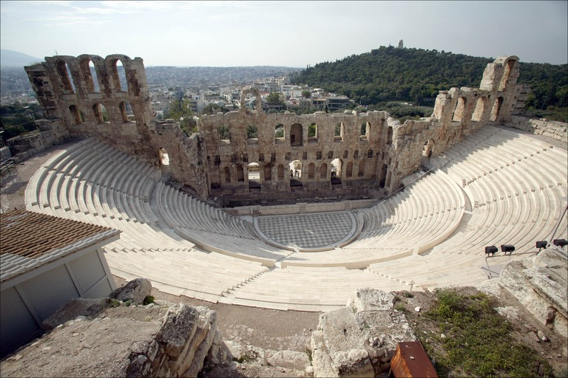
AMPHI-THEATER ACROPOLIS, ATHENS

Slide 57
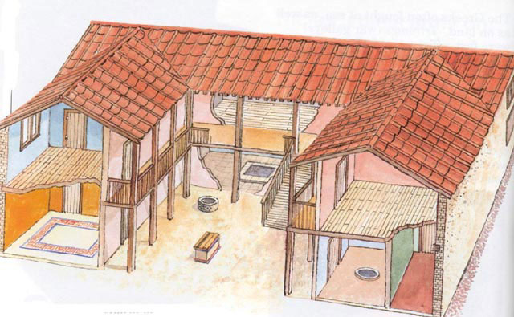
TYPICAL GREEK HOME; “ANDRON” ON LEFT, TEXT PAGE 59

Slide 58
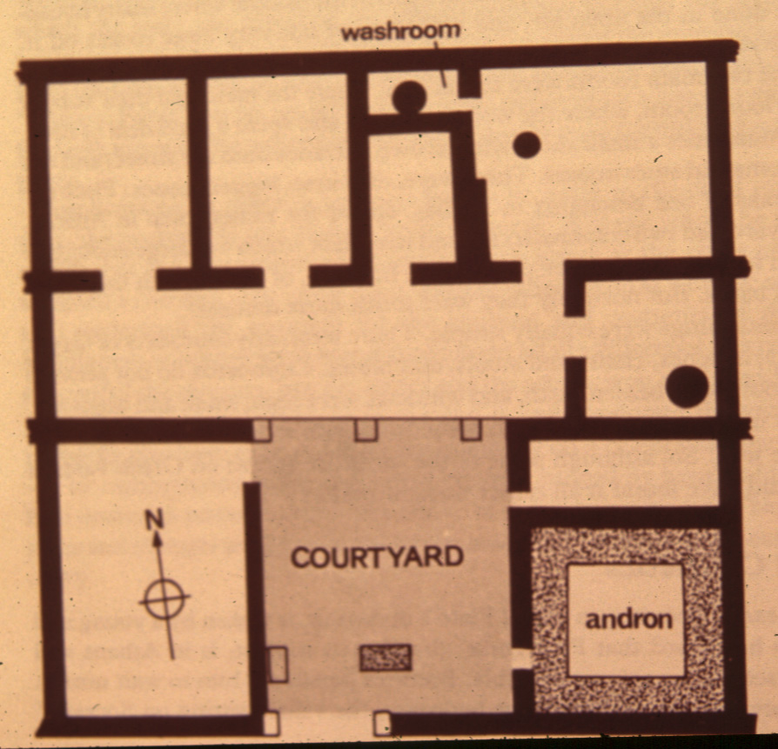
FLOOR PLAN OF MIDDLE CLASS HOUSE; ANDRON ON RIGHT

Slide 59
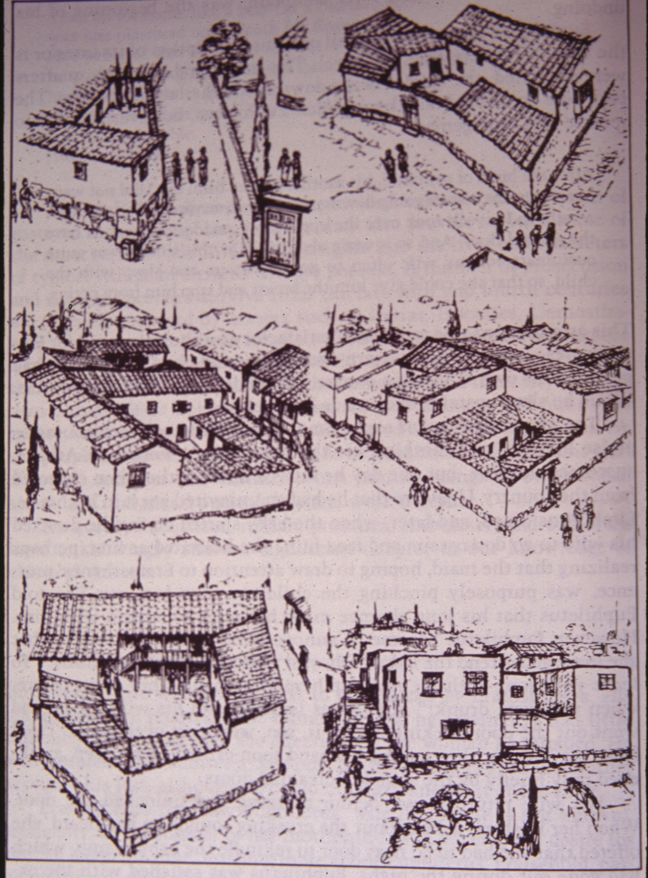
DRAWINGS OF GREEK MIDDLE CLASS HOUSES

Slide 60
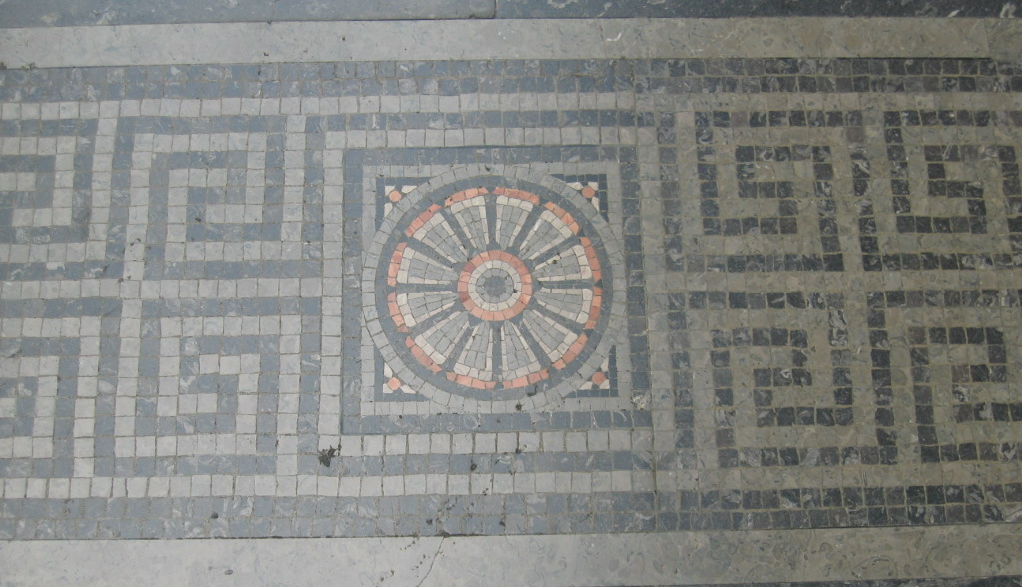
GREEK MOSAIC FLOORS: TESSERA(E) TINY CHIPS OF STONE, GLASS OR CERAMICS TEXT PAGE 64

Slide 61
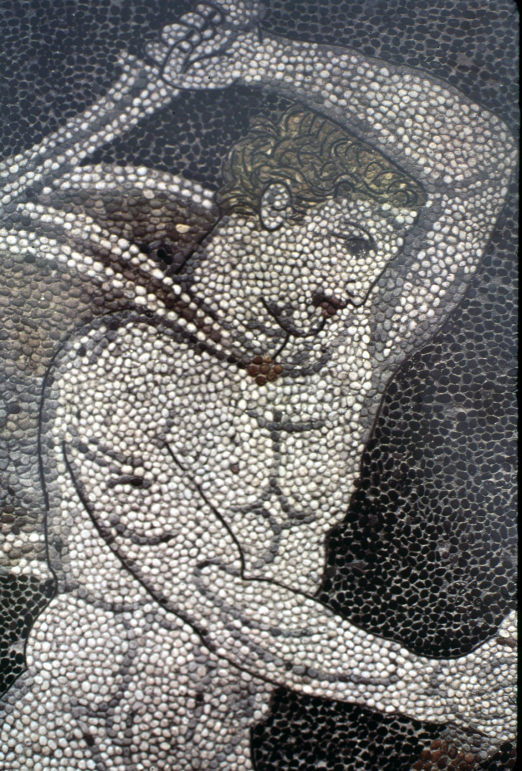
DETAIL GREEK MOSAIC FLOORS

Slide 62
GREEK MOSAIC WALL PANEL “BOXERS”

Slide 67
ACANTHUS PLANT MOTIF REPRESENTS: CYCLE OF LIFE

Slide 68
ACANTHUS LEAF MOTIF, TEXT PAGE 57

Slide 70
MOTIFS: EGG& DART BEAD & REEL ANTHIMEON OR HONEYSUCKLE PAGE 66 & 67

Slide 71
“EGG & DART” SYMBOL OF “LIFE AND DEATH” TEXT PAGE 66

Slide 72
VARIATIONS: LEAF & DART

Slide 74
“BEAD & REEL” TEXT PAGE 67

Slide 75
ANTHEMION: HONEYSUCKLE OR PALMETTE

Slide 77
ANTIFIX (PEDIMENT TOPPER)

Slide 78
ANTEFIX

Slide 80
ANIMAL HEAD SPOUT DETAIL

Slide 81
ANTHEMION: HONEYSUCKLE OR PALMETTE, LION HEAD DOWNSPOUTS

Slide 82
FRET OR GREEK KEY TEXT PAGE 67

Slide 84
DENTIL TRIM (MEMORY PROMPT: TEETH)

Slide 85
U. S. SUPREME COURT WASH DC NOTE: DENTIL TRIM, CORINTHIAN CAPITALS, PEDIMENT, COLONNADE

Slide 86
GUILLOCHE PATTERN MOSAIC

Slide 87
PILASTER: WITH EGG & DART & ROSETTES

Slide 88
VOLUTE

Slide 90
ROSETTE

Slide 92
ROSETTE

Slide 93
GREEK COFFER CEILING

Slide 94
PEDIMENT

Slide 95
PEDIMENT

Slide 96
GREEK PERIOD FURNITURE THRONOS(I): SEAT OF HONOR KLISMOS(I) CHAIR: SABRE LEGS DIPHROS: 4-LEG STOOL DIHROS OKLADIAS: FOLDING “X” STOOL W/ ANIMAL LEGS KLINE(I) BED: TURNED LEGS W/ FULCRA HEADBOARD TRAPEZA: 3 WOOD OR BRONZE LEGS KIBOTOS: WOODEN STORAGE CHEST

Slide 97
THRONOS GREEK THEATER CHAIR 400 - 300 B.C. MARBLE GETTY VILLA, MALIBU

Slide 98
KLISMOS CHAIR INTRODUCED CIRCA 5TH CENTURY BC FUNERARY PLAQUE

Slide 100
GREEK VASE PAINTING OF KLISMOS CHAIR

Slide 101
GREEK KLISMOS CHAIR IN MARBLE ON DISPLAY AT GETTY VILLA, MALIBU, CA

Slide 102
KLISMOS SIDE CHAIRS

Slide 103
T. H. ROBSJOHN-GIBBINGS (1905-1976) BRITISH http://www.architonic.com/mus/8101373/1

Slide 105
KLISMOI (PLURAL) CHAIR

Slide 107
KLISMOS CHAIR 18TH CENTURY “NEO” CLASSICAL (REVIVAL)

Slide 108
CONTEMPORARY SETTING

Slide 109
GREEK 4-LEGGED STOOL “DIPHROS”

Slide 110
GREEK STOOL “DIPHROS”

Slide 111
GREEK 4 LEGGED STOOL “DIPHROS”

Slide 112
SABER LEG, MORTISE & TENON JOINT

Slide 113
DRAWING ON VASE SHOWING TRAPEZA, & DYPHROS OKLADAIS X-STOOL

Slide 115
“DIPHROS OKLADIAS”

Slide 116
DIPHROS OKLADAIS WITH DEER HOOF FEET

Slide 117
PAINTING ON PLATE OF GUEST & MUSICIAN “KLINE” (BED)WITH “TRAPEZA” “TABLE” BENEATH

Slide 118
WHEN INVITED TO PARTIES, GUEST’S SERVANTS WENT AHEAD WITH KLINE (BED) & TRAPEZA (TABLES)

Slide 119
KLINE WITH BRONZE TURNED LEGS & FULCRUM HEADBOARD / ARMREST

Slide 120
FULCRUM ON GREEK KLINE OR ROMAN LECTUS (HEADBOARD OR ARMREST)

Slide 121
PAINTING ON VASE SHOWING TRAPEZA & DYPHROS OKLADAIS X-STOOL

Slide 122
MODERN REPRODUCTION “TRAPEZA” (TABLE) WITH WALNUT TOP, BRONZE LEGS & ANIMAL PAW FEET

Slide 123
TRAPEZA (TABLE) (CONTEMPORARY REPRODUCTION)

Slide 125
“TRAPEZA” (TABLE) 3 LEGGED RECTANGULAR WITH STRETCHERS

Slide 126
VASE PAINTING OF GREEK WOMEN AT 3-LEGGED TRAPEZA (TABLE) WITH DEER HOOF FEET

Slide 128
MODERN TABLES WITH GREEK INFLUENCE

Slide 129
KIBOTOS OR LARNAX (STORAGE CHEST, BOX, COFFER, OR COFFIN)

Slide 130
KIBOTOS OR LARNAX (CHEST) WITH POLYCHROME PAINT

Slide 131
GREEK WOMEN FOLDING CLOTHING FOR STORAGE

Slide 132
FUNERARY KIBOTOS OR LARNAX GOLD SHEETS OVER WOOD, P. 64

Slide 134
GREEK BLACK & RED CERAMIC VASES http://www.youtube.com/watch?v=qlxsE_KOvbE&feature=player_embedded#

Slide 135
GREEK LADIES TRANSPORTING WATER

Slide 137
BLACK FIGURE POTTERY ON LEFT RED FIGURE POTTERY BELOW

Slide 141
GREEK DRINKING CONTAINER OF APHRODITE

Slide 142
GREEK FIGURE HOLDING OIL BRAZIER (LIGHT FIXTURE)

Slide 143
GREEK BRONZE AMPHORA WITH HANDLES

Slide 144
GREEK BRONZE KRATER WITH HANDLES AND FIGURE

Slide 145
GREEK HELLENISTIC PERIOD GILT BRONZE GREEK VASE

Slide 146
FIGURE DETAIL OF VASE HANDLE

Slide 147
GREEK INCENSE BURNER

Slide 148
GREEK HAND MIRROR: ONE SIDE POLISHED

Slide 149
GREEK HAIR ORNAMENT

Slide 150
GREEK SIGNET RING

Slide 151
ANCIENT GREEK PROCESSION SHOWING COLORS OF FRESCO

Slide 152
GREEK COLOR EARTHY REDS & YELLOWS: CRUSHED IRON OXIDE MINERALS TERRA COTTA: NATURAL CLAYS MEDIUM BLUES & GREENS: CRUSHED MINERALS PURPLE: CRUSHED SEA SHELLS GOLD LEAFING APPLIED TO MARBLE & BRONZE

Slide 153
APPLICATION OF COLOR TO ARCHITECTURE, INTERIORS AND SCULPTURE

Slide 154
CORINTHIAN ORDER (COLOR APPLIED)

Slide 156
HOW A GREEK STATUE LOOKED WITH COLOR APPLIED

Slide 157
HOW A GREEK STATUE LOOKED WITH COLOR APPLIED

Slide 158
HEAD OF A GOD, GREEK 325 B.C. TERRACOTTA AND PIGMENT

Slide 159
PHILADEPHIA MUSEUM WITH COLORED PEDIMENT

Slide 160
REPRODUCTION OF ATHENA FROM THE GREEK PARTHENON NASHVILLE, TN GILDED WITH IVORY

Slide 161
GREEK TEXTILES: WOOL: NATURAL COLOR FROM SHEEP DYED PURPLE FROM SHELLFISH IMPORTED TEXTILES: SILK, COTTON & LINEN: EMBROIDERED WITH GOLD THREADS AND BORDERS DYE PIGMENTS FROM NATURAL MINERALS AND PLANTS

Slide 162
TEXTILES: CLASSICAL GREEK APPAREL LIGHT NEUTRAL AND NATURAL COLOR USED AS ACCENTS

Slide 163
GREEK TEXTILE 500 BCE WOOL FRAGMENT

Slide 164
TYPICAL GREEK WOODS: BEECH CITRUS MAPLE OAK WILLOW INLAYS OF EBONY & IVORY & SEMI-PRECIOUS STONES

Slide 165
IN 146 BCE THE ROMANS OCCUPIED GREECE AND ADOPTED MANY GREEK AESTHETICS IN ART AND ARCHITECTURE.

Slide 166
THE ETRUSCANS 1,200-300 BC DNA PROVES THEY ARRIVED IN TUSCANY FROM TURKEY (LYDIA) (FALL OF TROY?)

Slide 167
ETRUSCANS USED BARREL ARCHES WHICH ROMANS LATER ADAPTED AS AN ESSENTIAL ELEMENT OF THEIR ARCHITECTURL ACHIEVEMENTS

Slide 168
TUSCAN COLUMNS
TUSCAN ORDER DETAILED IN PALLADIO’S BOOKS ON ARCHITECTURE
ST. PAUL’S CHURCH, LONDON BY INIGO JONES MODELED AFTER ETRUSCAN TEMPLES DESCRIBED IN VITRUVIUS’S BOOKS ON ARCHITECTURE.

Slide 169
ETRUSCAN COLUMNS, ARCHED GATEWAYS, PRIVATE VILLAS WITH ATRIUMS AND IMPLUVIUMS , LARGE TEMPLES ON RAISED PLATFORMS ARE SOME OF THE ETRUSCAN ARCHITECTURAL FEATURES WHICH ROMANS LATER ADOPTED.

Slide 170
ETRUSCAN TOMBS LEFT BEST CLUES ABOUT THE CULTURE’S CUSTOMS AND AESTHETICS

Slide 171
ETRUCSCAN CERAMIC FUNERARY IMAGE OF DECEASED

Slide 172
FRESCOS FROM TOMBS IN TARQUINA

Slide 173
ETRUSCAN BRONZE

Slide 174
“BUCCHERO WARE” POTTERY BY ETRUSCANS USING A DARK GLOSSY FINISH TO IMITATE BRONZE, A VALUED TRADE COMMODITY

Slide 176
ROMANS CAPTURED THE ETRUSCAN SETTLEMENT OF VEII IN 396 BC WHICH BEGAN THE PROCESS OF ASSIMILATION INTO ROMAN CULTURE.

Slide 177
FASCES
AN ETRUSCAN SYMBOL SIGNIFYING UNITY. THAT A SINGLE ROD IS EASILY BROKEN YET BUNDLED TOGETHER THEY ARE STRONG. USED BY ROMANS AS A SIGN OF POWER AND BY LATER GOVERNMENTS. ALSO USED BY ITALIAN FASCISTS IN WWII. (WHERE THE WORD FASCISM ORGINATES)

Slide 178
ROMANS 509 BC – 476 AD ROMAN TECHNOLOGY IN ROADS, BRIDGES, LIGHTHOUSES, WATER SUPPLIES, SEWAGE AND HEATING SYSTEMS AND BUILDING INNOVATIONS HELP THEM BUILD A VAST EMPIRE OF CIVIC IMPROVEMENTS.

Slide 179
POMPEII ITALY A RESORT CITY CIRCA 78 AD

Slide 180
POMPEII & HERCULANEUM BURIED BY ERUPTIONOF MOUNT VESUVIUS, 79C.E.

Slide 181
POMPEII FORUM, 700 BC TO 78 AD

Slide 182
Sebastian Pether , 1824, “Eruption of Vesuvius” Museum of Fine Arts, Boston

Slide 183
FORUM AT POMPEII TODAY (MT. VESUVIUS BACKGROUND)

Slide 184
DISCOVERY OF RUINS OF POMPEII 1748

Slide 185
POMPEII’S EXCAVATED COLOSEUM RUINS

Slide 187
ROMAN STYLE BORROWED FROM GREEK AND EMBELLISHED

Slide 188
ROMAN BRICK STACKED DIAGONALLY THEN PLASTERED GREEKS STACKED MARBLE “DRUMS”

Slide 189
PLASTER COVERED BRICK COLUMNS AT POMPEII

Slide 190
ROMAN BRICK TEXT PAGE 77 (CESAR’S PALACE CAFÉ, LAS VEGAS

Slide 191
POMPEII HOME RECREATION, 78 C.E.

Slide 192
POMPEII: CENTRAL ATRIUM WITH COLLECTION POOL LOOKING BEYOND TO “PERISTYLE”

Slide 193
RUINS OF “HOUSE OF FAUN” POMPEII, REMAINS OF ATRIUM POOL

Slide 194
VIRTUAL RECREATION OF POMPEII INTERIOR

Slide 196
POMPEII: HOME “PERISTYLE” CONTAINED THE OUTDOOR KITCHEN GARDEN HERBS & SPICES

Slide 198
POMPEII PRESERVED INTERIOR WALL FRESCO(ES)

Slide 202
ANCIENT MOSAICS FROM POMPEII & HERCULAEMUM

Slide 203
PAGE 91

Slide 204
GETTY VILLA MALIBU, CA MOSAIC NICHE FOUNTAIN

Slide 206
GETTY VILLA, MALIBU, CA

Slide 207
GETTY VILLA, MALIBU, CA ORIENTATION VIDEO History of the Getty Villa This film describes the history, collections, and setting of the Getty Villa. START TO 3:38 http://www.getty.edu/visit/index.html

Slide 208
MYTHOLOGY OF ROME

Slide 209
ROME, ITALY TIMELINE PAGE 74 EARLY ROME: 753-386 BCE REPUBLICAN ROME: 386-44 BCE EARLY EMPIRIE: 44 BCE-50 CE HIGH EMPIRE: 50-250 CE DECLINE OF ROME: 250-550 CE

Slide 210
ANNENBERG MEDIA “ART OF THE WESTERN WORLD” ‘THE CLASSICAL IDEAL’ ROMAN EMPIRE (26:25 TO 47:30) http://www.learner.org/resources/series1.html?pop=yes&pid=228

Slide 211
BRONZE (ALLOY COPPER & TIN)

Slide 212
STATE OF TABERIUS ROBES OF A SENATOR

Slide 213
CEASAR & SENATORS’ ROBES

Slide 214
WOMEN’S COSTUME OF THE NOBLE CLASS

Slide 215
ROMAN FOOT SOLDIER

Slide 216
MILITARY GENERAL’S UNIFORMS. (NOTE TYRIAN PURPLE)

Slide 217
DETAIL DRAWING OF ROMAN ARCH BARREL VAULT TEXT PAGE 84 & 85

Slide 218
ROMAN ARCH WITH KEYSTONE

Slide 219
TERMAE PUBLIC BATHS OF POMPEII HALF DOME “APSE”

Slide 220
ROMAN AQUEDUCT

Slide 221
GREAT ROMAN AQUEDUCTS OF SEGOVIA, SPAIN, BUILT 100 CE

Slide 222
SYMBOL OF ROMAN EMPIRE 94’ TALL, 20 MILES LONG

Slide 226
ROMANS GAVE BRICK & CONCRETE CONSTRUCTION TECHNOLOGY TO THE WORLD BRICK WALL COVERED WITH PLASTER

Slide 227
RUINS OF TRAJAN’S FORUM & TRAJAN’S MARKET TODAY ROME

Slide 228
EMPORER TRAJAN BUILT THE TRAJAN’S FORUM, ROME 113 AD

Slide 229
“STOA” AT TRAJAN’S FORUM, ROME 113 AD, PAGE 83

Slide 230
BASILICA ULPIA AT TRAJAN’S FORUM, ROME 113 AD, PAGE 83

Slide 231
EMPORER TRAJAN BUILT THE LIBRARY AT TRAJAN’S FORUM, ROME 113 AD

Slide 232
TRAJAN’S COLUMN

Slide 233
DACIAN DRACO MOTIF ON TRAJAN’S COLUMN

Slide 234
DETAIL TEMPLE OF CONCORDIA, ROMANUM FORUM, ROME

Slide 235
RUINS OF ROMAN FORUM
ROME

Slide 236
PANTHEON, ROME, 120 CE

Slide 237
142’ DIAMETER UNSUPPORTED DOME, ROMAN CONCRETE TEXT PAGE 80

Slide 238
142’ DIAMETER UNSUPPORTED DOME, ROMAN CONCRETE

Slide 239
“COFFERED” DOMED CEILING OF PANTHEON, ROME WITH 27’ DIA. OCCULUS

Slide 240
ROMAN PANTHEON WAS DEDICATED TO HONORING ALL THE ROMAN GODS

Slide 241
REPRODUCTION OF COFFERED CEILINGS AT GETTY VILLA

Slide 242
TYPICALLY, THE ROMAN CATHOLIC CHURCH WOULD TAKE OVER ALL ROMAN BUILDING AND CONVERT THEM TO CATHOLIC CATHEDRALS

Slide 243
MARBLE PANELS, PANTHEON, ROME, 120 CE

Slide 244
ROMAN BATHS OF CARACALLA, 212 CE DESTROYED BY INVADERS, 600 CE

Slide 245
ROMAN BATHS OF CARACALLA, 212 CE INSPIRED DESIGN OF PENN STATION, NYC

Slide 246
“THERMAE” PUBLIC BATHS OF ROME, PAGE 82

Slide 247
“THERMAE” “ROMAN BATHS” BATH, UK

Slide 248
ROMAN DOMUS (HOME)

Slide 249
DETAILS IN TEXT, PAGE 84

Slide 250
ROMAN HOUSE WITH CENTRAL ATRIUM AND PERISTYLE

Slide 251
ROMAN INTERIOR ATRIUM

Slide 252
ROMAN “ATRIUM” WITH WATER COLLECTION POOL AT GETTY VILLA

Slide 253
“PERISTYLE” KITCHEN GARDEN GETTY VILLA MUSEUM, MALIBU, CA

Slide 254
ROMAN HOME “BASILICA” PERSONAL CHAPEL TO HONOR GODS

Slide 255
VITRUVIUS DE ARCHITECTURA

Slide 257
CLASSICAL ROMAN DETAILS: DECORATIVE ORNAMENTATION & MOTIFS TEXT PAGE 79

Slide 258
IONIC ORDER

Slide 259
PILASTER (HALF COLUMN) IONIC ORDER

Slide 260
CORINTHIAN ORDER

Slide 261
PILASTER (HALF COLUMN) CORINTHIAN ORDER

Slide 264
“LAUREL WREATH” CONQUORER OR WINNER

Slide 265
MICHAEL PHELPS WITH “LAUREL WREATH” WINNER GREEK OLYMPICS

Slide 267
ROMAN; SCULL WITH FESTOON OR SWAG

Slide 268
ROMAN DECORATIVE MOTIF; FESTOON OR SWAG

Slide 269
ROMAN PALMETTE APPLIED TO ANTEFIX

Slide 270
ROMAN RINCEAU MOTIF: LIKE A GREEK GUILLOCHE WITH EXTRA ROSETTES & FOILAGE

Slide 271
ROMAN MARBLE MOSIAC FLOORS, GETTY VILLA, MALIBU, CA

Slide 272
ROMAN MARBLE MOSIAC FLOORS, GETTY VILLA, MALIBU, CA

Slide 273
ROMAN MARBLE MOSIAC FLOORS, GETTY VILLA, MALIBU, CA

Slide 274
ROMAN MOSAIC, GETTY VILLA, MALIBY, CA

Slide 275
CEILING FRESCO ORNAMEN-TATION “GROTESQUE” GROTTO- ESQUE AT GETTY VILLA

Slide 278
TROMPE L’OEIL “FOOL THE EYE”

Slide 279
TROMPE L’OEIL “FOOL THE EYE” GETTY VILLA, MALIBU, CA

Slide 280
“BAS (LOW) RELIEF” SCULPTURE

Slide 281
ROMAN FURNISHINGS SOLIUM: (THRONOS) CHAIR CATHEDRA: (KLISMOS) CHAIR WOVEN CANE CHAIRS SELLA CURULIS: (DIPHROS OKLADIES) CROSS LEG STOOL (POLITICAL POWER) LECTUS: (KLINE) ROMAN BED SEDAN (LETICA) TRIPODS: BRAIZER & BASINS CANDELABRA ROMAN GLASSWARE

Slide 283
SOLIUM THRONE CHAIR

Slide 285
CATHEDRA: DETAIL OF FUNERAL MEMORIAL CATHEDRA CHAIR IS GREEK KLISMOS

Slide 286
CATHEDRA: ROMAN VARIATION ON GREEK KLISMOS CHAIR U. S. SUPREME COURT, WASH. D.C.

Slide 287
EXAMPLE OF ROMAN WICKER BASKET CHAIR MADE FROM LOCAL REEDS

Slide 289
EXAMPLE OF ROMAN WICKER BASKET CHAIR MADE FROM LOCAL REEDS

Slide 290
SELLA CURULIS: SEAT OF POWER (GREEK: DIPHROS OKLAIDES)

Slide 291
SELLA CURULIS: ETRUSCAN NOBLEMAN SITTING ON FOLDING STOOL TEXT PAGE 98

Slide 292
SELLA CURULIS: SHOWN WITH CUSHION TEXT P. 93

Slide 293
SELLA CURULIS: SHOWN ON ROMAN COIN

Slide 295
15TH CENTURY ITALIAN RENAISSANCE VERSION: SELLA CURULIS

Slide 296
18TH & 19TH CENTURY STOOLS

Slide 297
CHAIR & STOOL OF TODAY INSPIRED BY “SELLA CURULIS”

Slide 298
ROMAN CUBICULUM (BEDROOM) POMPEII, ITALY

Slide 299
ROMAN LECTUS: BED OR COUCH GREEK IS KLINE, TEXT PAGE 100

Slide 303
FULCRUM ON GREEK KLINE OR ROMAN LECTUS (HEADBOARD OR ARMREST)

Slide 304
ROMAN BED WITH CUSHIONS & LINENS: LECTUS

Slide 305
ROMAN TRAVELING LECTUS BED, BRONZE

Slide 306
ROMAN LETICA (SEDAN CHAIR)

Slide 307
ROMAN MENSA WITH LECTUS

Slide 308
MONOPODIUM LEG

Slide 309
TRIPOD TABLE BASE; MONIPODUIM LEG

Slide 311
“CARTIBULUM” CEREMONIAL “MENSA” (TABLE) WITH MARBLE SUPPORTS GETTY VILLA MALIBU, CA

Slide 312
ROMAN CARTIBULUM, TEXT PAGE 99

Slide 313
TRIPOD: FOLDING BRONZE TABLE WITH A REMOVABLE TOP

Slide 314
ROMAN BRAIZER ON FOLDING STAND (CONTAINED HOT COALS FOR WARMTH)

Slide 315
ROMAN BRONZE TRIPOD TABLE (BRONZE= COPPER+TIN)

Slide 316
ROMAN BRAIZER ON FOLDING STAND (CONTAINED HOT COALS FOR WARMTH)

Slide 317
TODAY: BALLARD DESIGNS (FURNITURE CATALOG COMPANY)

Slide 318
ROMAN OIL LAMP

Slide 319
HANGING BRONZE OIL LAMP GETTY VILLA, MALIBU, CA

Slide 320
ROMAN CANDELABRA GETTY VILLA

Slide 321
ROMAN CANDELABRA

Slide 322
HADRIAN’S VILLA ROMAN MARBLE CANDELABRA

Slide 323
U S SUPREME COURT “CANDELABRA” WITH LIGHT BULBS

Slide 324
ROMAN BRONZE WINE JUGS GETTY VILLA, MALIBU, CA BRONZE= COPPER + TIN

Slide 325
ROMAN BRONZE WINE JUG

Slide 326
ROMAN GLASS WARE, GETTY VILLA

Slide 327
ROMAN GLASS WARE, GETTY VILLA

Slide 328
CARVED ROMAN GLASS CAGE CUP 300 CE TEXT PAGE 97

Slide 329
ROMAN CARVED GLASS LATER INSPIRATION TO JOSIAH WEDGEWOOD OF 1750 ENGLAND TEXT P. 384

Slide 330
ROMAN GLASS WARE, GETTY VILLA

Slide 331
PERFUME BOTTLES

Slide 332
ROMAN GLASS 25 BCE

Slide 333
THE END

