Slide 1
ID 108 HISTORY OF THE BUILT ENVIRONMENT 1
LECTURE #11
NEOCLASSICAL PERIOD

Slide 2
LATE NEOCLASSICAL PERIOD
LATE 18TH & EARLY 19TH CENTURY
FRANCE: DIRECTOIRE
& FRENCH EMPIRE (NAPOLEON)
ENGLAND: ADAM PERIOD
& ENGLISH REGENCY
AMERICAN: FEDERALISM (1776)
& AMERICAN EMPIRE

Slide 3
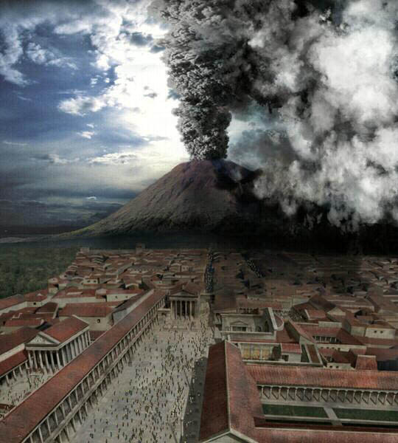
POMPEII & HERCULANEUM
BURIED BY ERUPTION OF MOUNT VESUVIUS
79C.E.

Slide 4
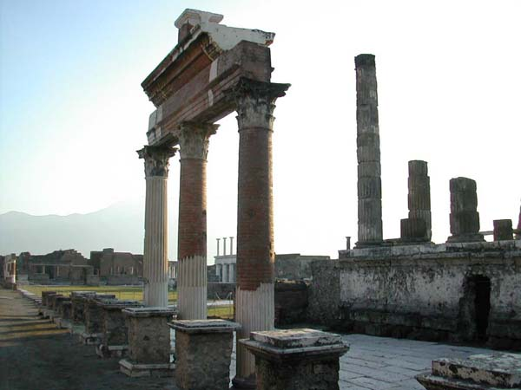
DISCOVERY OF RUINS OF HERCULANEUM
IN 1709
AND POMPEII IN 1748

Slide 5
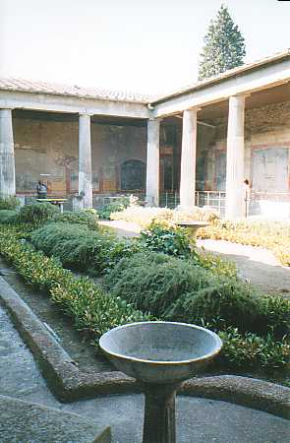
EXCAVATION OF HOMES IN POMPEII
BEGAN
1748
“PERISTYLE” OF ROMAN HOME WITH FOUNTAINS AND KITCHEN GARDEN

Slide 6
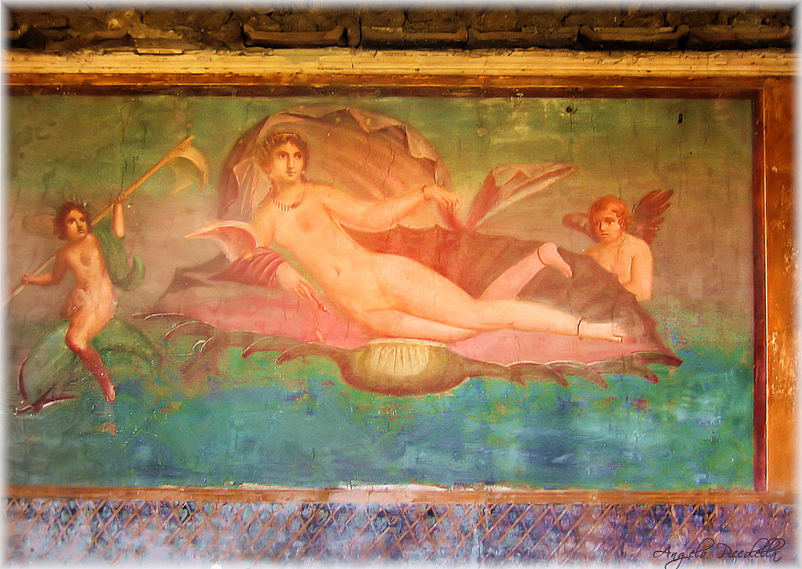
POMPEII: INTERIOR WALL FRESCO SHOWING VENUS

Slide 7
AN INTEREST IN ARCHEOLOGY, CLASSICAL ART AND PHILOSOPHY WAS IGNITED BY THESE DISCOVERIES AS PEOPLE FLOCKED TO VISIT THESE ANCIENT SITES.

Slide 8
NEOCLASSICAL DESIGN WAS ALSO A REACTION AGAINST BAROQUE AND ROCOCO STYLES THAT WERE CONSIDERED DECADEDANT AND OVER-WROUGHT. CLASSICAL CULTURES WERE IDEALIZED AND THEIR SUPPOSED “SIMPLICITY AND MORALITY” WERE REFLECTED IN THIS NEW STYLE.

Slide 9
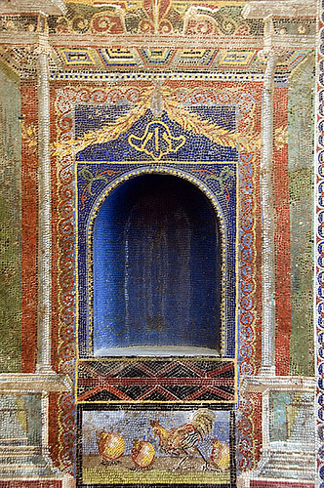
ANCIENT
MOSAIC
NICHES
FROM
POMPEII
&
HERCULANEUM

Slide 10
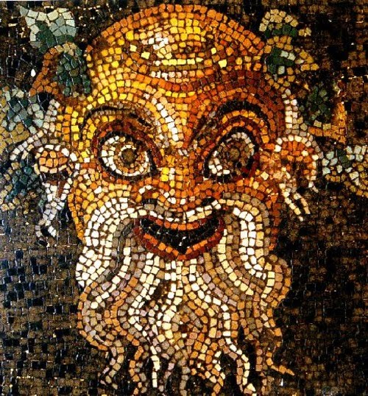
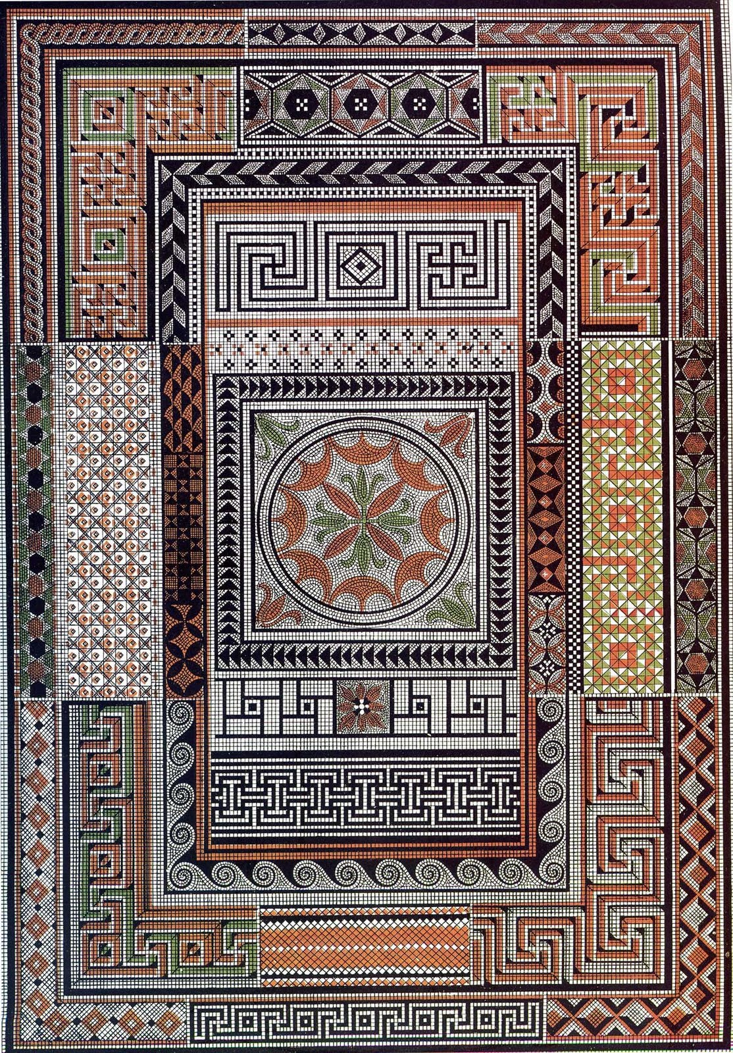
APPLICATION
OF MOSAICS
FROM
POMPEII

Slide 11
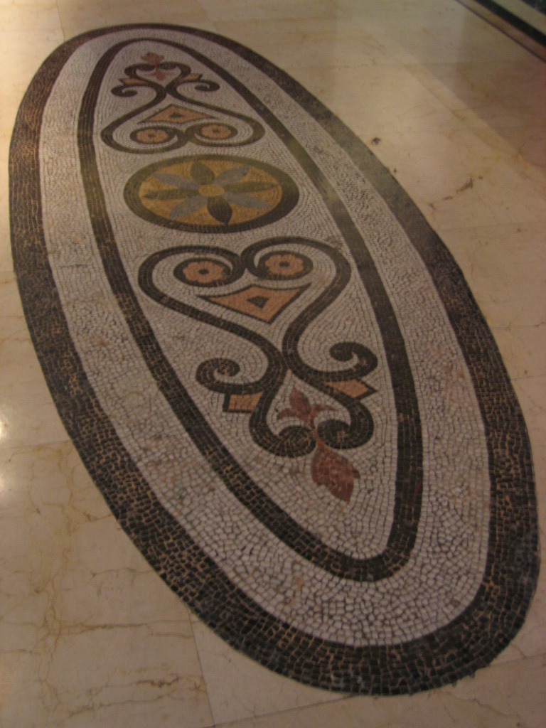
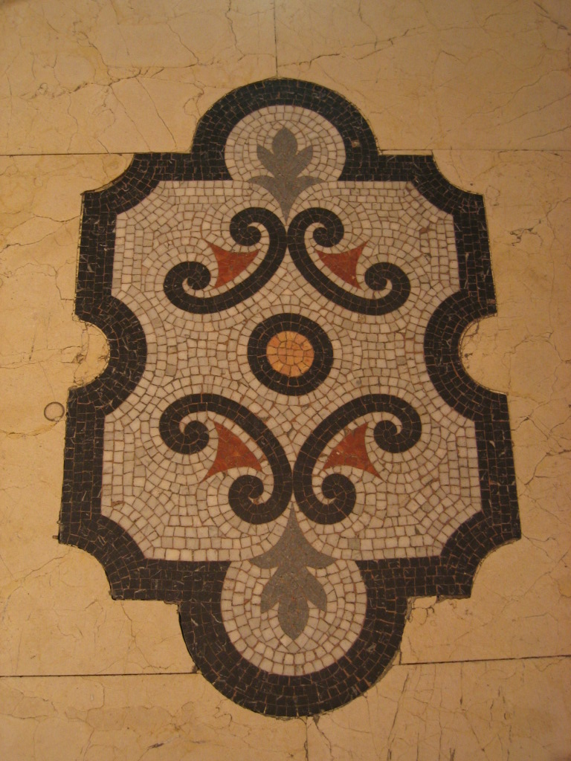
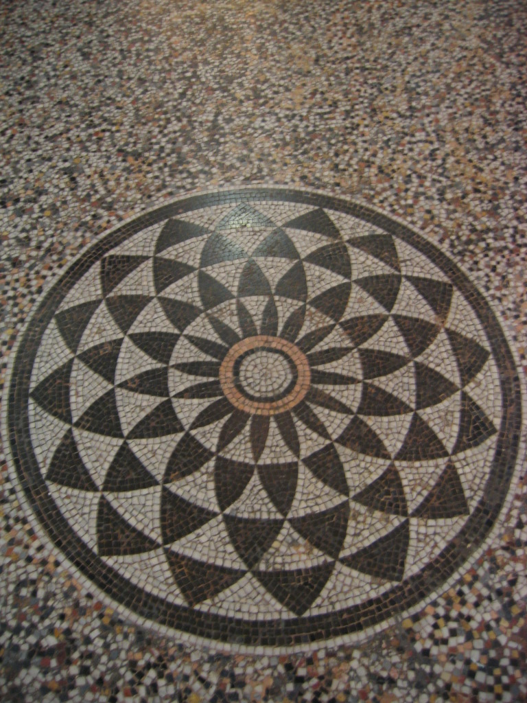
1778 NEOCLASSICAL
MOSAIC FLOORS

Slide 12
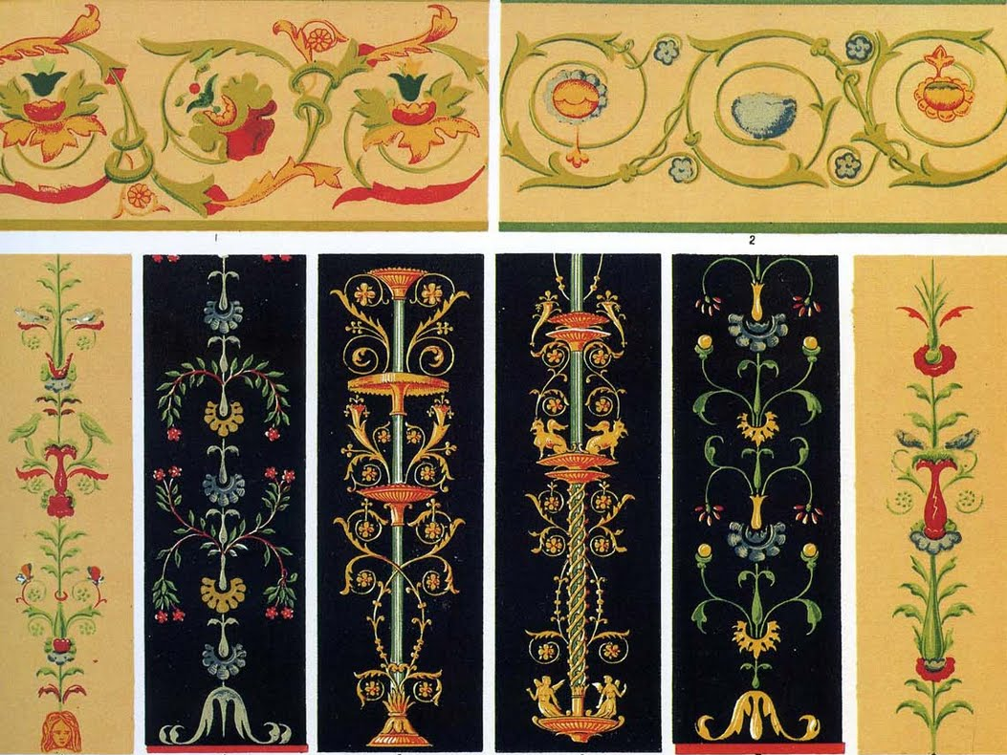
WALL AND CEILING FRESCO “GROTESQUE”
DETAILS FROM POMPEII

Slide 13
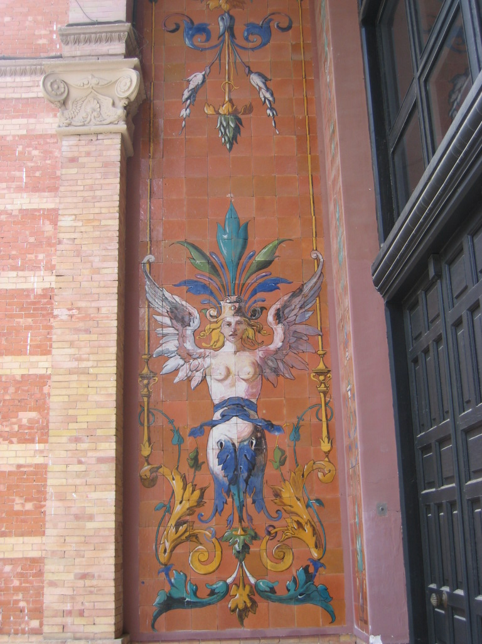
“GROTESQUE”
VERTICAL &
SYMMETRICAL.
FEATURING FANCIFUL
MYTHICAL
HUMAN,
AMIMAL &
FLORAL GARLAND FORMS

Slide 14
FRANCE
LOUIS XVI (1754-1793)
CROWNED KING 1774-1792
AT 15 HE MARRIED 14 YEAR OLD
MARIE ANTOINETTE,
(1755-1793)
1789 FRENCH REVOLUTION BEGINS
“STORMING OF THE “BASTILLE”
A FRENCH PRISON FOR ROYAL ENEMIES OF THE STATE

Slide 15
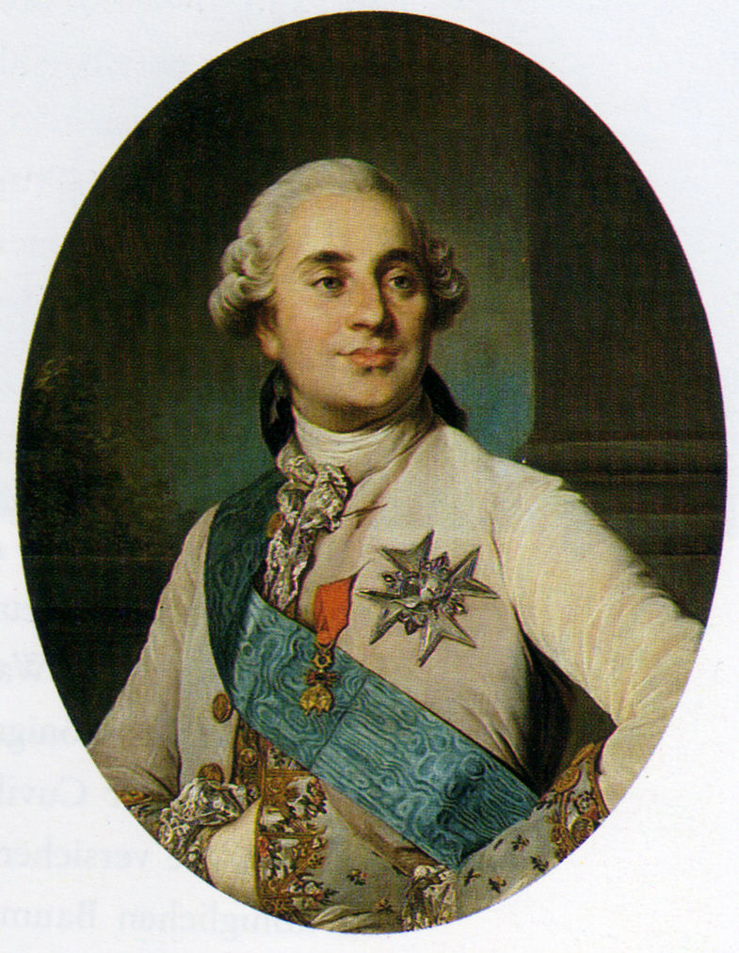
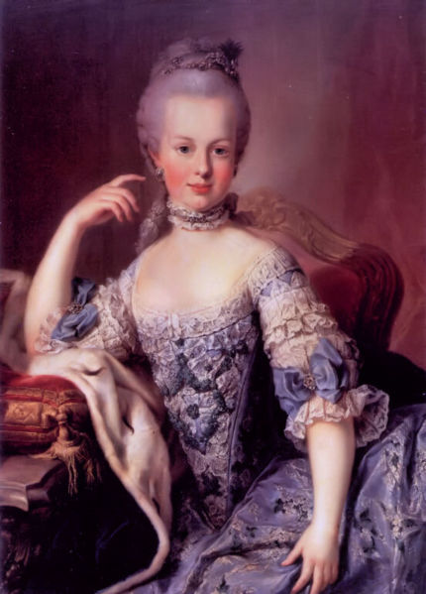
FRENCH
NEOCLASSICAL PERIOD:
KING LOUIS XVI , MARIE ANTOINETTE

Slide 16
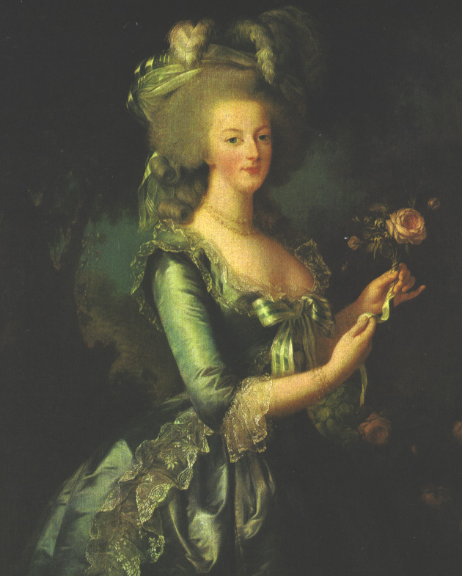
MARIE
ANTOINETTE
PAINTING BY ÉLISABETH VIGÉE
LE BRUN

Slide 17
SOCIAL INFLUENCES:
“AGE OF ENLIGHTENMENT”
JEAN JACQUES ROUSSEAU;
THE NATURAL STATE OF MAN
VOLTAIRE; PHILOSOPHER
& AUTHOR, RAILED AGAINST CHURCH AND STATE

Slide 18
ARCHITECTS:
ANGE-JACQUES GABRIEL
NOTABLE FURNITURE MAKERS:
JEAN HENRI RIESENER
JEAN-FRANCOIS OEBEN
MARTIN CARLIN
GEORGES JACOB

Slide 19
NEOCLASSICAL ARCHITECTURE ARRIVES AT THE PALACE OF VERSAILLES UNDER
KING LOUIS XV & XVI
ARCHITECT:
ANGE JACQUES GABRIEL

Slide 20
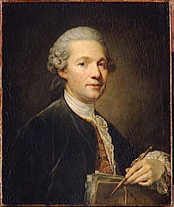
ANGE-JACQUES GABRIEL 1698 TO 1782
ARCHITECT TO KING LOUIS XV

Slide 21
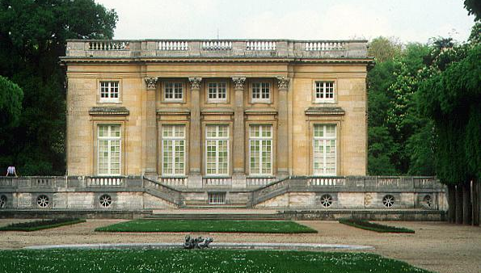
PETIT TRIANON BUILT BY LOUIS XV FOR
MADAME POMPADOUR,
1762-68 BY ARCHITECT GABRIEL

Slide 22
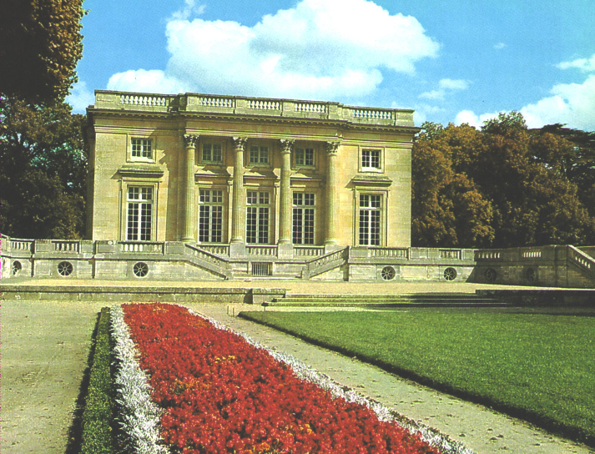
1774, Louis XVI gifts Petit Trianon to Marie Antoinette becomes The Queen’s Sanctuary from Court Life

Slide 23
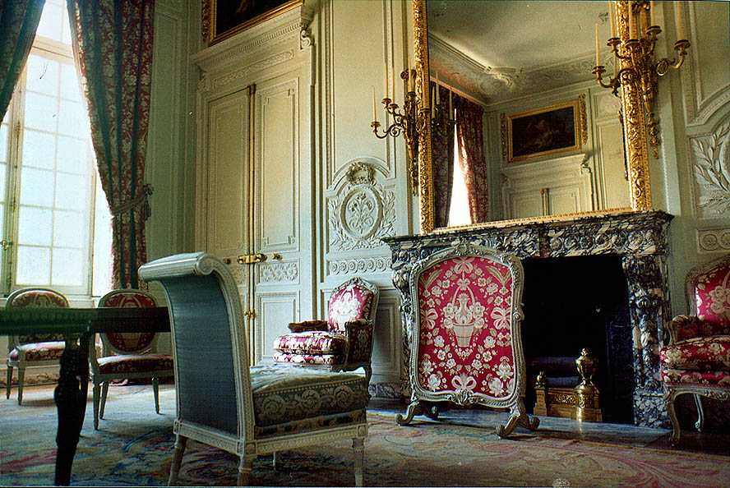
MAIN SALON, PETITE TRIANON

Slide 24
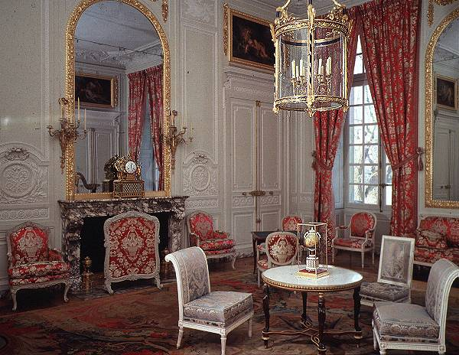

Slide 25
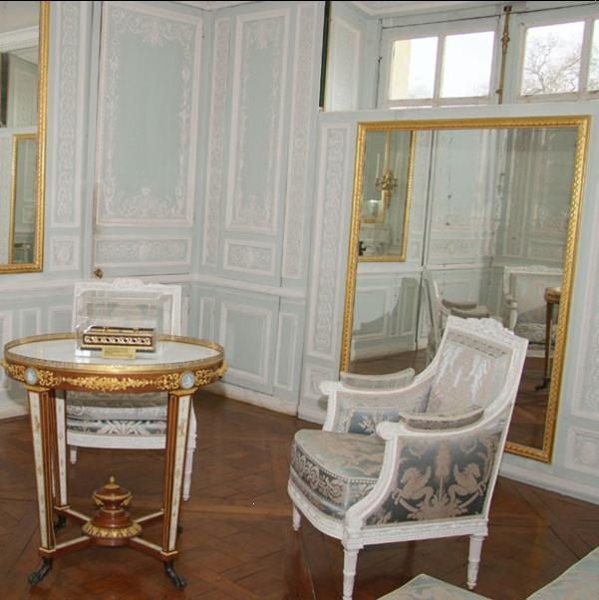
Queen’s
Bedroom,
Petite
Trianon,
Versailles

Slide 26
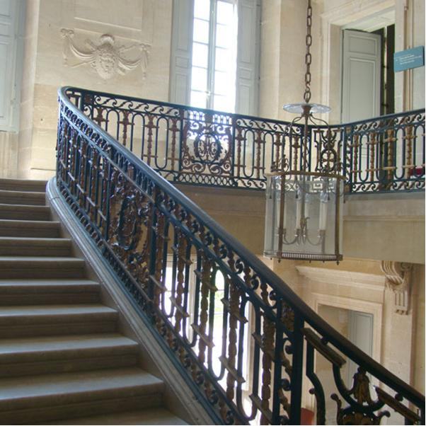
STAIRWELL AND BALUSTRADE OF PETITE TRIANON, VERSAILLES

Slide 27
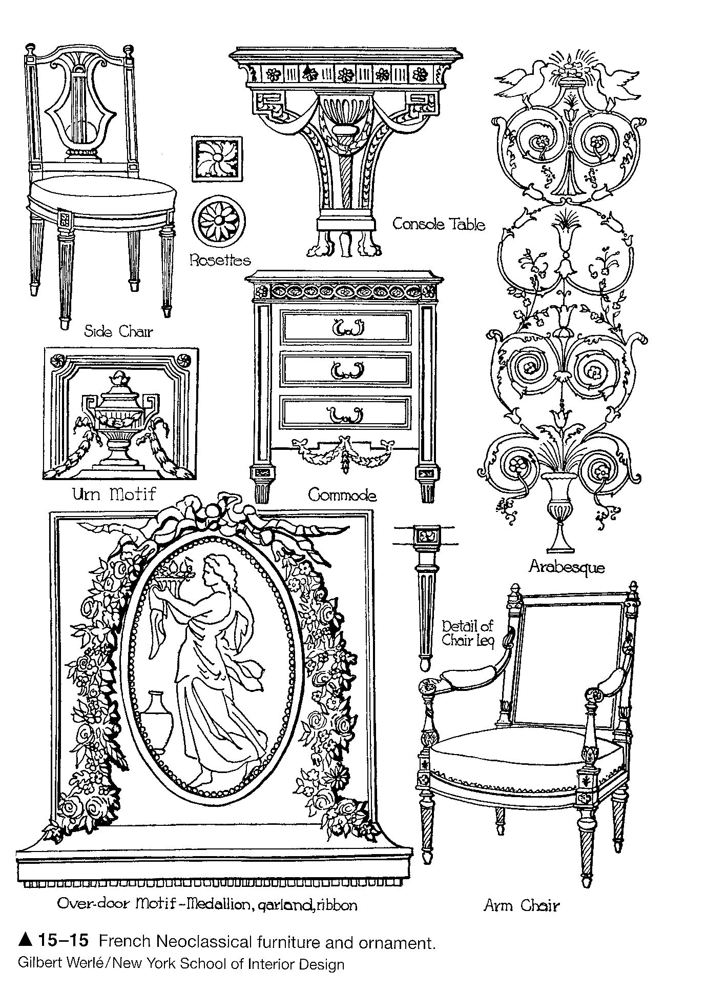
FRENCH
NEOCLASSIC
DETAILS
& FURNITURE

Slide 28
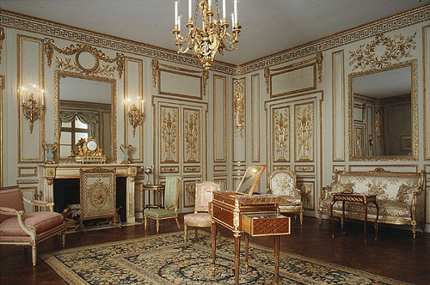
Louis XVI Room, Getty Museum, LA

Slide 29
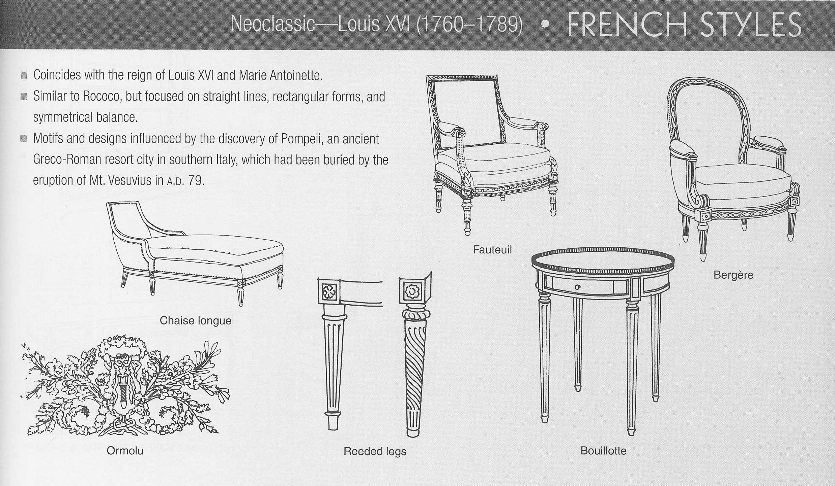

Slide 30
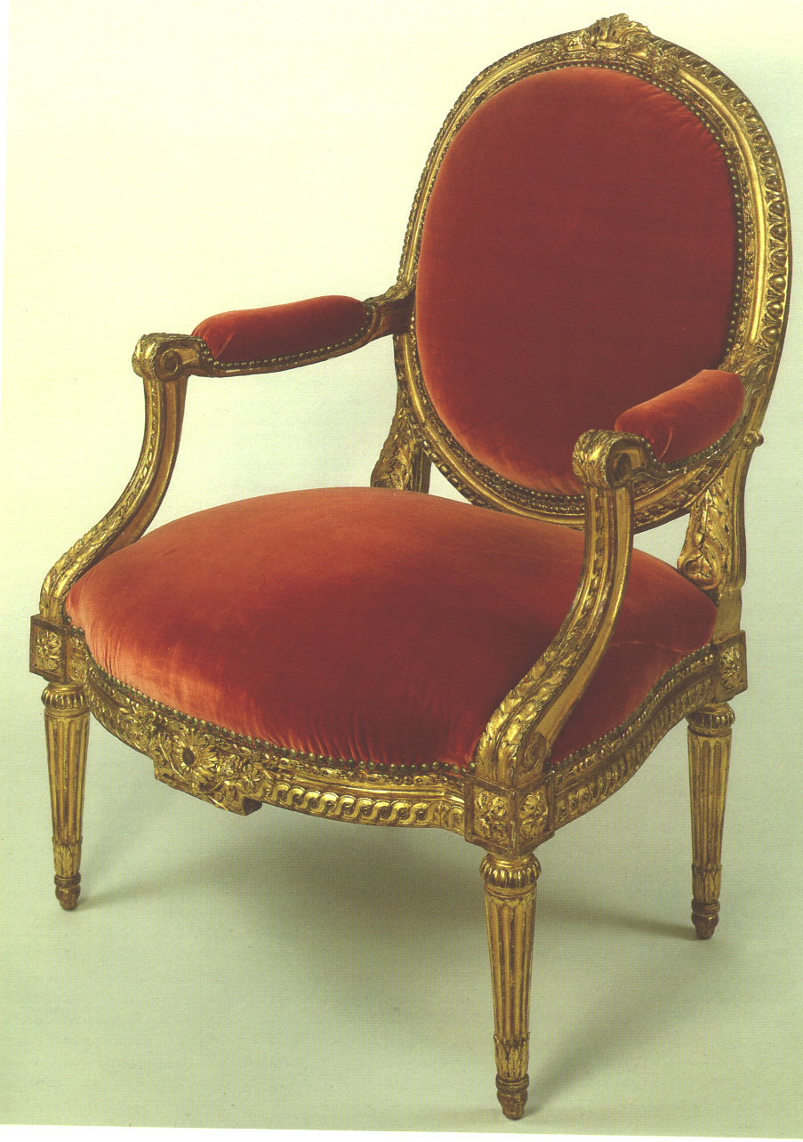
LOUIS XVI
FAUTEUIL GILT MEDALLION BACK

Slide 31
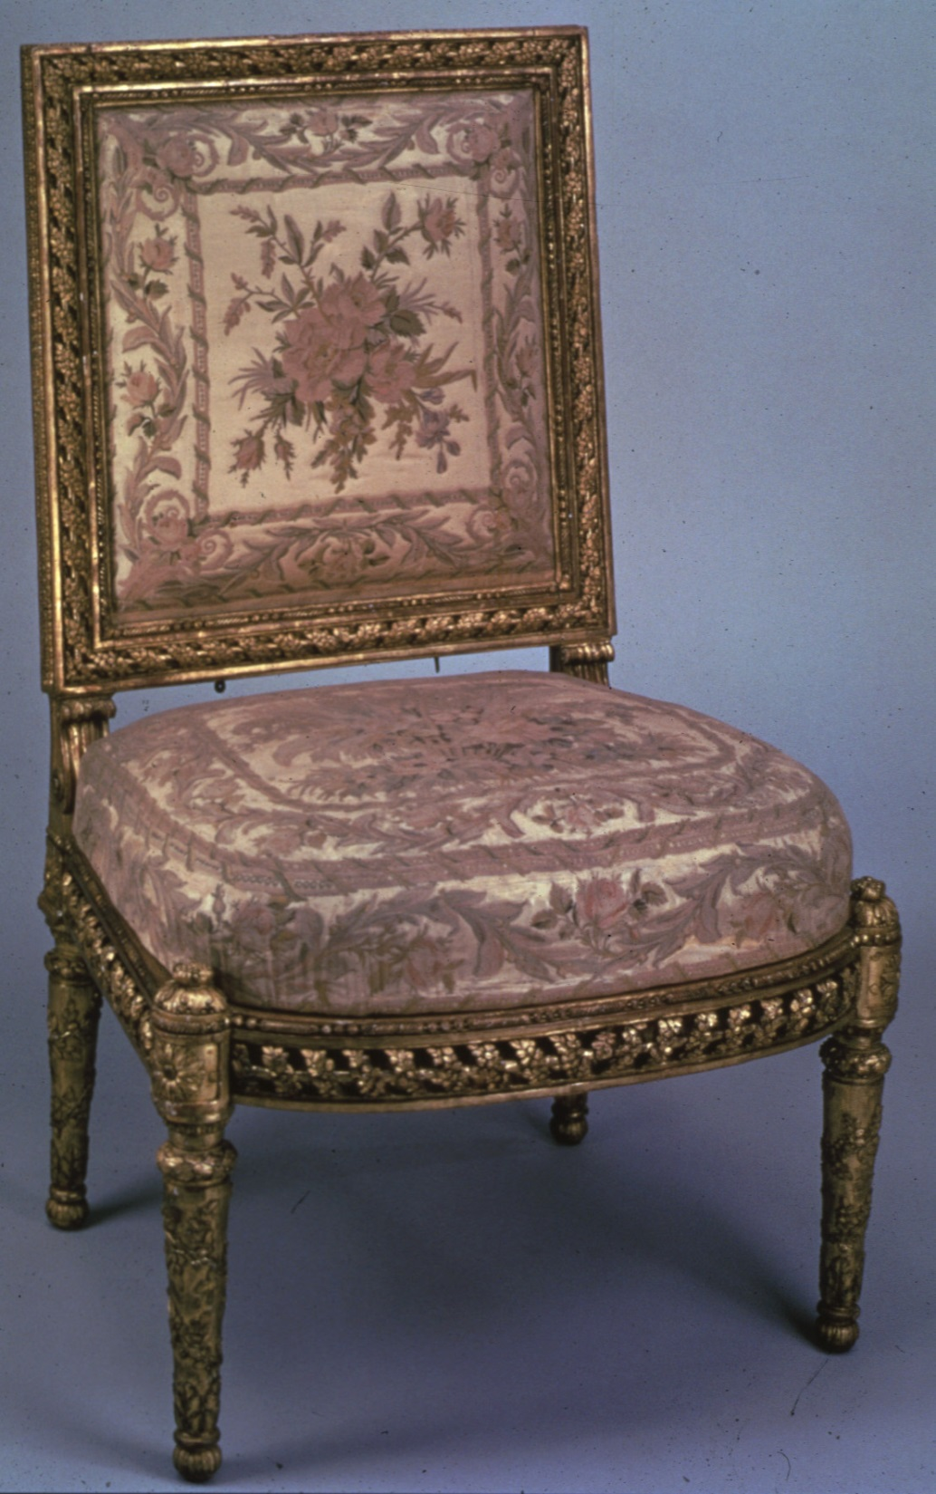
SQUARE BACK
SIDE CHAIR
GEORGES JACOB

Slide 32
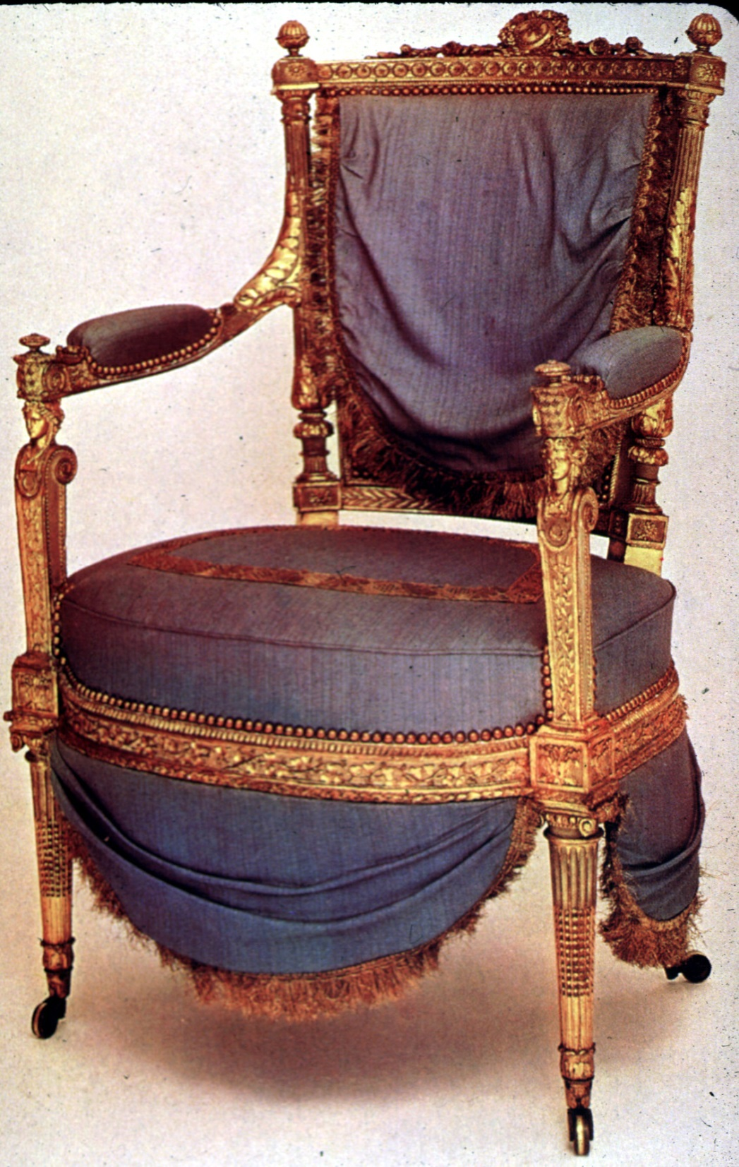
CHAIR
MADE FOR QUEEN
MARIE
ANTOINETTE
1785

Slide 33
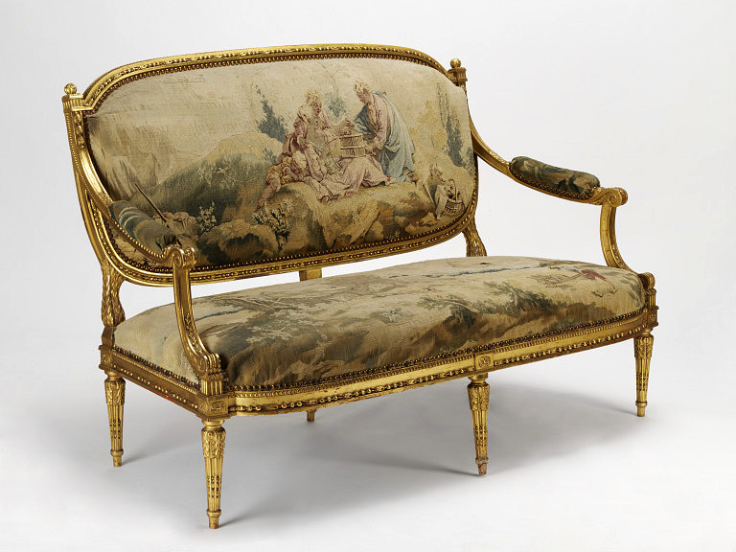
CANAPE; PETITE POINT UPHOLSTERY

Slide 34
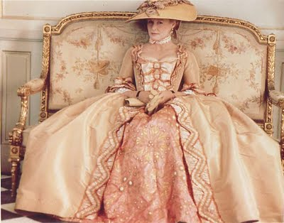

Slide 35
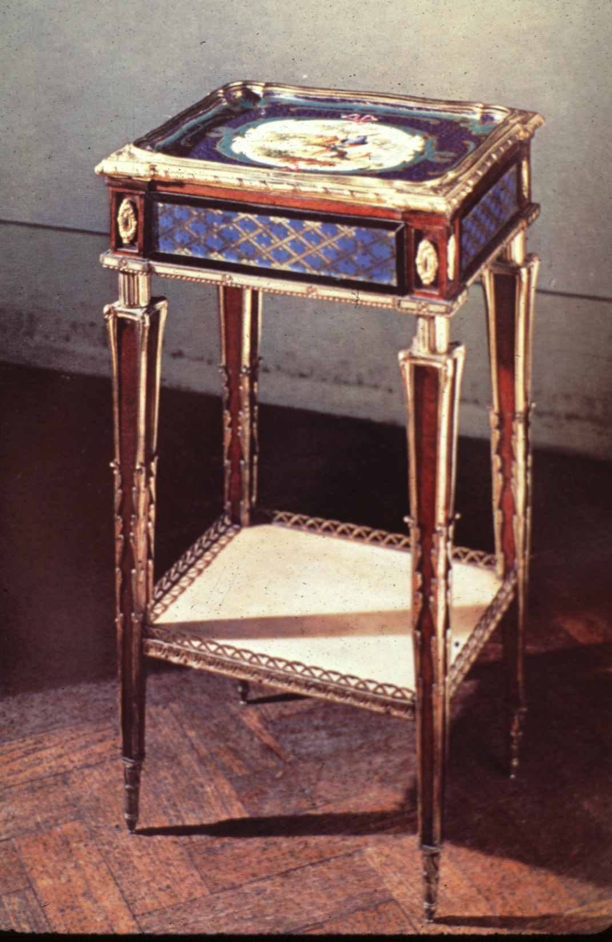
SEVRES PORCELAIN
PLAQUES
SET INTO TABLE
WITH
ORMOLU
1780

Slide 36
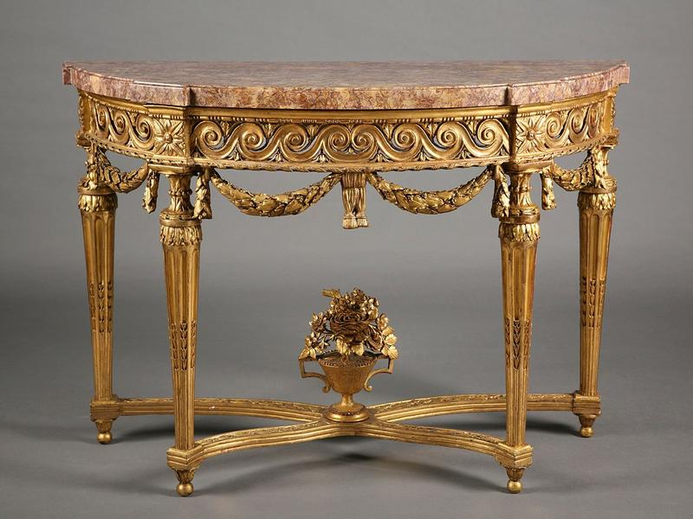
FRENCH NEOCLASSIC CONSOLE

Slide 37
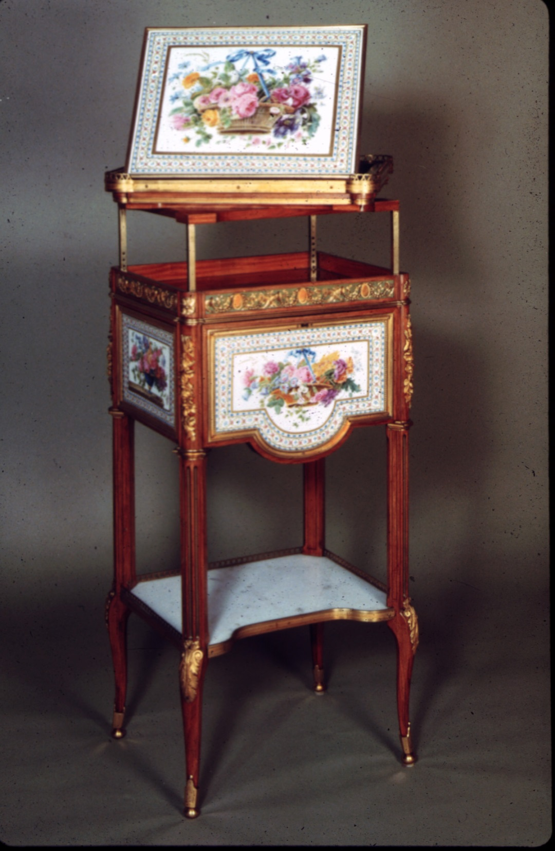
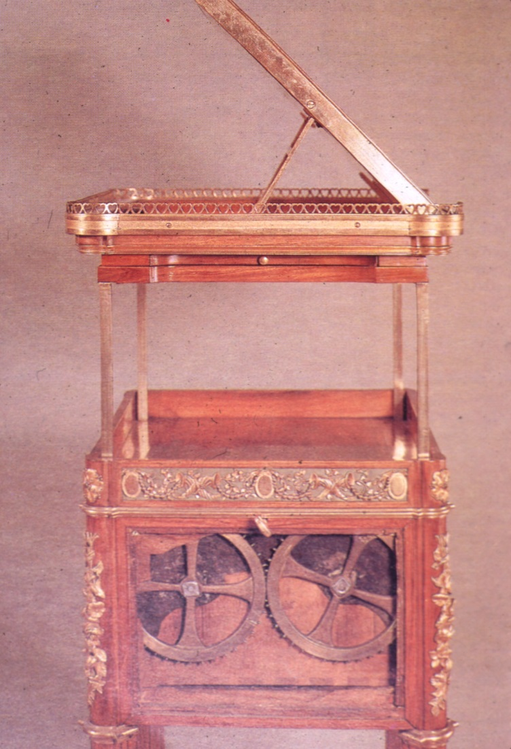
“MECHANICAL”
WORK TABLE
MARTIN CARLIN, 1783

Slide 38
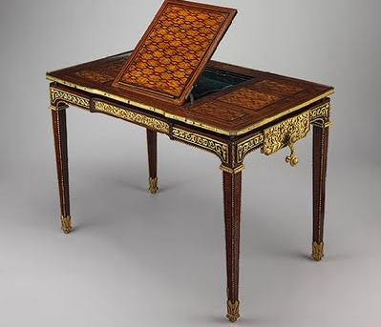
MECHANICAL BUREAU PLAT WITH CRANK BY
RIESENER FOR MARIE ANTOINETTE, 1778

Slide 39
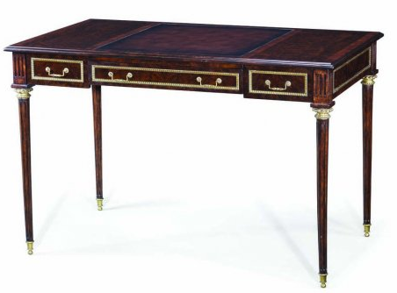
LOUIS XVI NEOCLASSICAL
BUREAU PLAT (DESK)

Slide 40
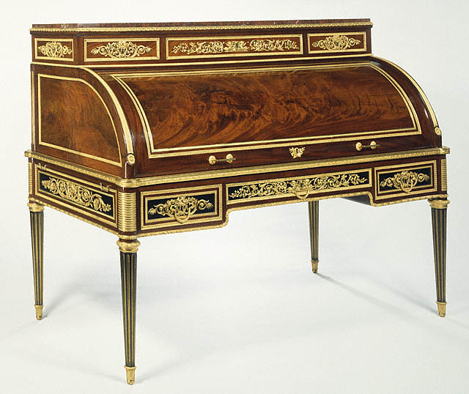
WITH “REEDED” LEGS

Slide 41
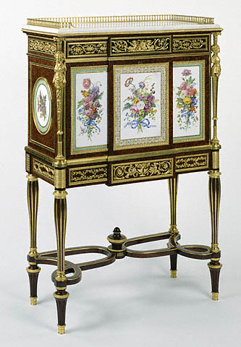
SECRETAIRE
A ABATTANT
PARIS, FR.
SÈVRES PLAQUES
1780 - 1783

Slide 42
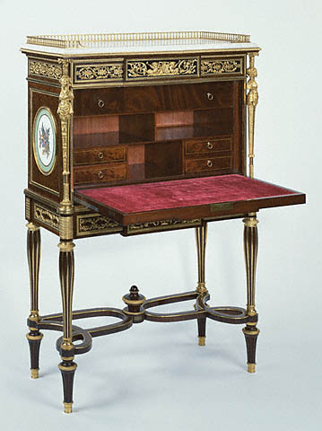
SECRETAIRE
A ABATTANT
PARIS, FR.
SÈVRES PLAQUES
1780 - 1783

Slide 43
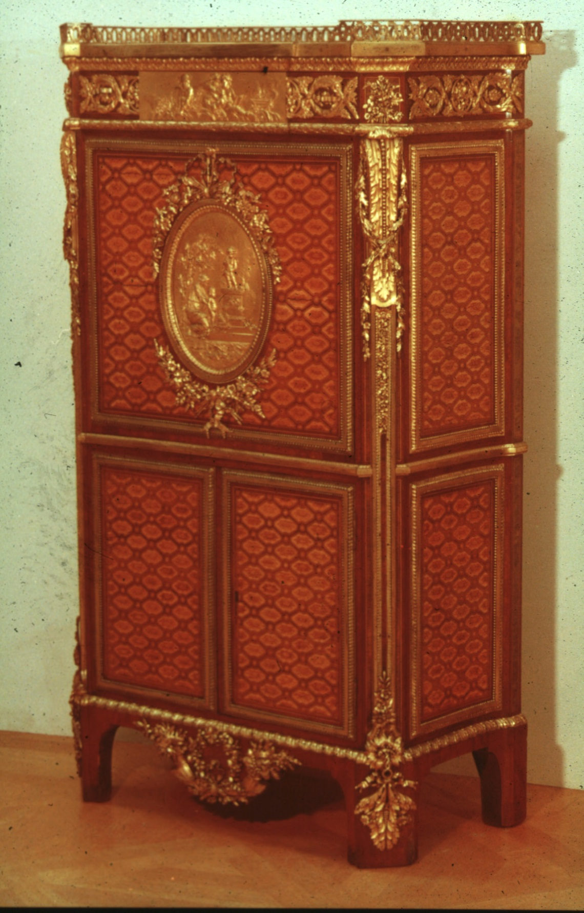
SECRETAIRE
“A ABATTANT”
BY
JEAN HENRI RIESENER 1771

Slide 44
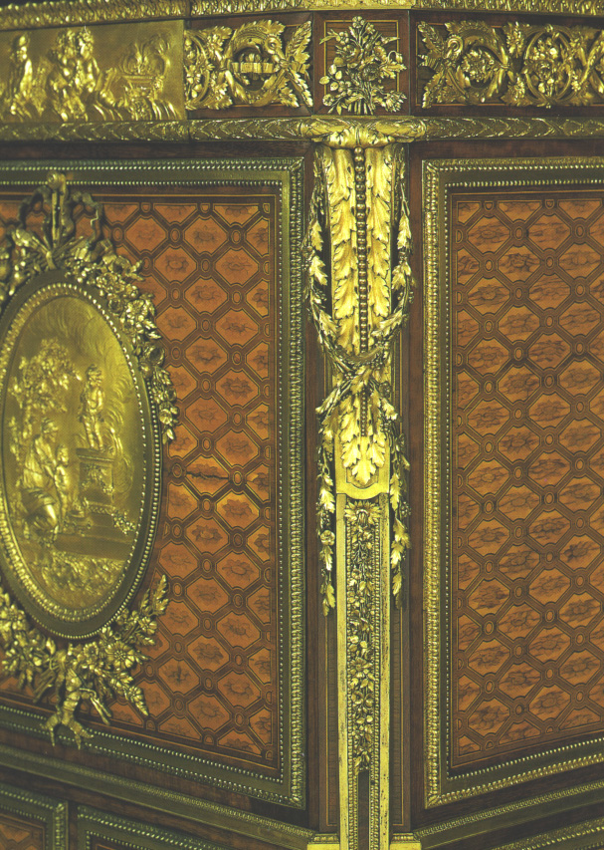
ORMOLU APPLIED TO “CHAMFERED” CORNER

Slide 45
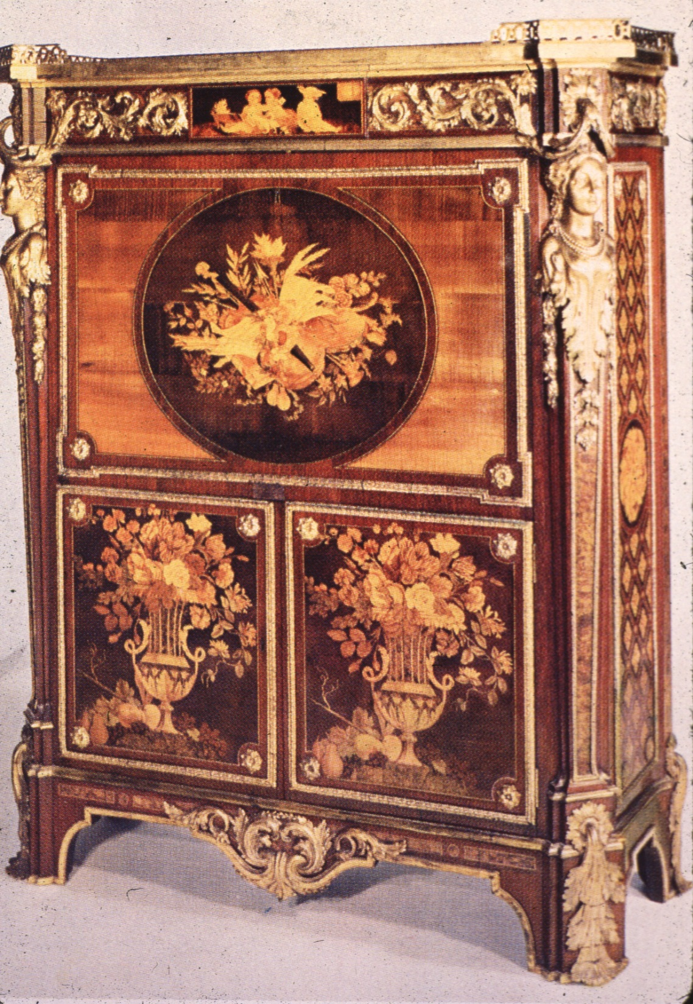
SECRETAIRE A ABATTANT WITH CARYATIDS AT CORNERS
BY
JEAN HENRI RIESENER
1774

Slide 46
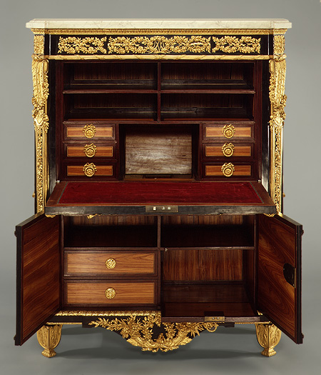
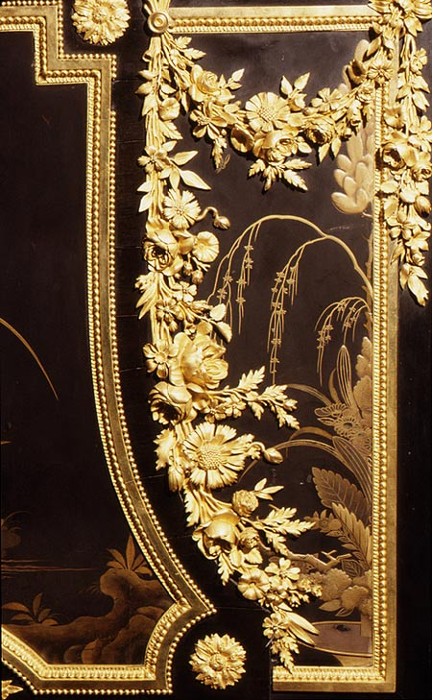
DROP FRONT

Slide 47
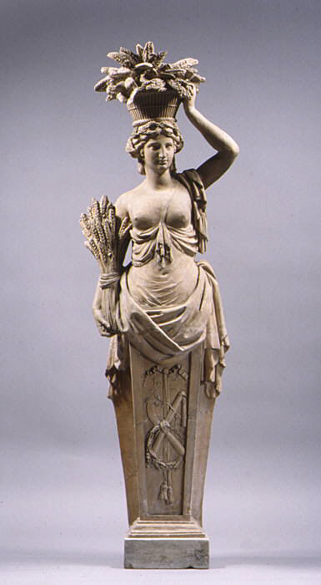
“CANEPHORAE” OR FIGURE BEARING A BASKET OR VASE ON HEAD/ SHOULDER WAS A COMMON
NEOCLASSICAL MOTIF. TERRA COTTA STATUE
FRENCH
1775

Slide 48
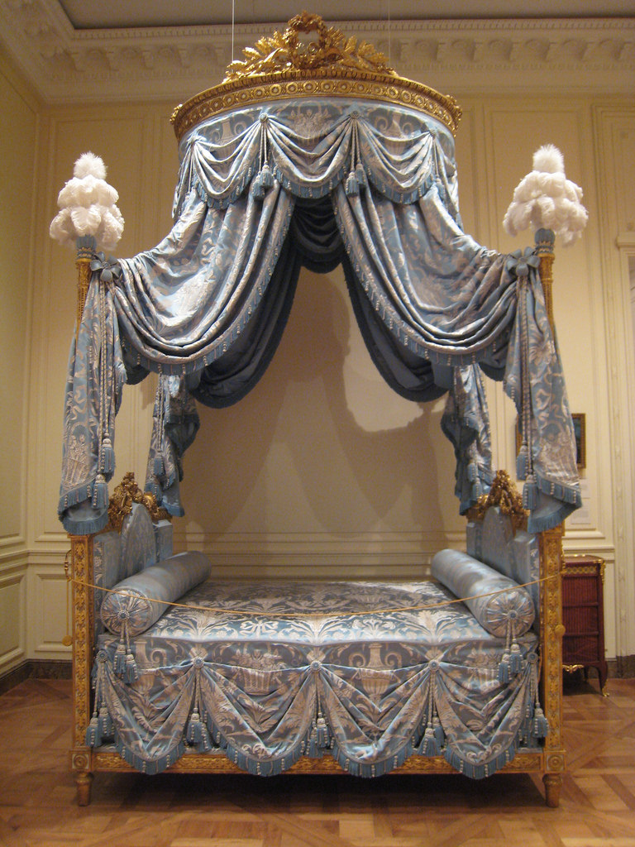

Slide 49
ENGLISH
NEOCLASSICAL PERIOD
1750 TO 1800
REGENCY PERIOD
1800 TO 1830

Slide 50
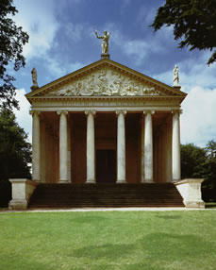
1748
TEMPLE
OF
CONCORD
AND
VICTORY,
ENGLAND,
GRENVILLE, KENT, UK

Slide 51
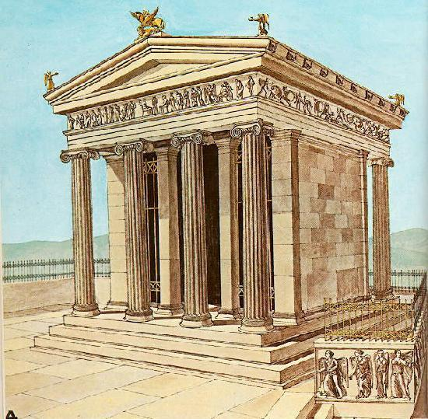

Slide 52
BOOKS ABOUT ANCIENT GREEK DESIGN WERE PUBLISHED IN 1758 AND 1762 WHICH SPARKED “GREEK REVIVAL” STYLE WITH GREEK TEMPLE FORMS USED FOR MANY PUBLIC
AND PRIVATE BUILDINGS.

Slide 53
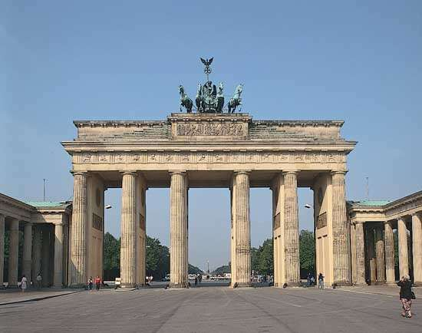
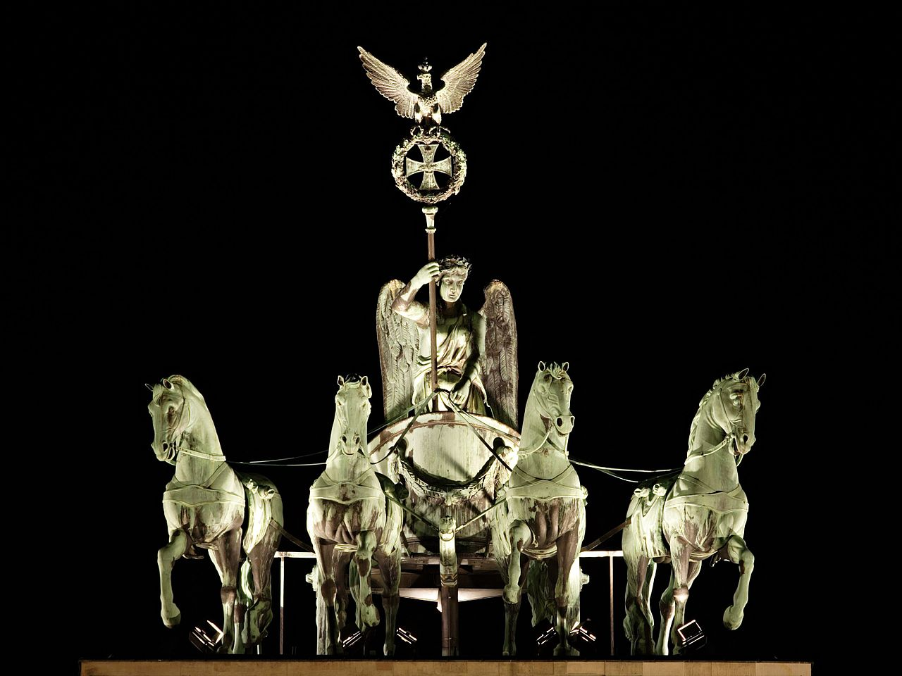
THE BRANDENBURG GATE WITH “QUADRIGAS”
BERLIN GERMANY
1793 INSPIRED BY THE ATHENIAN PROPYLAEA

Slide 54
ENGLISH NEOCLASSICAL (GEORGIAN)
REIGN OF
KING GEORGE III
1760 TO 1805
(KING DURING AMERICAN REVOLUTION)

Slide 55

ROYAL PORTRAIT OF KING GEORGE III & ROYAL FAMILY

Slide 56

GEORGE III
1800
MILITARY
DRESS

Slide 57

MRS. ELLIOT
PAINTED
BY
THOMAS GAINSBOROUGH
1785

Slide 58
NOTABLE ARCHITECT/DESIGNER
ROBERT ADAM - (1728-1792)
FURNITURE & CABINETMAKERS:
GEORGE HEPPLEWHITE - (?-1786)
THOMAS SHERATON – (1751-1806)
JASPERWARE PORCELAIN:
JOSIAH WEDGWOOD

Slide 59

ROBERT ADAM 1728-1792
SCOTTISH NEOCLASSICAL ARCHITECT, INTERIOR DESIGNER & FURNITURE DESIGNER

Slide 60

ENGLISH NEOCLASSICAL
ROBERT ADAM DECORATIVE STYLE

Slide 61
3/4 THOMAS CHIPPENDALE
WORKS WITH ROBERT ADAM
0:00-4:25 http://www.youtube.com/watch?v=1tOzQsHnd68

Slide 62
ROBERT ADAM 1728-1792
RESPONSIBLE FOR ARCHITECTURE, INTERIORS, & FURNITURE DESIGN
TWO DESIGN PHASES
1ST; 1756-1770, BOLD, MASCULINE
LARGE SCALE
2ND; 1770-1792, DELICATE & FEMININE
PLASTERWORK INSPIRED BY
HADRIAN’S VILLA AT TIVOLI (ROME)

Slide 63
DURING THEIR LIFETIME,
ROBERT AND JAMES ADAM
PUBLISHED TWO VOLUMES
OF THEIR DESIGNS IN 1773 AND 1779
“WORKS IN ARCHITECTURE OF ROBERT AND JAMES ADAM”
A THIRD VOLUME WAS PUBLISHED AFTER THEIR DEATH IN 1822

Slide 64
VICTORIA AND ALBERT MUSEUM
LONDON, UK
ROBERT ADAM GALLERY
58 IMAGES http://www.vandaimages.com/results.asp?W=4&F=0003&Step=1#ROW1

Slide 65

AN EXAMPLE OF THE ADAM BROTHERS' DECORATIVE
GROTESQUE & DESIGNS DETAILS FOR DERBY HOUSE IN GROSVENOR SQUARE

Slide 66

DECORATIVE DETAILS OF
ADAM
PERIOD
STYLE:
STRAIGHT LINES,
SYMMETRICAL
ORNAMENTATION,
CLASSICAL DETAILS &
MOTIFS

Slide 67

KEDLESTON HALL; A CROSS SECTION THROUGH THE HALL AND SALON, 1759

Slide 68

SYON HOUSE
INTERIOR RE-DESIGNED BY ROBERT ADAM, 1762,

Slide 69

ELEVATION DESIGN FOR THE HALL BY ROBERT ADAM 1762

Slide 70

SYON HOUSE
GREAT HALL
DESIGNED BY
ROBERT
ADAM
1762

Slide 71

SYON HOUSE LONG GALLERY

Slide 72
POMPEII: INTERIOR WALL FRESCO SHOWING VENUS

Slide 73

ADAM SYON HOUSE CANOPY
BED WITH MATCHING CEILING

Slide 74

KENWOOD HOUSE; REMODELED BY
ROBERT ADAM 1764-1779

Slide 75

KENWOOD HOUSE, HAMPSTEAD, ENGLAND, ROBERT ADAM REMODEL FROM 1764-1779

Slide 76

ADAM ENGRAVING OF CROSS SECTION
FOR LIBRARY AT KENWOOD HOUSE

Slide 77

KENWOOD HOUSE; REMODELED BY
ROBERT ADAM
1764-1779
LIBRARY

Slide 78

KENWOOD HOUSE; REMODELED BY
ROBERT ADAM, 1764-1779,
LIBRARY REFLECTED CEILING DESIGN

Slide 79

ROBERT ADAM, OSTERLEY HOUSE, LONDON,
BUILT 1571, RE-DESIGNED 1771

Slide 80


Slide 81

ADAM'S DESIGN FOR THE ETRUSCAN DRESSING ROOM, OSTERLEY PARK, 1773-74

Slide 82

ETRUSCAN ROOM
GROTESQUE PATTERNS
(inspired by Etrucscan vase patterns)

Slide 83

OSTERLEY PARK SECERTARIE WITH “JAPANNING” ATTRIBUTED TO CHIPPENDALE

Slide 84

OSTERLEY HOUSE, DINING AREA
ADAM DESIGNED
PLASTER
AT
WALLS & CEILING DETAILS &
FURNITURE

Slide 85

WALL GROTESQUES
DESIGNED
BY
ROBERT ADAM

Slide 86

BRITISH
NATIONAL HISTORIC
TRUST
ADAM’S
DETAILS &
COLORS

Slide 87


Slide 88

ADAM’S
PLASTER
WORK
CEILINGS
EXECUTED
BY JOSEPH ROSE

Slide 89

ADAM’S
DESIGN FOR
PLASTER
WORK
CEILINGS

Slide 90

ADAM’S
PLASTER
WORK
CEILINGS
(WEDGWOOD BLUE)

Slide 91

ADAM’S
PLASTER
WORK
WALL DETAILS

Slide 92

WALL PAPER
DESIGNED
BY
ROBERT ADAM

Slide 93

EARLY CHAIR
DESIGNED BY
ROBERT ADAM
PROBABLY MADE BY
CHIPPENDALE

Slide 94

SECOND PHASE OF ADAM
ETRUSCAN CHAIR
WITH LYRE BACK

Slide 95

SECOND PHASE OF ADAM
DELICATE CAMELBACK SOFA

Slide 96

DRAWING
BY ROBERT
ADAM
SHOWING GRIFFINS FROM BOOK

Slide 97


Slide 98

KENWOOD INTERIOR
ROBERT ADAM

Slide 99

ADAM
INTERIORS
PLASTERED CEILINGS
PIER MIRROR & DEMILUNE
CONSOLE CABINET

Slide 100

ADAM “DEMILUNE” COMMODE:
MEANS “HALF MOON” (HALF ROUND)

Slide 101

DETAIL OF ADAM DEMILUNE DOOR INLAY

Slide 102

ADAM
PIER MIRROR
AND CONSOLE TABLE

Slide 103

ADAM’S “DIANA AND MINERVA COMMODE”
(MADE IN CHIPPENDALE’S FACTORY)

Slide 104

SATINWOOD ON COMMODE BY CHIPPENDALE, 1773

Slide 105

DESK DESIGNED BY
ROBERT ADAM

Slide 106

ADAM
OSTERLEY PARK
HOUSE
BED OF STATE

Slide 107
GEORGE HEPPLEWHITE
(1727 - 1786)
BROUGHT THE NEOCLASSIC STYLE OF ADAM TO THE GENERAL PUBLIC
1788 BOOK: “CABINET MAKER AND
UPHOLSTERER’S GUIDE”
WIFE; ALICE TOOK OVER BUSINESS
AFTER HEPPLEWHITE’S DEATH
& PUBLISHED 2 MORE VOLUMES
IN 1789 & 1790

Slide 108

ENGLISH NEOCLASSICAL:
HEPPLEWHITE
AND
SHERATON
PERIOD

Slide 109

HEPPLEWHITE
SHIELD-BACK CHAIR &
SIDE TABLE
WITH
ENGLISH
TEA SERVICE
NOTE: HAND PAINTED WALL MURAL PAPER

Slide 110


Slide 111

HEPPLEWHITE
SHIELD BACK CHAIR

Slide 112


Slide 113

HEPPLEWHITE DOUBLE HEART BACK CHAIR

Slide 114


Slide 115

ENGLISH NEOCLASSICAL; 1760-1810

Slide 116


Slide 117


DRAWING FROM BOOK
AND FINISHED CHAIR

Slide 118

HEPPLEWHITE OVAL BACK CHAIR

Slide 119



Slide 120

HEPPLEWHITE SIDEBOARD WITH SERPENTINE FRONT

Slide 122

HEPPLEWHITE SIDEBOARD
WITH OVAL PATERAE PULLS

Slide 123

HEPPLEWHITE
PEMBROKE
DROPLEAF
TABLE
(cross-banding)

Slide 124

HEPPLEWHITE
OPENED PEMBROKE TABLE

Slide 125

HEPPLEWHITE
PEMBROKE TABLE
SATINWOOD WITH
PAINTED TOP FINISHES

Slide 126
HEPPLEWHITE
PEMBROKE TABLE
DETAIL:
SATINWOOD WITH
PAINTED TOP FINISHES

Slide 127


Slide 128

OVAL
PATERAE,
STRINGING INLAY
BELL FLOWER
DETAIL

Slide 129

HEPPLEWHITE
SECRETARY
1800

Slide 130

Josiah
Wedgwood
Factory
Burslem, Staffordshire, Britain

Slide 131
JOSIAH WEDGWOOD
BBC VIDEO
CREAMWARE 1:46-6:05 http://www.youtube.com/watch?v=YjcMVfeAOc0
JASPERWARE
12:35-END
PART 2: JASPERWARE http://www.youtube.com/watch?v=hnTBMM4MqAw

Slide 132


JASPERWARE
JOSIAH WEDGWOOD
PORTLAND VASE
1789
(ORIGINAL ROMAN
CAMEO GLASS
FROM CIRCA
5-25 AD)

Slide 133

CREAMWARE
“QUEEN’S WARE”
Made At
Josiah
Wedgwood's Factory,
Burslem, Staffordshire, Britain
About 1765

Slide 134

JASPERWARE
PLAQUES ON FIREPLACE
BY JOSIAH WEDGWOOD

Slide 135


Slide 136



Slide 137


Slide 138

NEOCLASSICAL JOSIAH WEDGWOOD JASPERWARE URN ON PEDESTAL
(NOW WORTH
$30,000.00)

Slide 139

TWO URNS WEDGWOOD”ROSSO ANTICO” TERRA COTTA & BASALT

Slide 140


Slide 141


Slide 142
THOMAS SHERATON
1751-1806
TWO PERIODS
1ST BOOK PUBLISHED 1793
“THE CABINET-MAKER AND UPHOLSTERER’S DRAWING BOOK”
2ND BOOK PUBLISHED 1803
“CABINET DICTIONARY”
MAHOGANY & SATINWOOD

Slide 143

ENGLISH NEOCLASSICAL:
HEPPLEWHITE
AND
SHERATON
PERIOD

Slide 144

DINING ROOM
SHERATON CHAIRS

Slide 145

SHERATON TRIPLE SECTION DINING TABLE

Slide 146

DROP LEAF AND 2 DEMI-LUNES

Slide 147


Slide 148

EARLY SHERATON SIDE CHAIR

Slide 149

SHERATON SIDE CHAIRS BACKS
RECTANGULAR, SPARE AND PRECISE

Slide 150

EARLY STYLE SHERATON ARM
CHAIRS

Slide 151

SHERATON
ARMCHAIR WITH
UPHOLSTERED SEAT AND DECORATIVE NAIL HEADS

Slide 152


SHERATON
ARM CHAIR
INSPIRED BY LOUIS XVI FURNITURE

Slide 153

SOFA IN SHERATON STYLE

Slide 154

HEPPLEWHITE VS SHERATON

Slide 155

SHERATON SIDE CHAIR
AND SEWING TABLE

Slide 156

SHERATON STYLE DROPLEAF
TABLE WITH TWIST LEGS

Slide 157

DRAWING BY SHERATON
OF A SIDEBOARD

Slide 158


Slide 159

SHERATON CYLINDER SECRETARY BOOKCASE

Slide 160


Slide 161

SOFA IN LATE SHERATON 1805

Slide 162

ENGLISH REGENCY DRAWINGS
SHERATON
“PIER” MIRROR & DRAPERY
AND SOFA

Slide 163
ENGLISH REGENCY PERIOD
1811 TO 1820
ENGLAND’S ANSWER TO FRENCH EMPIRE
KING GEORGE IV
1762-1830

Slide 164

“PRINCE
REGENT”
1811-1820
KING
GEORGE IV
1762-1830
“PRINCE OF WALES”

Slide 165

“PRINCE REGENT”
A PATRON OF NEW FORMS OF LEISURE, STYLE AND TASTE. HE COMMISSIONED JOHN NASH TO BUILD THE
ROYAL PAVILION
IN BRIGHTON
AND REMODEL BUCKINGHAM PALACE

Slide 166

BEAU BRUMMELL
1748-1840
BEAU WAS GOOD FRIEND OF THE PRINCE REGENT AND
A MEN’S FASHION
TRENDSETTER.
COAT AND TIE WORN WITH LONG TROUSERS ARE FROM HIS INFLUENCE.

Slide 167

ENGLISH REGENCY
JOHN NASH ARCHITECT
1752-1835
ARCHITECT TO PRINCE REGENT
(GEORGE IV)

Slide 168

Nash’s own home “East Cowes Castle”
designed in “Picturesque” style

Slide 169

BRIGHTON’S ROYAL PAVILION, JOHN NASH, ANGLO-INDIAN REVIVAL,
1820, ENGLAND

Slide 170


Slide 171

BANQUETING HALL ROYAL PAVILLION, BRIGHTON, UK,

Slide 172


Slide 173


Slide 174


Slide 175

TRAFALGAR SQUARE, LONDON URBAN PLANNING BY NASH

Slide 176

BRITISH
ADMIRAL
“LORD NELSON”

Slide 177


NAPOLEONIC WARS,
WON “BATTLE OF TRAFALGAR”, 1805

Slide 178

ENGLISH REGENCY
GONDOLA
CHAIR
“DOLPHIN” MOTIF
(ADMIRIAL NELSON VICTORY)

Slide 179

ENGLISH REGENCY
DOLPHIN BASE TABLE

Slide 180

ENGLISH REGENCY
ADMIRIAL NELSON’S
MARITIME
VICTORY
COMMEMORATED BY THE
“DOLPHIN”
MOTIF

Slide 181

REGENCY
“TRAFALGAR CHAIR”
1810
GREEK KLISMOS
REVIVALISM

Slide 182

ENGLISH REGENCY
TRAFALGAR ARMCHAIR

Slide 183

ENGLISH REGENCY
SITTING ROOM

Slide 184

ENGLISH REGENCY
“SQUIB” OR DAYBED

Slide 185
FRANCE
“AGE OF ENLIGHTENMENT”
NEOCLASSICAL PERIOD: 1760-1789
LOUIS XVI & MARIE ANTOINETTE
DIRECTOIRE PERIOD: 1795-1799
TRANSITIONAL GOVERNMENT
EMPIRE PERIOD: 1799-1814
NAPOLEON & JOSEPHINE

Slide 186

END OF THE FRENCH MONARCHY KING LOUIS XVI & MARIE ANTOINETTE, GUILLOTINED, OCTOBER 16, 1793

Slide 187
Age of Enlightenment or Age of Reason
The cultural movement of intellectuals in the 17th and 18th century Europe and the American Colonies.
Its purpose was to reform society using reason, challenge ideas grounded in tradition / faith, and advance knowledge through the scientific method.

Slide 188

AGE OF ENLIGHTENMENT
DENIS DIDEROT
1713–1784
PARIS STATUE

Slide 189
In France, Enlightenment culminated in the great Encyclopédie (1751–72) edited by Denis Diderot with contributions by hundreds of leading philosophers & intellectuals such as Voltaire, Rousseau and Montesquieu. Some 25,000 copies of the 35 volume set were sold, half of them outside France.

Slide 190

AUTHOR: VOLTAIRE
1694–1778
SOCIAL REFORMER & ADVOCATE OF CIVIL LIBERTIES; INCLUDING FREEDOM OF RELIGION AND FREE TRADE

Slide 191

JEAN JACQUES ROUSSEAU
1712-1778
“AGE OF ENLIGHTENMENT”
OR
“AGE OF REASON”
AUTHOR:
“THE NATURAL STATE OF MAN” http://en.wikipedia.org/wiki/Jean-Jacques_Rousseau

Slide 192
The new intellectual forces spread across Europe, notably England, Scotland, the Germany, the Netherlands, Russia, Italy, Austria, and Spain, then jumped the Atlantic into the European colonies, where it influenced Benjamin Franklin and Thomas Jefferson, and played a major role in the American Revolution.

Slide 193
The political ideals of the
Age of Enlightenment influenced the
American Declaration of Independence 1776 & Bill of Rights,
French Declaration of the Rights of Man & of the Citizen,
& the Polish–Lithuanian Constitution of 1791. http://en.wikipedia.org/wiki/Age_of_Enlightenment

Slide 194
FRENCH REVOLUTION 1789
GUILDS ABOLISHED – 1791
REIGN OF TERROR – 1793-1794
DIRECTOIRE; 1795 TO 1799

Slide 195
THE REIGN OF TERROR
NO ONE WANTED TO BE ASSOCIATED WITH “ROYALTY” OR “ROYAL TASTE”
1793 TO 1794
A PERIOD OF ABOUT 11 MONTHS DURING THE FRENCH REVOLUTION.
DEATHS ARE ESTIMATED BETWEEN 20,000 TO 40,000 LIVES LOST
PERIOD OF ANARCHY

Slide 196

“THE RADICAL'S ARMS”
DEPICTS THE INFAMOUS GUILLOTINE.
"NO GOD!
NO RELIGION!
NO KING!
NO CONSTITUTION!" WRITTEN ON THE BANNER.

Slide 197
DIRECTOIRE
1795 TO 1799
A TRANSITIONAL GOVERNMENT
THE DIRECTORY:
COMPRISED OF 5 DIRECTOR MEMBERS AND THE COUNCIL OF FIVE HUNDRED (500)

Slide 198

COSTUME OF THE DIRECTOIRE PERIOD
MILITARY LOOK FOR UNSETTLED TIMES

Slide 199
FRENCH DIRECTOIRE PERIOD
1789 TO 1804
NOTABLE DESIGNERS:
PERCIER & FONTAINE
AND GEORGE JACOBS
PAIRED DOWN, “GESSO-ED”, PAINTED OR NATURAL WOOD FRAMES, NO GILDING, ORMOLU; SIMPLE CLASSICAL THEMES & MOTIFS

Slide 200

DIRECTOIRE STYLE
ROYALTY IS OUT
PARED DOWN
“GESSO-ED” CHAIRS, NATURAL WOOD COMMODE,
NO GILDING

Slide 201

ROOM OF DIRECTOIRE PERIOD
SIMPLE WHITE BOISERIE
(PANELING)
NOTE: CHEVAL MIRROR

Slide 202


MOTIFS:
LOZENGE
PATERAE
CROSSED ARROWS

Slide 203

SEVRES CUP AND SAUCER
FRENCH REVOLUTION MOTIFS: FASCES & OLIVE BRANCH IN OVAL

Slide 204

DIRECTOIRE
MOTIFS:
CLASSICAL
LYRE (HARP)
SCONCE

Slide 205

DIRECTOIRE MOTIFS:
CLASSICAL AQUATIC GRIFFINS

Slide 206

RETURN OF CLASSICAL MOTIFS:VASES
WITH ANTHEMION/ PALMETTES
FOOTED URNS & SWAGS

Slide 207

DIRECTOIRE
MOTIF:
PALMETTE
& LOZENGE
(ELONGATED
DIAMOND
SHAPE)
GESSO FINISH

Slide 208

FAUTEUIL
GEORGES JACOB
FRENCH, PARIS, ABOUT 1791
“GESSO-ED” FINISH

Slide 209

FAUTEUIL DIRECTOIRE STYLE
CREST RAIL GONE, REPLACED WITH
ROLLED OVER BACK: VOLUTE

Slide 210

FAUTEUIL DIRECTOIRE
STYLE
NO GILDING OR ORMOLU
“GESSO-ED” FINISH

Slide 211

DIRECTOIRE CANAPE WITH OPEN BACK,
CROSSED ARROWS & LOZENGE

Slide 212

DIRECTOIRE DAY BED: LOZENGE

Slide 213


ROMAN INSPIRED TRIPOD TABLES

Slide 214


Slide 215



Slide 216

DIRECTOIRE
BUREAU DE DAME
(LADY’S DESK)

Slide 217

DIRECTOIRE CREDENZA MAHOGANY VENEERED DOORS

Slide 218

DIRECTOIRE
REPRODUCTION
ARMOIRE
WITH GESSO FINISH
CROSSED ARROWS

Slide 219

CONTEMPORARY VERSION OF DIRECTOIRE CREDENZA

Slide 220

FRENCH
EMPIRE
PERIOD
1799-1814

Slide 221


MILITARY DRESS FOR MEN
GREEK CLASSICAL “EMPIRE” FOR WOMEN

Slide 222
FRENCH EMPIRE
INFLUENCES
NAPOLEON: EMPEROR
JACQUES LOUIS DAVID; ARTIST
CHARLES PERCIER; ARCHITECT
PIERRE FRANCOIS FONTAINE; ARCHITECT
GEORGES JACOB; EBENISTE

Slide 223

NAPOLEON
BONAPARTE:
FIRST CONSUL
IN
COUP D’ÉTAT
PARIS, 1799

Slide 224

EMPRESS JOSÉPHINE
1809
EMPIRE
FASHIONS:
GOWN & HAIR

Slide 225

CORONATION OF JOSEPHINE BY
EMPEROR NAPOLEON
JACQUES LOUIS DAVID; ARTIST

Slide 226


INTERIOR DESIGNERS:
PERCIER AND FONTAINE
WERE RESPONSIBLE FOR REFURBISHING THE PALACES
AT MALMAISON, FONTAINEBLEAU AND
VERSAILLES.
THE EMPIRE STYLE THAT THEY CREATED DREW ON THE ANCIENT & CLASSICAL ART
AND ARCHITECTURE.

Slide 227

CHATEAU MALMAISON
HOME OF JOSEPHINE (ROSE)

Slide 228

LES ROSES
A MILESTONE IN
ILLUSTRATION BY PIERRE-JOSEPH REDONTE IN 1817
SHOWING 195 OF 250 ROSES WHICH JOSEPHINE COLLECTED AND HYBRIDIZED AT HER HOME MALMAISON.
STILL IN PRINT TODAY AND POPULARIZED ROSE
CULTIVATION AND USE AS A DECORATIVE MOTIF.

Slide 229


Slide 230

DINING ROOM
CHATEAU
MALMAISON
REMODELED BY DESIGNERS
PERCIER & FONTAINE

Slide 231

NAPOLEON’S LIBRARY
CHATEAU
MALMAISON
REMODELED BY DESIGNERS
PERCIER & FONTAINE

Slide 232

EMPRESS JOSEPHINE
A LATER PORTRAIT
FAVORITE MOTIF:
SWAN

Slide 233

JOSEPHINE’S
BEDROOM;
CHATEAU MALMAISON
LIT A
L’IMPERIALE
(CANOPY TOP)

Slide 234

CHÂTEAU DE FONTAINEBLEAU
REMODELED BY
PERCIER & FONTAINE

Slide 235

EMPEROR NAPOLEON
BONAPARTE
1768 TO 1821
PAINTING
JACQUES-LOUIS DAVID (1812)

Slide 236

NAPOLEON’S THRONE ROOM
AT FONTAINEBLEAU

Slide 237

NAPOLÉON'S THRONE CHAIR
AT FONTAINEBLEAU
“N” IN ROMAN CONQUEROR’S WREATH

Slide 238

MILITARY TENT OF TYPE USED BY NAPOLEON

Slide 239

NAPOLÉON'S
BED ROOM
AT FONTAINEBLEAU

Slide 240

WALL
GROTESQUE:
AT
CHÂTEAU DE FONTAINEBLEAU

Slide 241

QUEEN JOSEPHINE’S BED CHAMBER,
PERCIER &
FONTAINE

Slide 242

RECALL: ROMAN LECTUS

Slide 243

DRAWING BY
PERCIER AND
FONTAINE

Slide 244

DRAWING BY
PERCIER AND
FONTAINE

Slide 245

MALMAISON BED STEAD

Slide 246


Slide 247
FRENCH EMPIRE
“A little Greek, a little Roman, a little Egyptian: Put it in the mixer, and that is Empire style,”. Indeed, the ubiquitous elements of Empire style—palmettes and lyres, swans and sphinxes, masks, caryatids, Egyptian heads and lions’ muzzles and paws—run through both periods.

Slide 248
1798, NAPOLEON RETURNED TRIUMPHANT FROM HIS EGYPTIAN WAR CAMPAIGN
“EGYPTIAN REVIVAL”
DESIGN MOTIFS: OBELISKS,
SPHINXES, WINGED LIONS, LOTUS, CARYATIDS AND SCARABS

Slide 249

Description de l'Égypte
Published in 37 volumes from
1809-1829

Slide 250

“EGYPTO-MANIA”
EARLY FRENCH EMPIRE FAUTEUIL
EGYPTIAN
INFLUENCE

Slide 251

“EGYPTO-MANIA” EMPIRE STYLE FAUTEUIL
NOTE SPHINX
HEADS
AND TEXTILE PATTERN

Slide 252

ROMAN LAUREL WREATH OF THE CONQUOROR AND VICTOR

Slide 253

EMPIRE STYLE FAUTEUIL;
NOTE
TEXTILE WITH ROMAN LAUREL WREATH PATTERN

Slide 254

NAPOLEONIC BEE
(HIS MOTIF OR SYMBOL)

Slide 255

1810 VERSAILLES FABRIC:
NAPOLEON’S
PERSONAL EMBLEM, THE BEE, & IMAGES RELATED TO THE GLORIES OF THE ROMAN EMPIRE

Slide 256


EMPIRE
“GONDOLA”
CHAIR

Slide 257

VENETIANGONDOLA
WITH
ROUND-
BACK GONDOLA CHAIR

Slide 258

FRENCH
EMPIRE
INTERIOR
SELLA CURULIS

Slide 259

EMPIRE REVIVAL: SELLA CURULIS

Slide 260

LION’S HEAD “X” STOOL

Slide 261

SWORD “X” STOOL

Slide 262

EMPIRE
“ROMAN”
SELLA CURULIS
CHAIR
BY
GEORGE JACOB

Slide 263

EMPIRE
DUCHESSE BRISE
SPHINX
ARM SUPPORTS

Slide 264

MADAME RECAMIER, 1800,
BY JACQUES-LOUIS DAVID

Slide 265

EMPIRE RACAMIER
RECALL GREEK KLINE, ROMAN LECTUS

Slide 266

EMPIRE RACAMIER
DAY BED
EMPIRE STRIPE

Slide 267

ROMAN TRIPOD TABLES
INSPIRED
FRENCH EMPIRE
“GUERIDON”
TABLE
1810

Slide 268

JOSEPHINE’S
BEDROOM
“ATHENIENNE”
OR TRIPOD
WASH STAND
MALMAISON

Slide 269

GRIFFINS ARE BACK IN STYLE

Slide 270

GRIFFIN BASE “GUERIDON” TABLE BY
PERCIER & FONTAINE

Slide 271

CARYATID SUPPORTS ON TABLE

Slide 272

EGYPTIAN HEAD
DETAIL
EBONIZED
CONSOLE
TABLE LEG
FONTAINEBLEAU

Slide 273

FRENCH EMPIRE MAHOGANY ROLLTOP DESK WITH ORMOLU MOUNTS

Slide 274

WREATH & ANTHEMION DETAILS

Slide 275

MOTIFS ON COMMODE
BY GEORGE JACOBS

Slide 276

FRENCH EMPIRE
GENTLEMAN’S
SECRETAIRE
A ABATTANT

Slide 277

EMPIRE CHEVAL OR PSYCHE MIRROR
(CHEVAL FRENCH FOR HORSE)
MIRROR ON LEGS

Slide 278

EMPIRE CHEVAL MIRROR WITH TROMPE L’OEIL

Slide 279

EMPIRE
TABLE
WITH
CENTERPIECE OF
“THE THREE GRACES”
CHARM, BEAUTY, & CREATIVITY

Slide 280
AMERICAN FEDERAL
FEDERAL PERIOD
1776 TO 1815
AMERICAN EMPIRE PERIOD
1810 TO 1830
(INSPIRED BY FRENCH EMPIRE STYLE)

Slide 281


Slide 282

BENJAMIN FRANKLIN’S DESIGN FOR THE “FRANKLIN STOVE” IN 1742 CREATED THE ABILITY TO HEAT LARGER ROOMS MORE EFFICENTLY THAN A TRADITIONAL FIREPLACE

Slide 283

THOMAS JEFFERSON, MONTICELLO, VIRGINIA, 1768-1824

Slide 284


THOMAS JEFFERSON;
ENTRY HALL

Slide 285

MONTICELLO DINING ROOM
WITH HEPPLEWHITE SHIELD BACK CHAIRS

Slide 286

GREEK REVIVAL STYLE – THE ORIGINAL “WHITE HOUSE” DESIGN BY JAMES HOBAN

Slide 287


Slide 288
AMERICAN FEDERAL PERIOD
DUNCAN PHYFE; 1768 - 1854
FURNITURE MAKER
SAMUEL McINTIRE; 1757-1811
LAMBERT HITCHCOCK
1795-1852

Slide 289

DUNCAN PHYFE
SCOTTISH BORN
(1768-1854)
AMERICAN FURNITURE MAKER
WORKING IN NEO-CLASSICAL STYLE.
SOME OF AMERICA’S WEALTHIEST FAMILIES WERE HIS PATRONS

Slide 290

AMERICAN FEDERAL
DUNCAN PHYFE SITTING ROOM

Slide 291

AMERICAN
FEDERAL DUNCAN PHYFE WORK TABLE

Slide 292

AMERICAN
FEDERAL
DUNCAN PHYFE
PEDESTAL TABLES
LYRE BASE AND SABER LEGS

Slide 293

AMERICAN FEDERAL DUNCAN PHYFE DINING TABLES

Slide 294

AMERICAN
FEDERAL
DUNCAN PHYFE
SECRETARY
BOOKCASE

Slide 295


SAMUEL McINTIRE
1757-1811
FEDERAL STYLE ARCHITECT AND CRAFTSMAN

Slide 296

AMERICAN FEDERAL:
ROOM BY SAMUEL McINTIRE

Slide 297


Slide 298

AMERICAN FEDERAL
HEPPLEWHITE
SIDE CHAIR
BY
SAMUEL MCINTIRE

Slide 299

AMERICAN
FEDERAL SHERATON
ARM CHAIR
FRAME

Slide 300

VENEERED OVAL “PATERAE”

Slide 301

AMERICAN FEDERAL MOTIF:
EAGLE WITH SHIELD
ARROWS & OLIVE BRANCH

Slide 302

AMERICANFEDERAL
DUNCAN PHYFE SOFA WITH CORNUCOPIA LEGS

Slide 303

AMERICAN FEDERAL EAGLE MOTIF DETAILON BACK OF SOFA

Slide 304

AMERICAN FEDERAL MOTIF:
EAGLE WITH SHIELD
ARROWS & OLIVE BRANCH

Slide 305

FEDERAL HEPPLEWHITE FLIPTOP
DEMI-LUNE CARD TABLE

Slide 306

AMERICAN FEDERAL DETAIL OF EAGLE

Slide 307

AMERICAN FFDERAL
HEPPLEWHITE SIDEBOARD, “TIGER MAPLE” VENEER 1790

Slide 308

AMERICAN HEPPLEWHITE SIDEBOARD, 1790 VENEERING DETAILS
& EAGLE HARDWARE

Slide 309

AMERICAN FEDERAL MIRRORS
NOTE: EAGLE MOTIF

Slide 310

AMERICAN EMPIRE PERIOD
INFLUENCED BY ENGLAND & FRANCE

Slide 311
AMERICAN EMPIRE: 1810-1830
INFLUENCE: CLASSICISM
DUNCAN PHYFE; 1768 - 1854
FURNITURE MAKER
LAMBERT HITCHCOCK
1795-1852
CHARLES HONORE LANNUIER
(1779-1819)

Slide 312


Slide 313

AMERICAN
EMPIRE
DUNCAN PHYFE
SITTING ROOM
HAND PAINTED WALL PAPERS

Slide 314

AMERICAN EMPIRE
DUNCAN PHYFE SOFA (SELLA CURULE)

Slide 315

EMPIRE DUNCAN PHYFE STYLE SOFA

Slide 316

AMERICAN EMPIRE “RACAMIER” LOUNGE SOFA, 1830

Slide 317

AMERICAN EMPIRE
LOUNGE SOFA, 1825

Slide 318

AMERICAN EMPIRE
DUNCAN PHYFE SOFA

Slide 319


Slide 320

AMERICAN EMPIRE SIDE CHAIR
1815
GREEK
“KLISMOS”
SABRE LEG

Slide 321

AMERICAN EMPIRE ARM CHAIR
1815
GREEK
“KLISMOS”
SABRE LEG

Slide 322

AMERICAN EMPIRE ARM CHAIR
1825
“ENGLISH
TRAFALGER CHAIR”

Slide 323

HITCHCOCK LACQUER ARMCHAIRS

Slide 324

“HITCHCOCK” STYLE CHAIR

Slide 325

AMERICAN EMPIRE
DUNCAN PHYFE
“HARP BACK”
SIDE CHAIR
WITH PAW FOOT

Slide 326

AMERICAN EMPIRE
DUNCAN PHYFE
“LYRE BACK”
SIDE CHAIR
WITH PAW FOOT

Slide 327

AMERICAN EMPIRE DRESSING TABLE
1820
RED / BLACK
ROSEWOOD
FINISH
(BOULLE WORK)

Slide 328

AMERICAN EMPIRE DRESSING TABLE
1820 DETAIL: RED / BLACK ROSEWOOD
“GRAINING” FINISH(BOULLE WORK)

Slide 329

AMERICAN EMPIRE
PIER TABLE; 1820

Slide 330


AMERICAN
EMPIRE
PIER TABLE 1820 DETAILS

Slide 331

AMERICAN EMPIRE SECRETARY
1825
CYLINDER ROLL TOP DESK

Slide 332

AMERICAN EMPIRE
CHEST WITH CHARLES HONORE LANNUIER’S LABEL

Slide 333

AMERICAN EMPIRE WALLPAPER TO LOOK LIKE FABRIC

Slide 334

AMERICAN EMPIRE IN
WHITE HOUSE AND FEDERAL BUILDINGS

Slide 335

AMERICAN EMPIRE IN
WHITE HOUSE AND FEDERAL BUILDINGS

Slide 336
THE END

